Slide 1
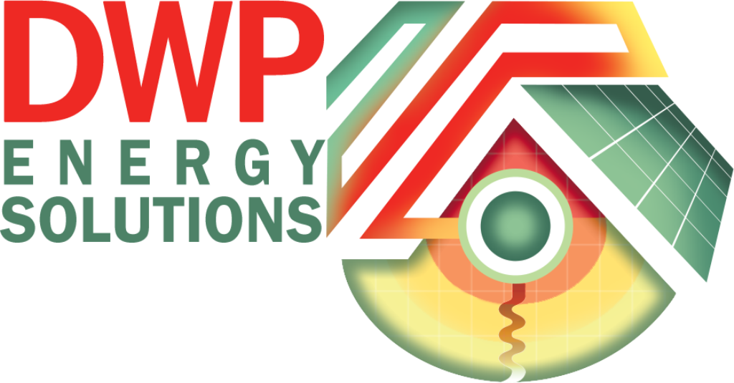
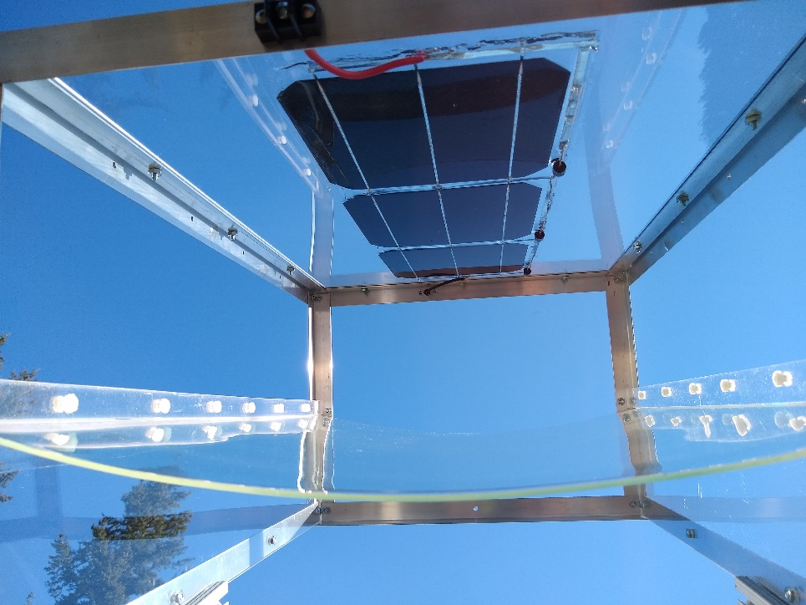
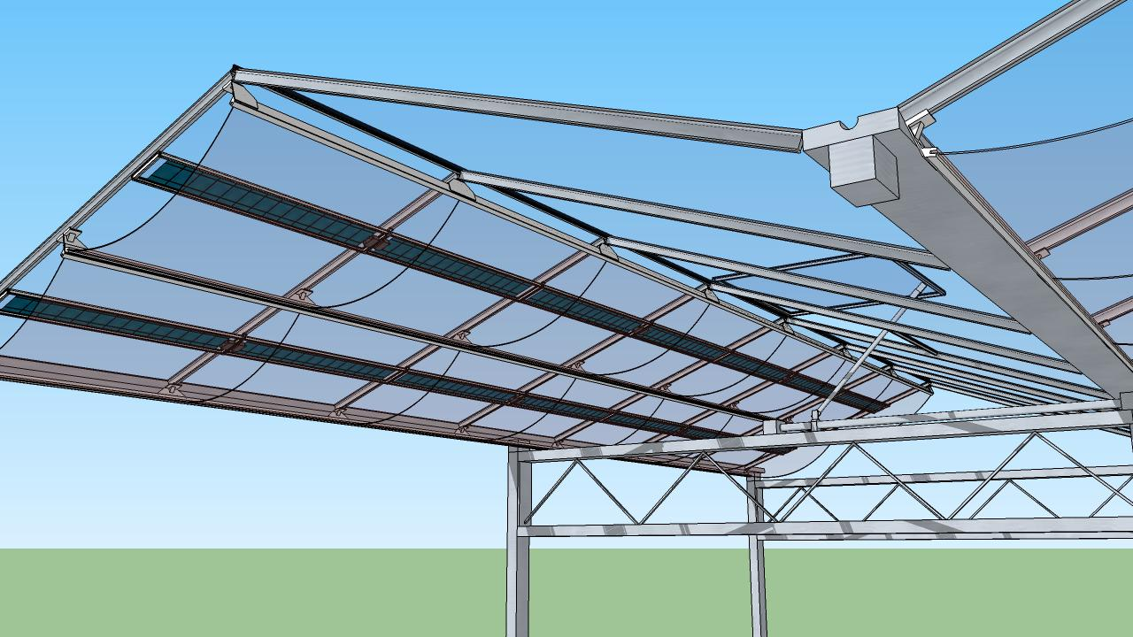
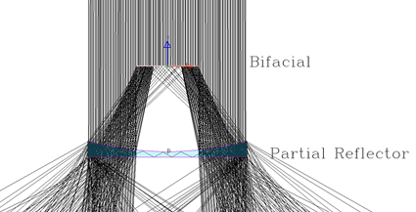

DWP Energy Solutions: Translucent Solar Module for Greenhouse Farming
Bifacial solar cells
Dichroic reflector
Sunlight
Bifacial Si solar cell
Solar module becomes an integral part of greenhouse roofing − minimize added cost and turn a greenhouse into a dual use
Pass the majority of visible light − good for plants photosynthesis but reflect and concentrate unwanted NIR light to boost electricity output and regulate greenhouse temperature
PV developer in Europe has committed to do initial testing and to build a greenhouse for pilot testing this technology
NIR
Dichroic reflector
Visible light

