Slide 1

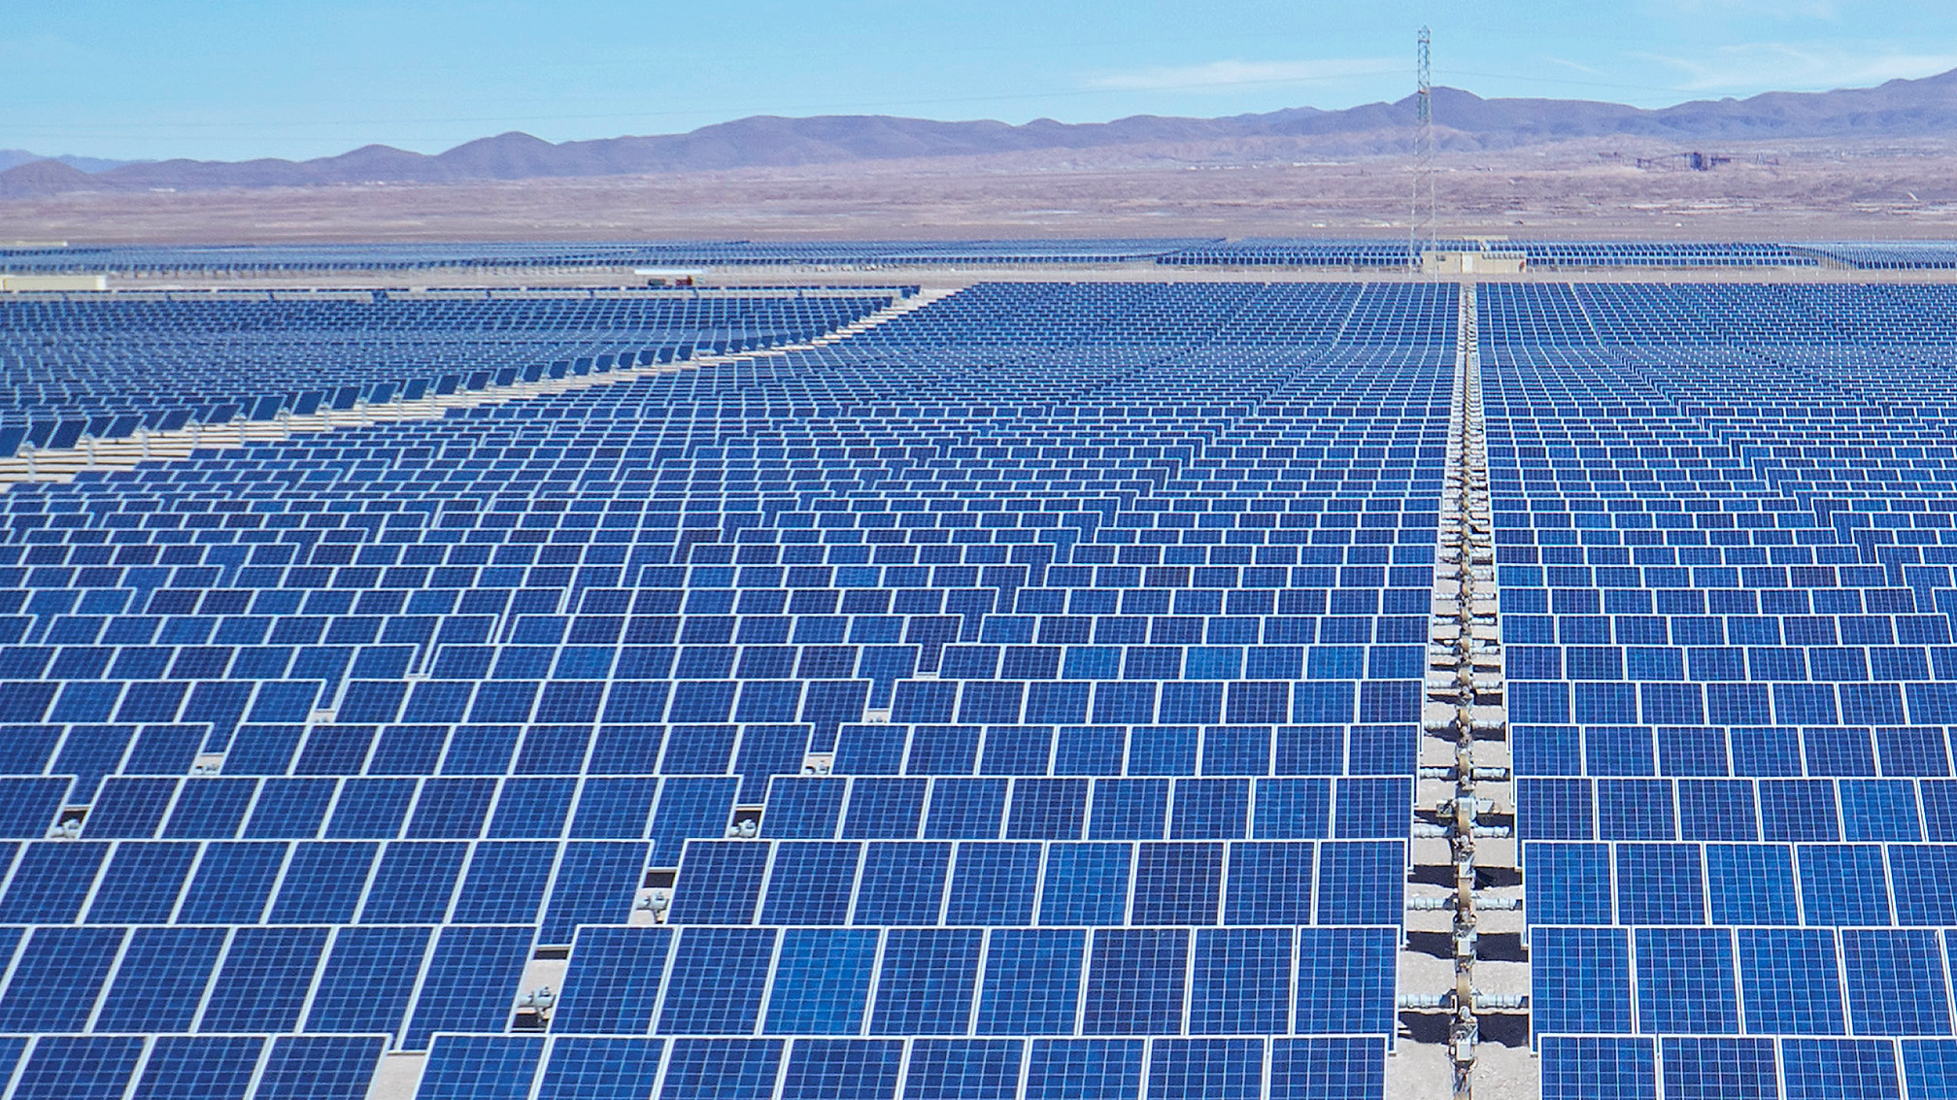
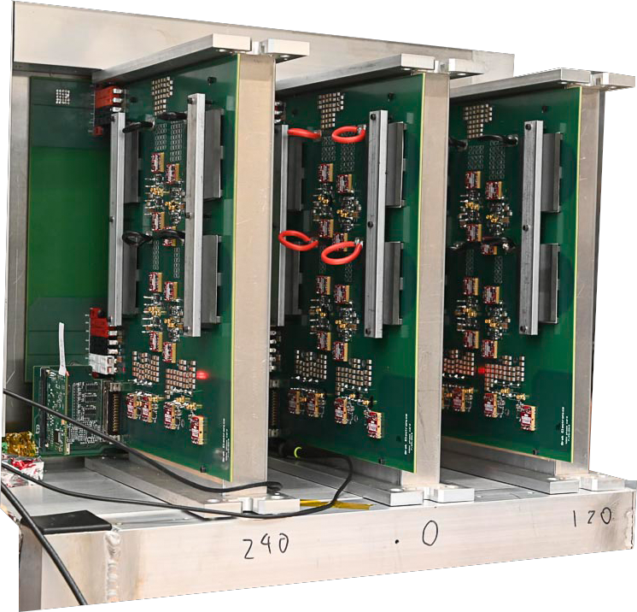
High Capacity 250 kW Silicon Carbide
Solar String Inverter
New Composite Architecture with
novel Planar Magnetics optimized for SiC
8x power density compared to silicon inverters
System Efficiency > 99%
3-Phase 600V_{AC} sine-wave demonstrated
Longer inverter life
Built in the USA
Designed for scalability, portability, high performance,
and high reliability >40% savings in CAPEX and OPEX

