Slide 1
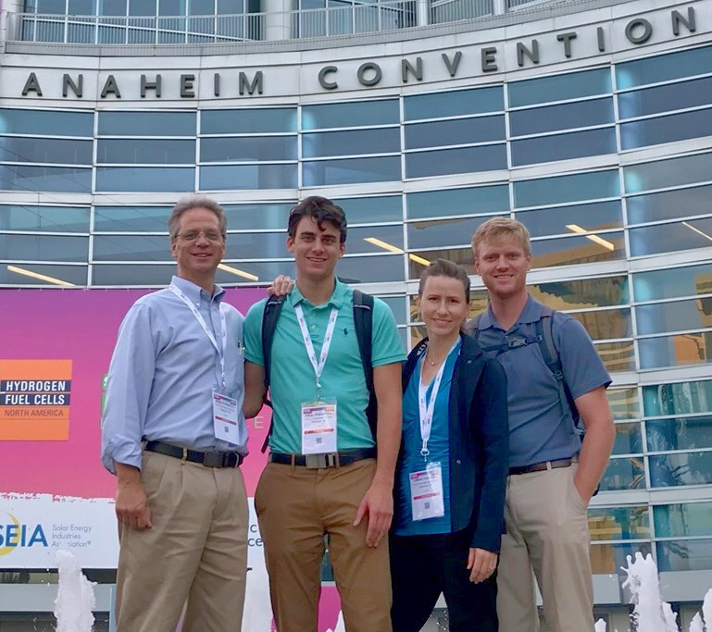
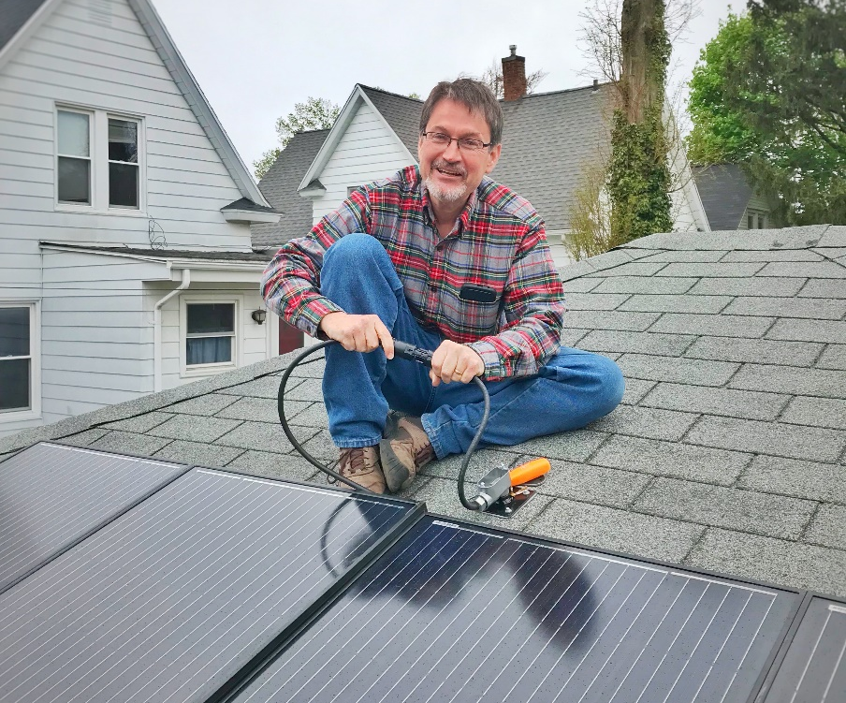
Team Catalyst
Project: 1st Step Solar
Goal: Accelerate the adoption of residential rooftop solar.
Challenge: There are homeowners interested in solar panels who haven’t yet acted. We will move them forward by making rooftop solar simple, shortening its payback time, and allowing purchases of just one panel at a time.
Plan: Offer a plug-in solar appliance for $465.
Homeowner setup will be as easy as putting Christmas lights on one’s roof.
Initial Cost: $465
After 30% Tax Credit: $326
Electric Bill Reduction: $80/year
x 4 years = $320
Solar panels pay back in FOUR years!!!

