Slide 1
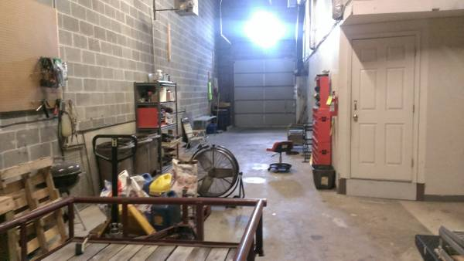
Road Less Taken – Drone Charging and Command Trailer
The concept is to build a trailer portable drone charging and command and control station. This can be towed to a central location for search and rescue operations.
It will include compute, storage and AI capability to analyze the images.

