Slide 1
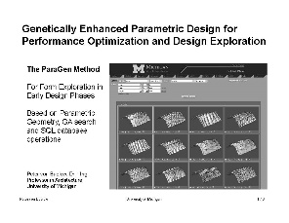
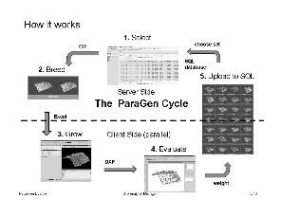

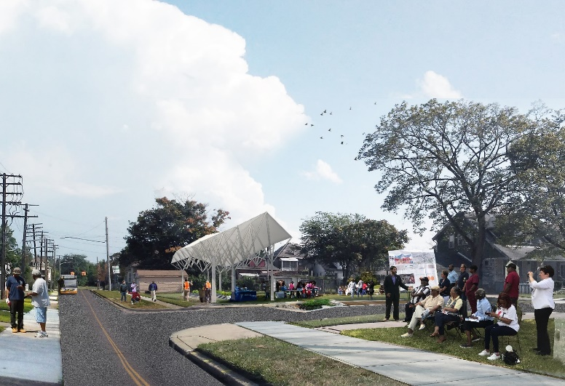
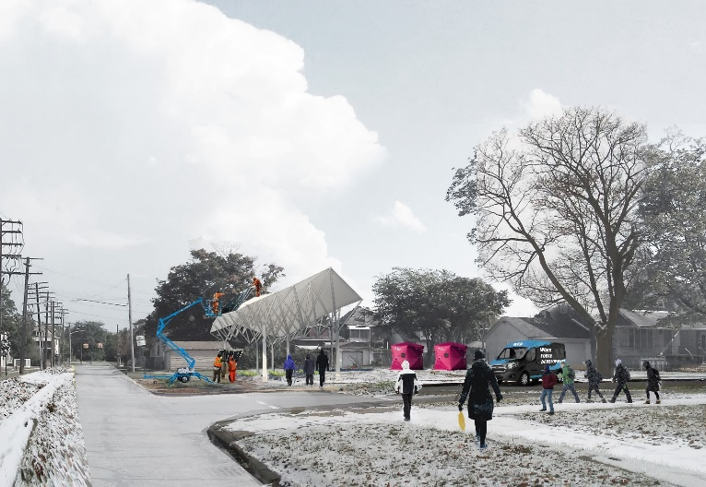
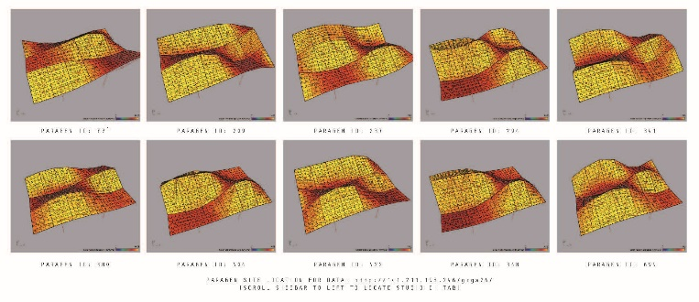
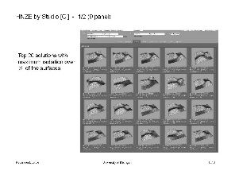
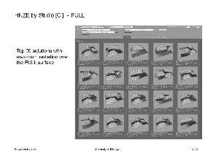
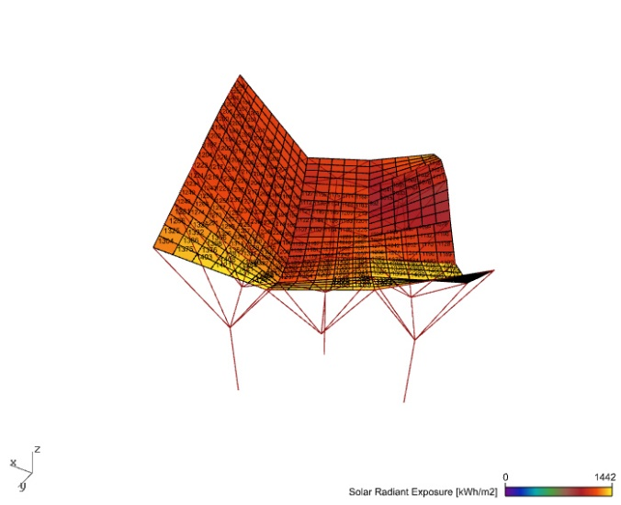
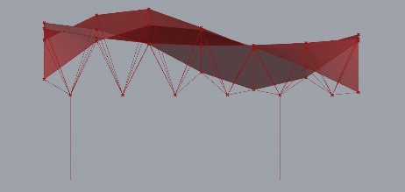
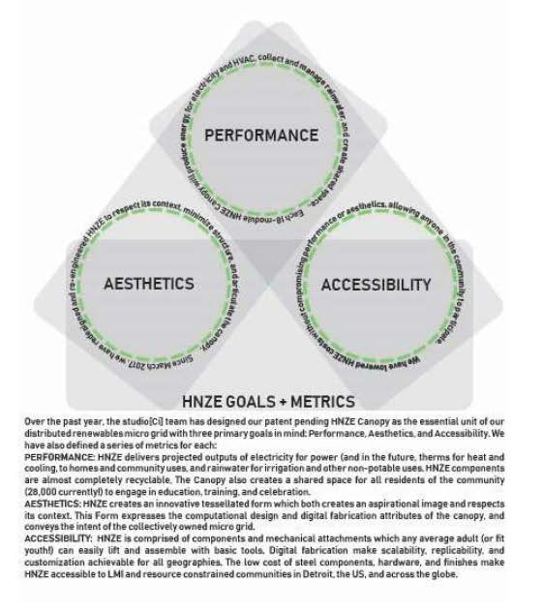
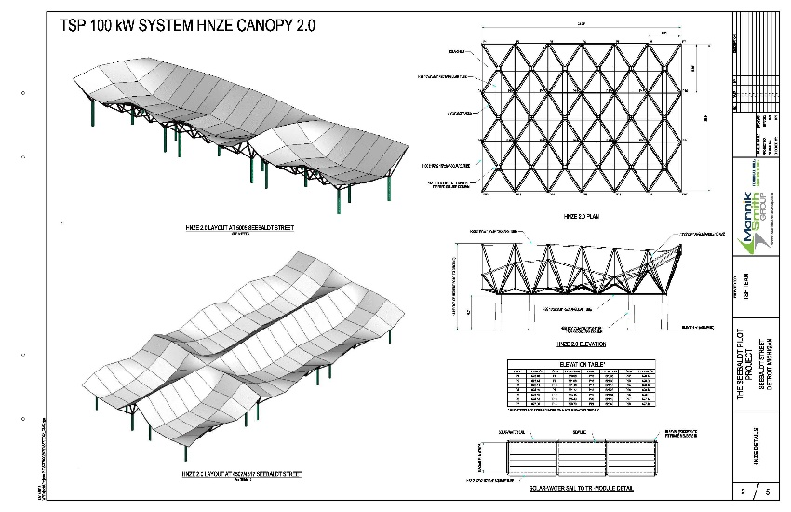
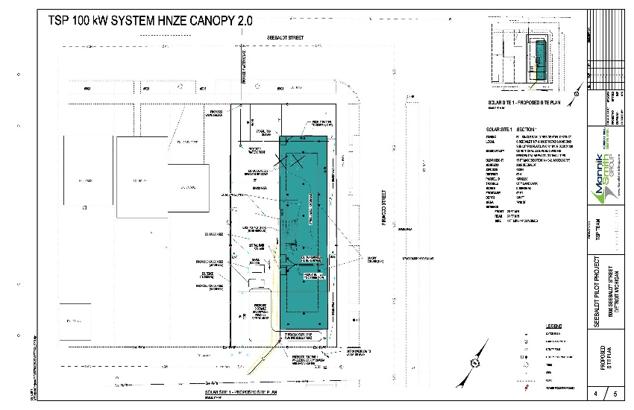
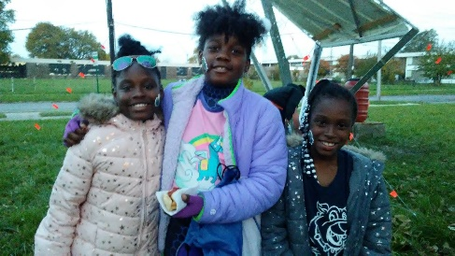
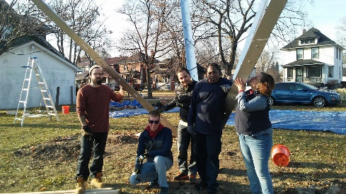
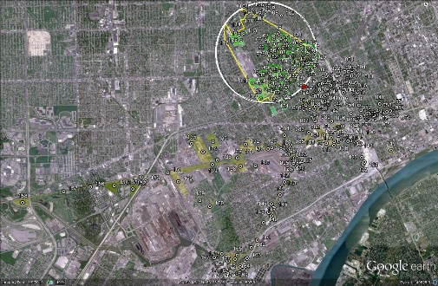
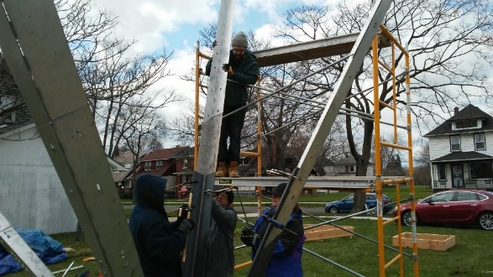
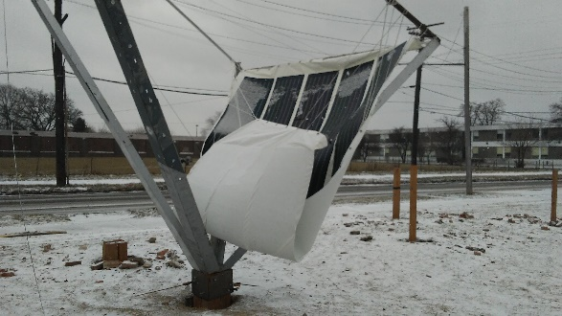
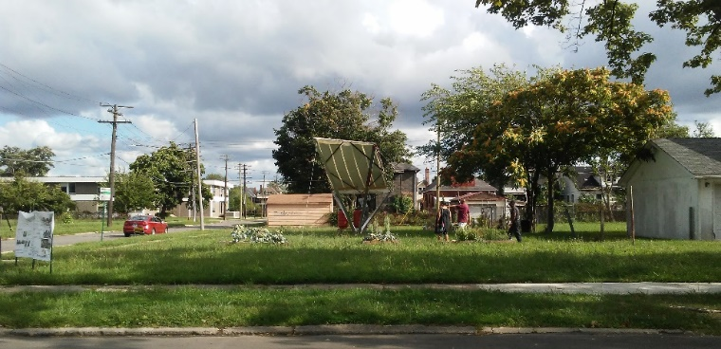
HNZE CANOPY: ENERGY, IRRIGATION, + EMPOWERMENT
An American Made Solar-Prize Challenge Applicant
16 JULY 2019
CONSTANCE C. BODUROW, Assoc. AIA, AICP, CUD
DIRECTOR studio[Ci] LLC, Co-inventor, HNZE Canopy
All rights reserved, copyright 2012-2019; US Design Patent D 850,362

Slide 2


HNZE CANOPY: ENERGY, IRRIGATION, + EMPOWERMENT
VOUCHER WORK|PROPOSED BUDGET [6 months]*
studio[Ci] LLC design direction + venture development
+ project/grant management: $30,000
Shop Drawings + Prototype Partners:
PV Thin Film $ 3,000
Tri-Modules $10,000
Water Conveyance + Storage Bladders $ 7,000
* Estimates as of 16 July 2019 to be finalized as partners/suppliers are identified.
CONSTANCE C. BODUROW, Assoc. AIA, AICP, CUD
DIRECTOR studio[Ci] LLC, Co-inventor, HNZE Canopy
All rights reserved, copyright 2012-2019; US Design Patent D 850,362

