Slide 1
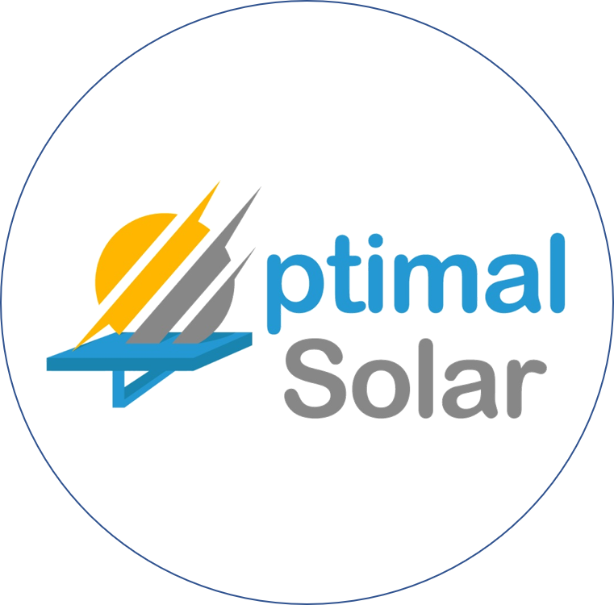
B2B Cleantech disrupting the $85 billion solar energy market with the highest efficiency solar tech

Slide 2

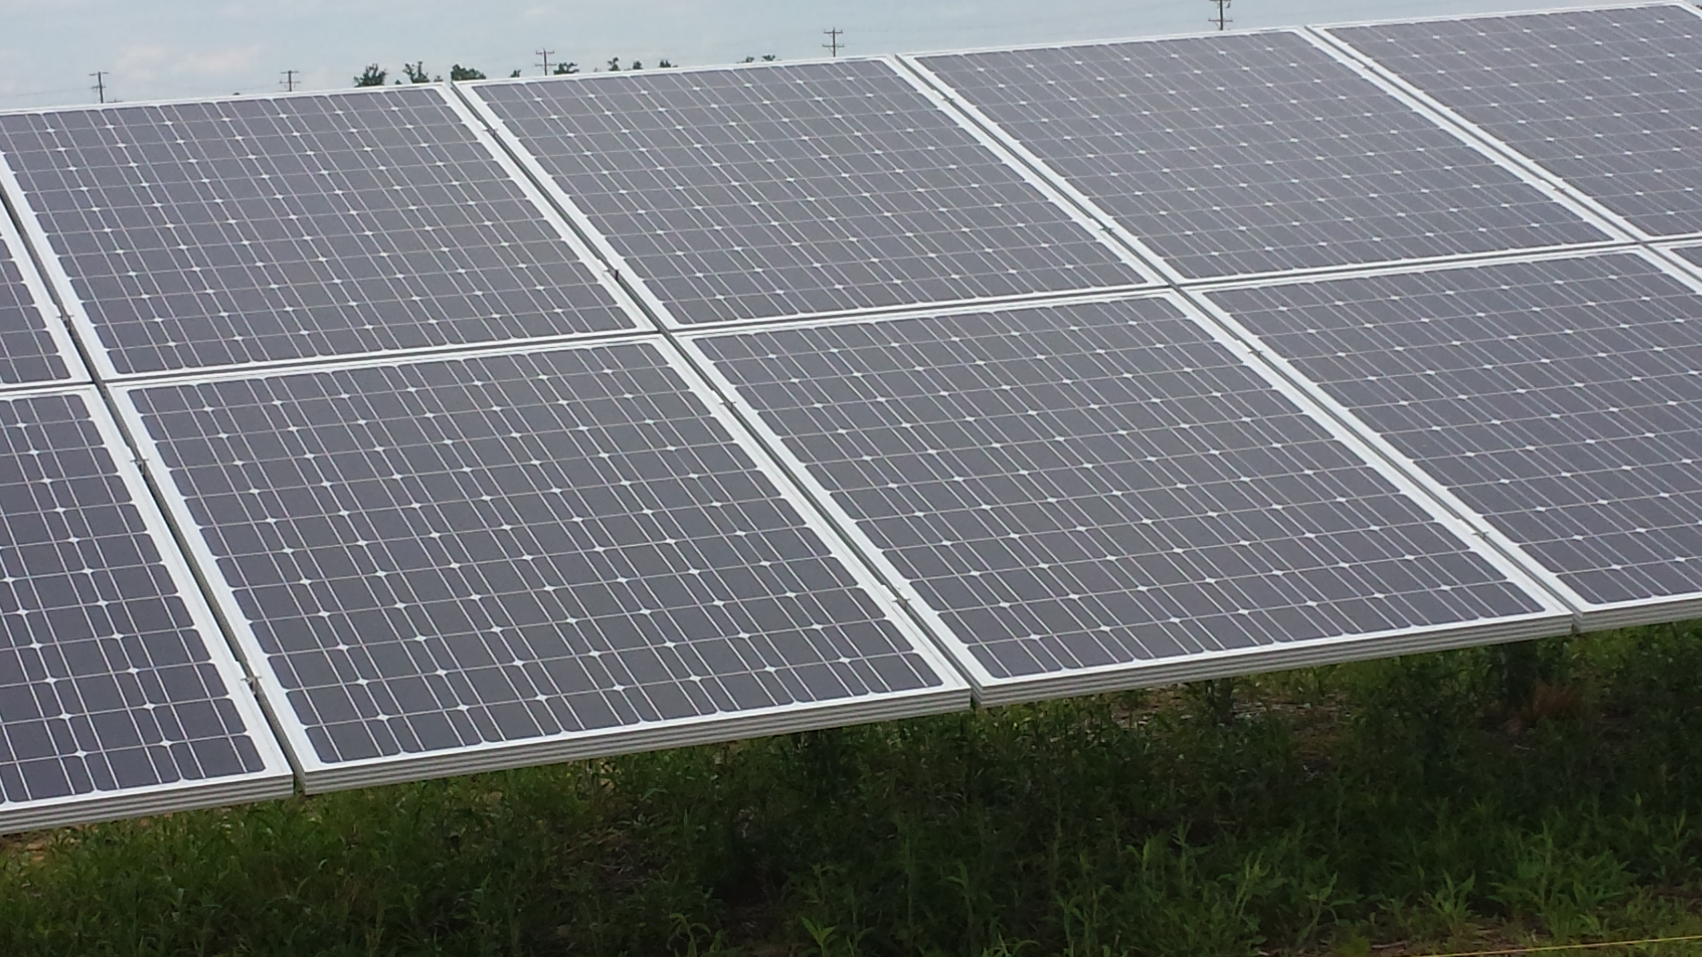
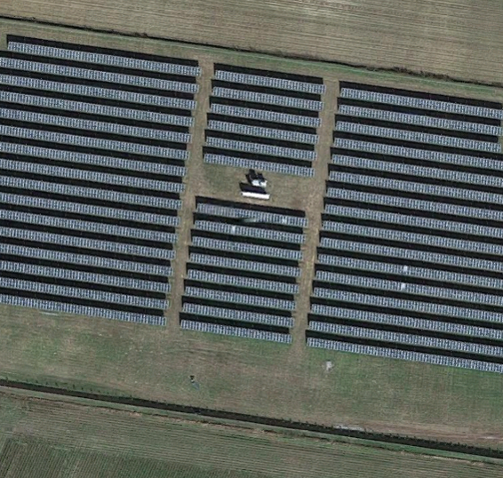
Founder’s Solar Experience
Developed and owns 1st African American utility scaled solar farm
Developed 20+ domestic & international commercial and utility solar projects

Slide 3
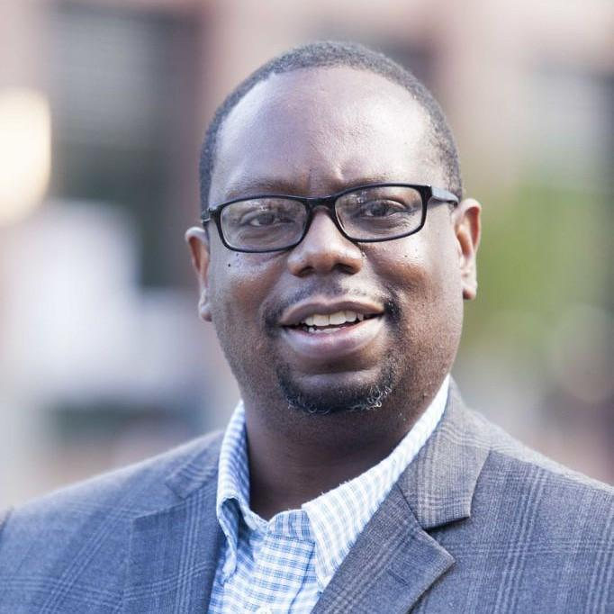


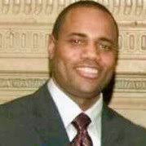
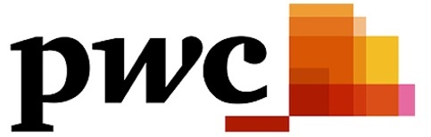

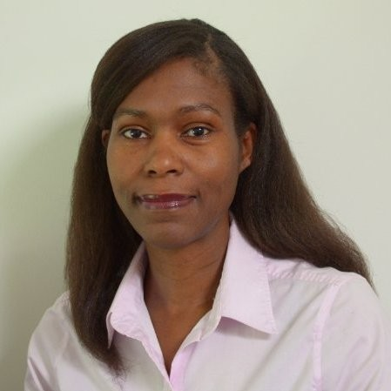
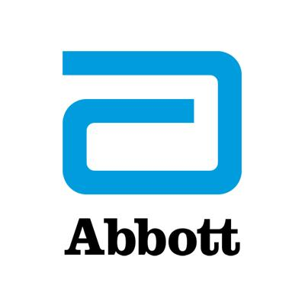

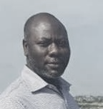
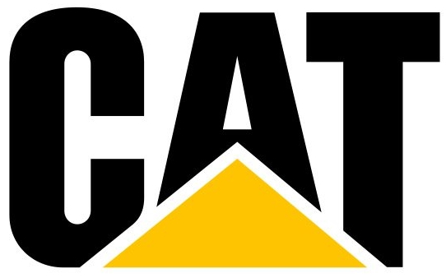

Team’s Experience
Dr. Reginald Parker, CEO
Commercialized over $60 million in new products
Tim Webb, VP Biz Dev
Managed and financed $400 million in assets
Dr. Aquanette Burt,
VP Tech
Managed technical teams launching over 12 new technologies
Dr. Ibrahim Braimah, VP Sales
8 years export-import of $M equipment between US, EU, and Africa
Notes:
3

Slide 4
Problem: Solar Requires Innovation for Viability
C&I clients require costs below utility bills
Subsidies are needed to incentivize builders
Subsidies are falling from 30% to 10% in 2022
Only 3% efficiency gain over past 15 years
Solar Must Innovate or Die
Notes:
4

Slide 5
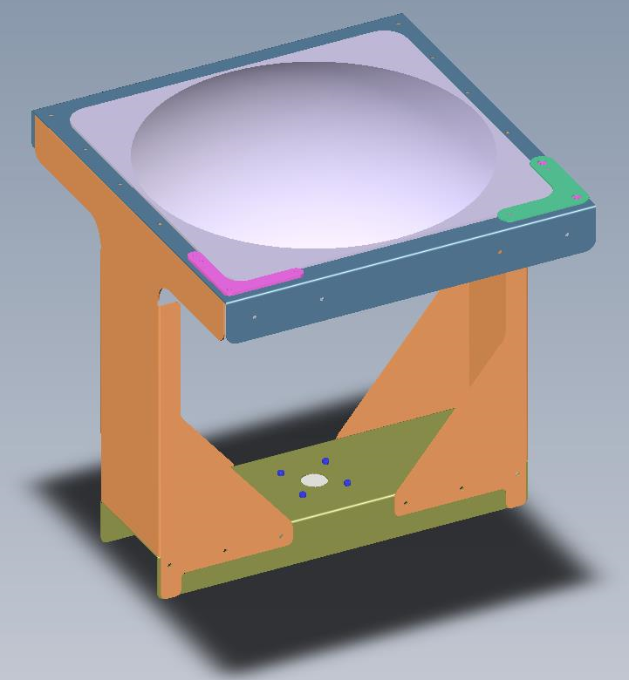
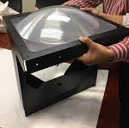





Solution: High Efficiency Solar Tech, VIA™
Innovation Realized
Revolutionary Design
Commercial Design
$800K in Life Time Value for every 1 MW sold
90%
33%
2 years
more electricity
less land
faster payback

Slide 6
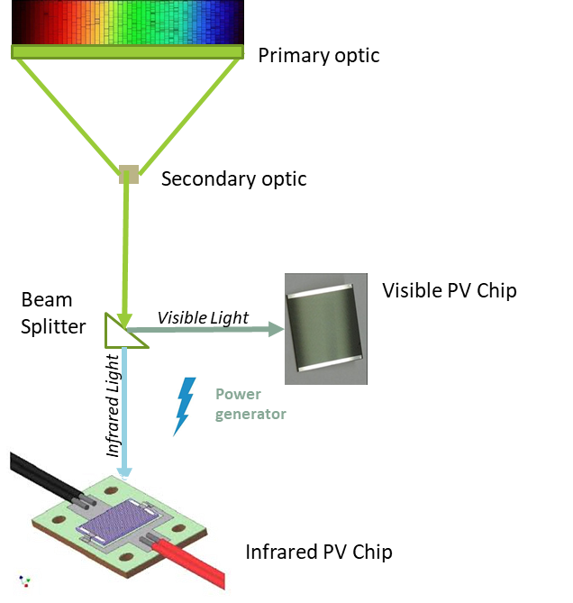
VIA™: The Technology
Capture: 40% more sunlight than fix tilt.
Concentrate: up to 1500X concentration.
Convert: split light with 53% efficiency with visible light and 20% with IR light.
C1
C2
C3

Slide 7

The VIA™ Competitive Advantage
The difference that 3 acres make
Solar Tech | Power (MW) | Energy (M kWh) | Cost ($/kWh)
Traditional | 0.6 | 0.7 | 0.08
VIA™ | 1 | 1.6 | 0.045

Slide 8
The Market Opportunity
Global market was $85 billion in 2018
CAGR of 10.9% over next five years
Optimal’s target market is $80 million in 2021
Notes:
8

Slide 9

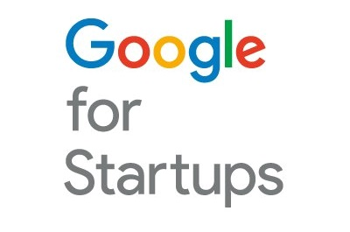

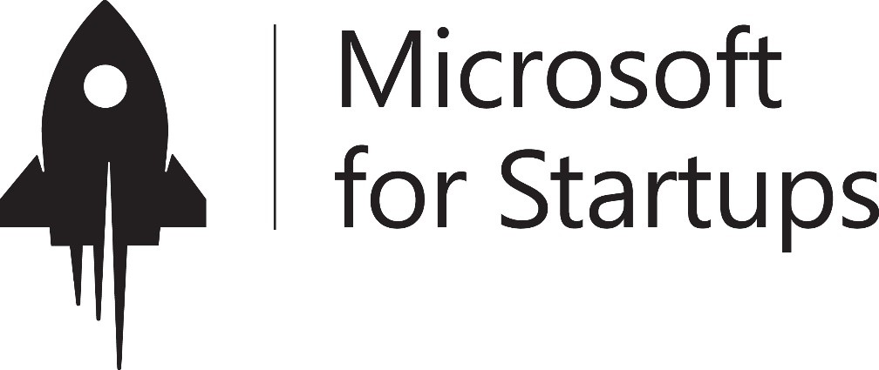




Backed By the Best

Slide 10
Thank you
Reginald Parker, PhD, MBA
reginald.parker@optimalsolar.energy
v: 919-521-5982
vm: 202-596-7334

