Slide 1
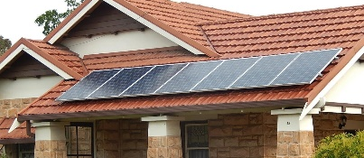
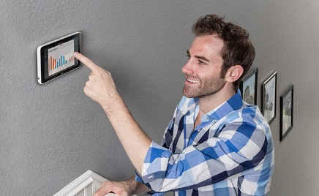
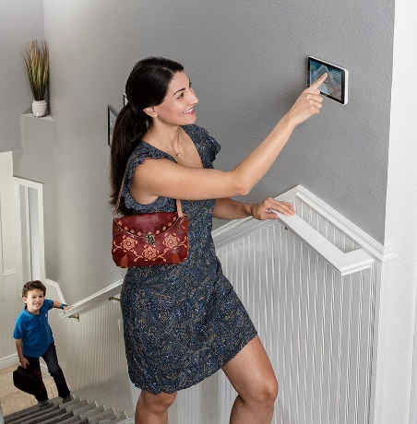
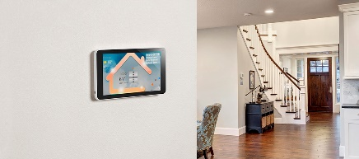
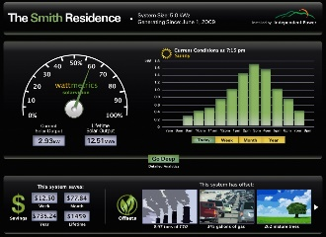
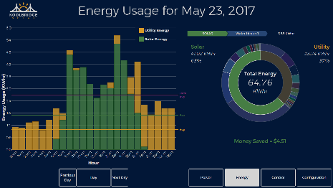

ICON Home Solar Dashboard
Problem
  Lack of always-on in-home-display for solar system performance monitors. Not able to keep solar system customer engaged.
Solution
  Integrating solar dashboard with ICON Home – an in-home-display connecting wired connected with AC system and wirelessly connected invertors
  Better interaction with customers and better performance monitoring & control.
Team
  Kevin Gao – Entrepreneur in solar, mechanical engineer, inventor of multiple US patents.
  Sean White – IREC Certified Solar PV Master Trainer. Book Author of Solar Photovoltaic Basics, and Solar Engineering and Installation.
  Madam Mi – Owner of SNEC PV Power Exo…the largest of solar tradeshow in the world and wide solar industry connection.
Plan
  ICON Home in-home-display prototype built completed.
  Next step integrating with third-party invertor manufacturer solar dashboard. Provide rapid shutdown in-home alert and control.
  Testing with national labs. Demo in 2020
Kevin & Sean & Madam Mi
Notes:
Built functional prototype
Two deals with home builders
Two deals with service providers

