Slide 1
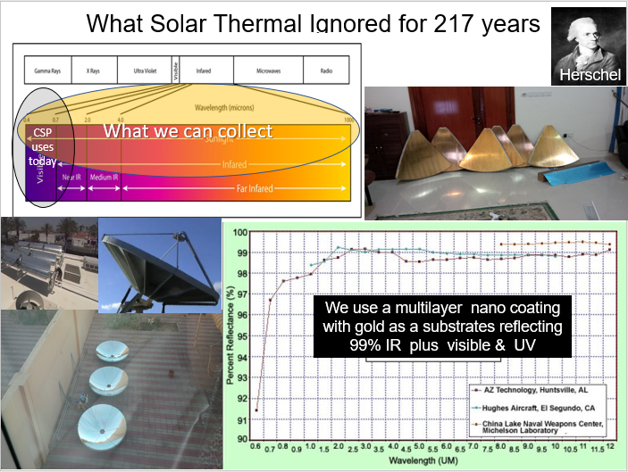
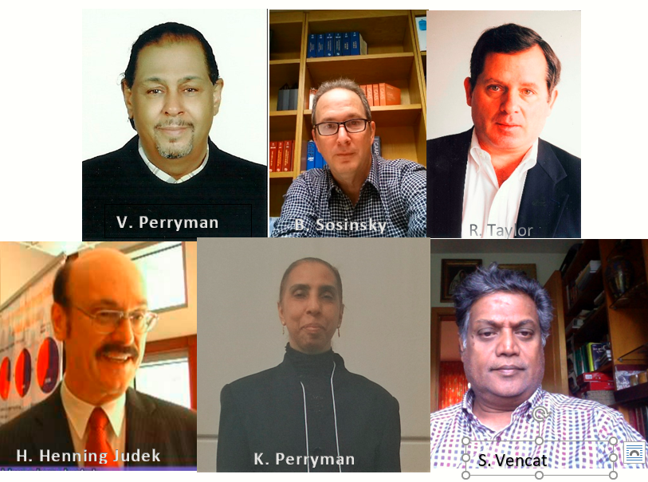
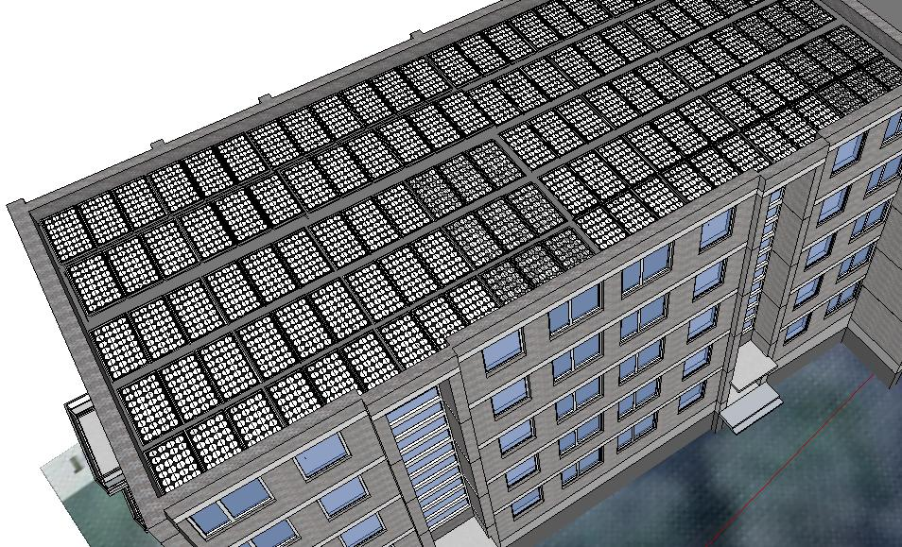
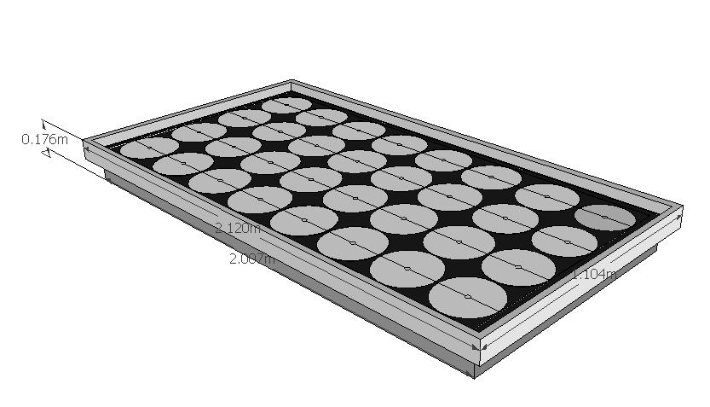
What CSP is not using 2/3 of the energy from IR spectrum
Infrared discovered 217 years ago;
we now have technology to utilize it
Our goal is to take CSP the final step of competing with PV by delivering <10 times more work the work in the same footprint with our roof top micro dish panels
Independent testng of gold’s IR reflectivity

