Slide 1
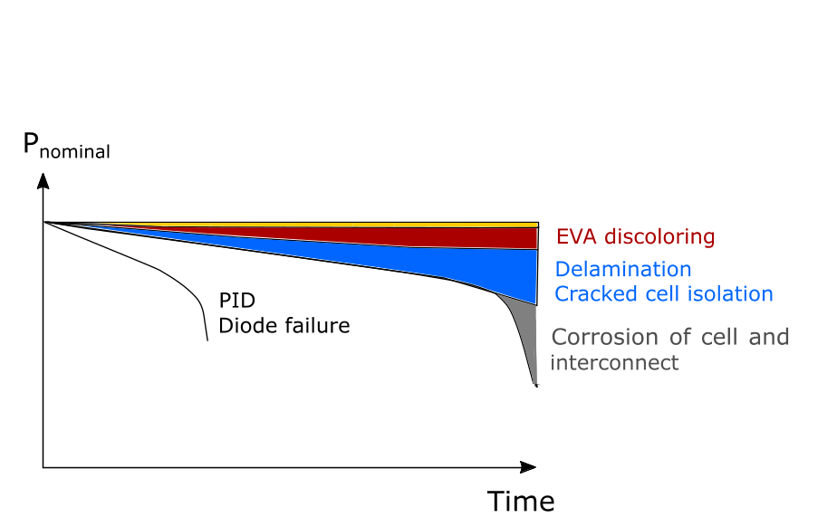
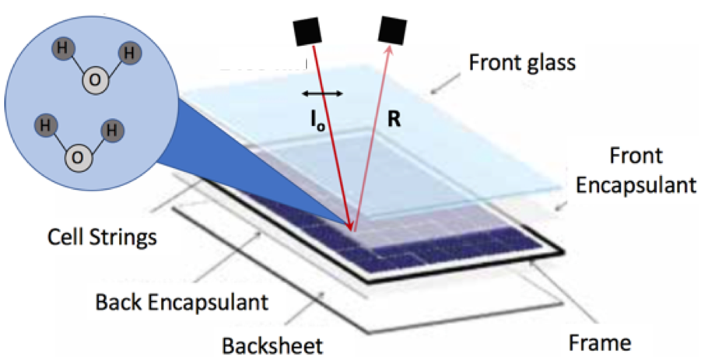
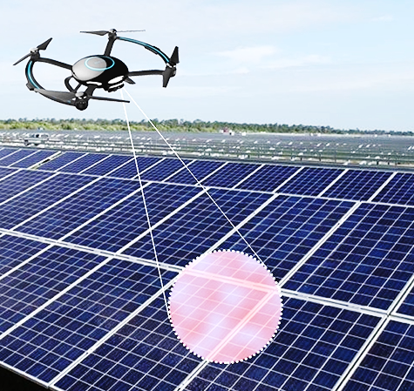
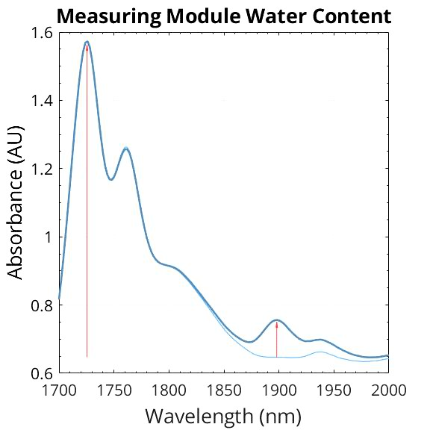
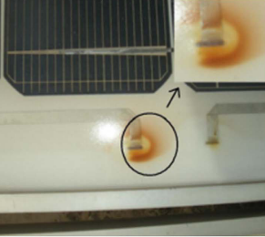
Water Reflectometry Detection
Solar modules suffer from water uptake
Water is the cause of many degradation pathways, reducing power output
Our approach
Measure water concentration in a polymer
via front-side module reflectance
A drone to map water in solar modules
Köntges, M., et al. International Energy Agency-Photovoltaic Power Systems Programme (2014)
Water signal

