Slide 1
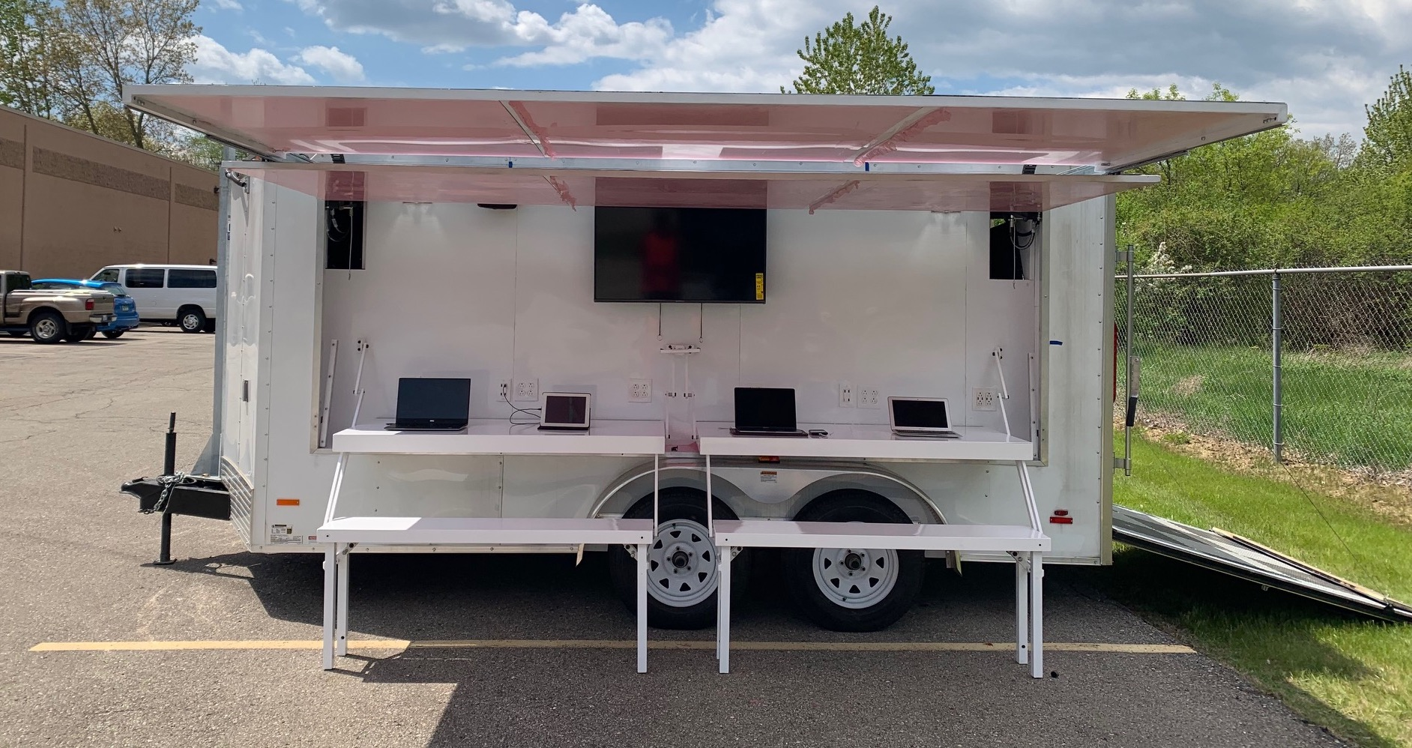
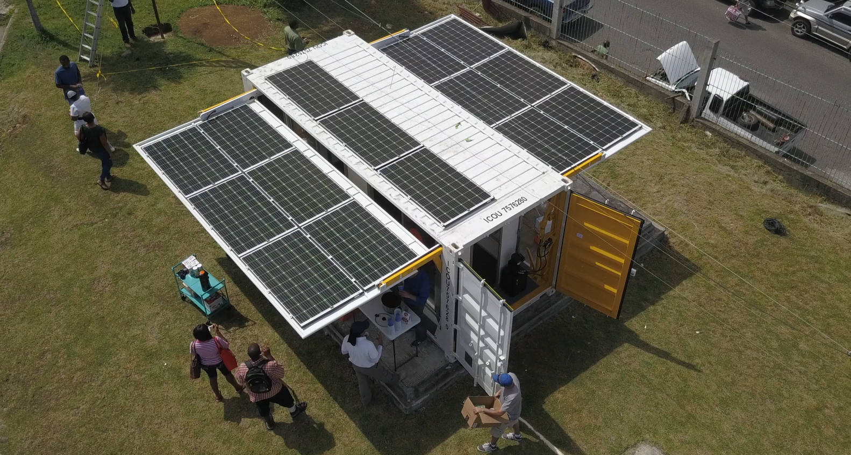
Sesame Solar Solution Summary
Ready-to-Use | Less than 15 minutes for fast on-site / remote set-up
Simple | Minimal training required; virtually maintenance free.
Flexible | Easily configured for custom applications
Mobile | Form factor of a Dual Axle Trailer or an ISO shipping container is easily transported by truck, train, ship or helicopter
Ready-to-Use, Solar Powered Solutions for: Off-Grid Power, Disaster Relief, Telecommunications, Medical, Industrial, EV Charging, Agriculture, Education and Retail

