Slide 1







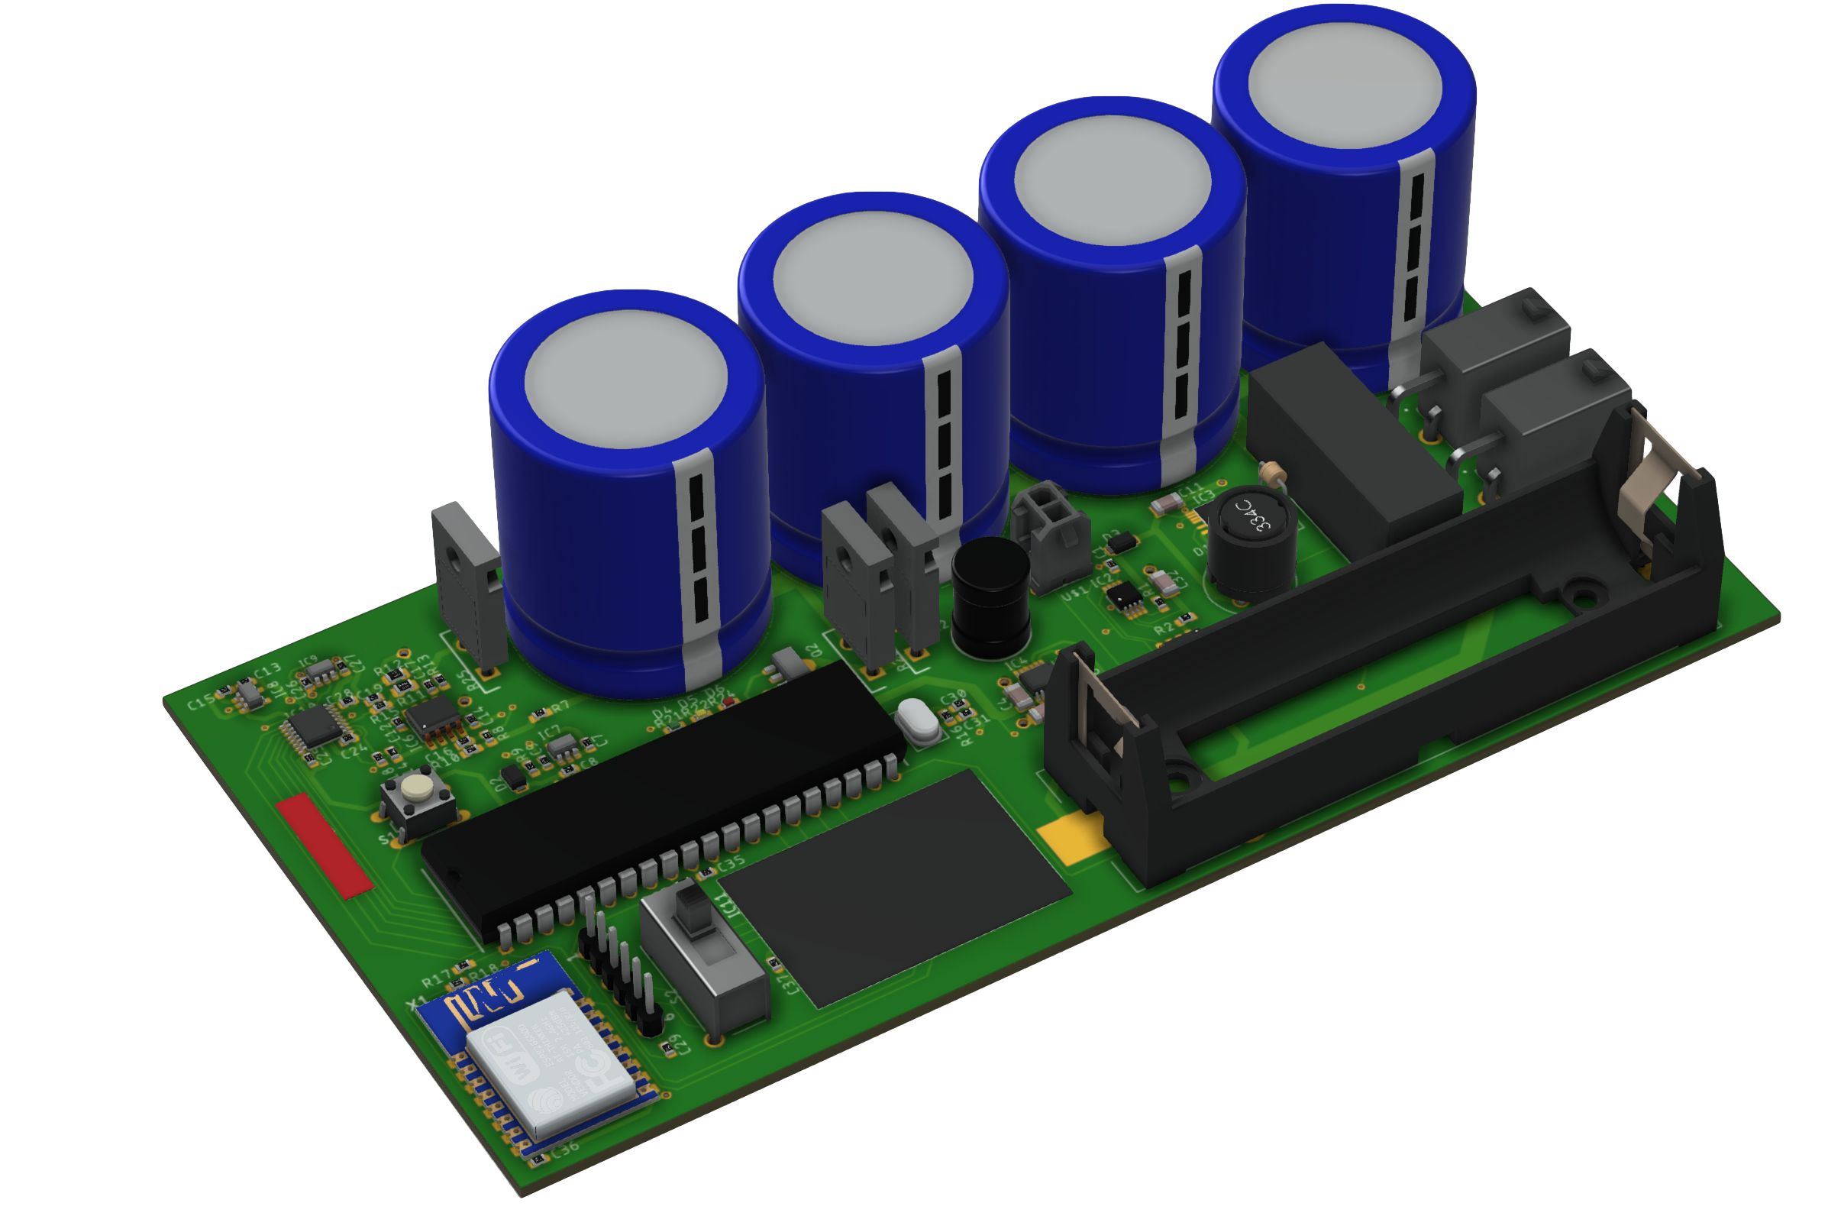



Renewable Energy Lifecycle Management Platform
Existing solar measurement hardware is expensive, hard to use, and requires manual analysis
Software solutions are fractured and outdated, obscuring access to business-critical data
The industry is ready for a change.
Introducing
Monitoring, asset management, operations, and analysis
in one seamless pane of glass
Next-gen IV curve tracer
1/10th cost of commercial models
WiFi & Bluetooth enabled
Competitive measurement
precision
starting with game-changing hardware...
The FirstWatt Team
Alex
Entrepreneur & computer engineer,
President of Georgia Tech Solar Racing
Michael
CEO of Cherry Street Energy,
10 years in finance industry

