Slide 1

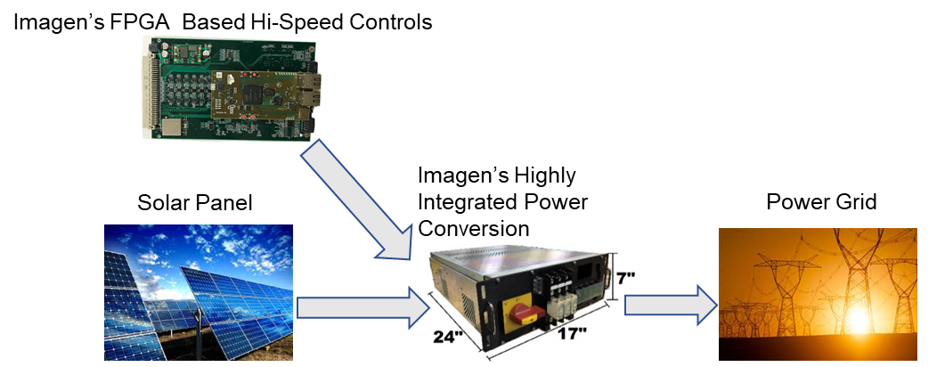
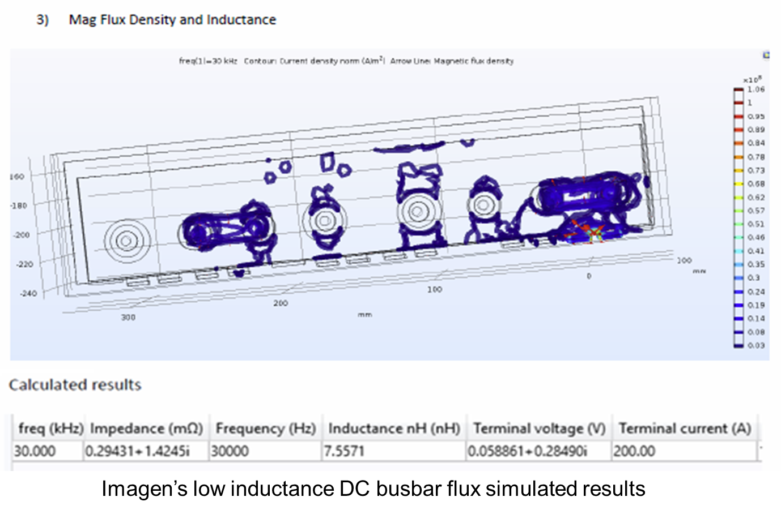
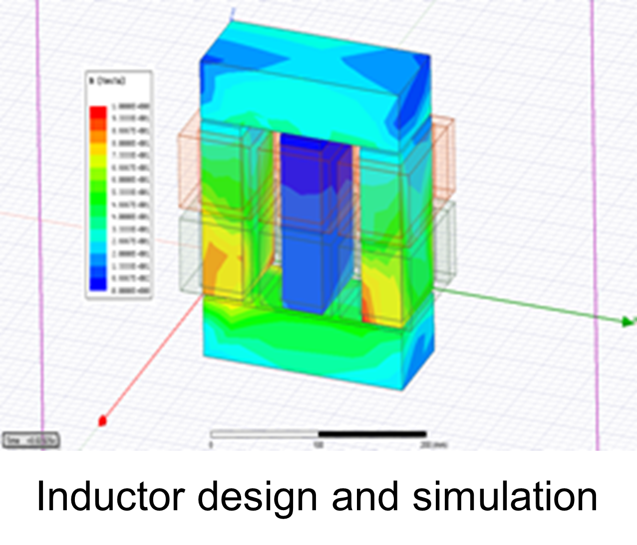
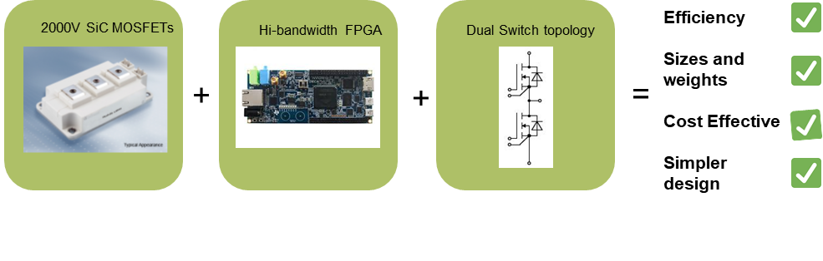
New class of 2000V SiC MOSFETS based Solar Power converter for enabling direct transformerless system
Technology Summary
Develop extremely compact (>6 kW/L), high efficiency 350kW power conversion system based on half bridge-SiC power configuration for 1500 VDC solar systems with high energy harness efficiency.
Demonstrate high-bandwidth FPGA based controller to take advantage of high switching frequency of SiC module.
Imagen’s Proprietary Power Electronics Packaging/magnetic design
Low inductance busbar design and with novel filter design to mitigate the issues caused due to high (dv/dt)
Magnetic Design and Simulation capability

