Slide 1
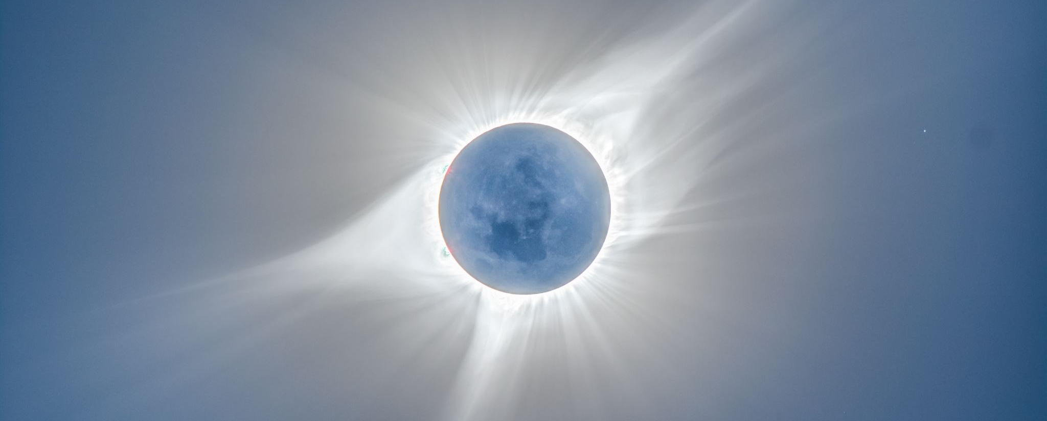
SOLAR POWERED BOILER ASSEMBLY
Traps thermal solar energy within a medium vacuum
Boiler is shaped to optimize quick heating
Boiler is ALSO designed to retain heat during THE times of the day WHEN THERE IS LACK OF SUNLIGHT

