Slide 1

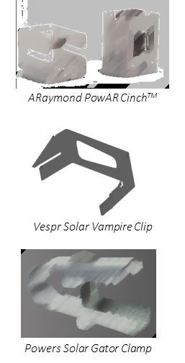

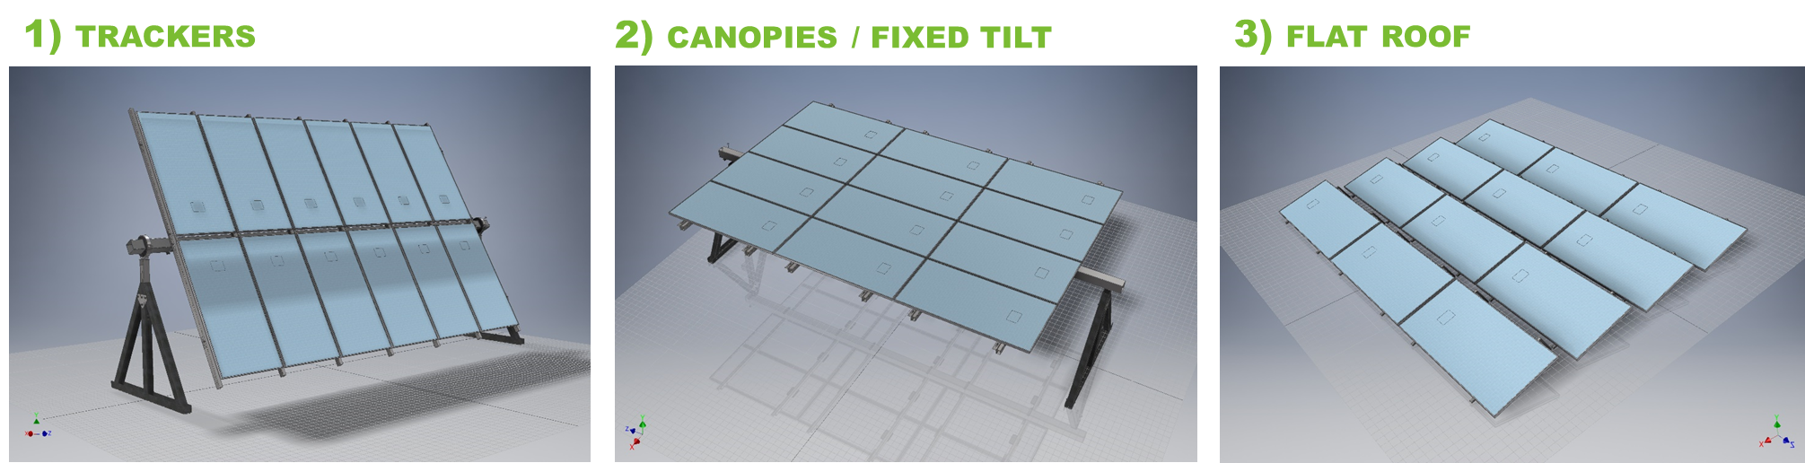
The Piranha System: Transforming the PV module attachment process
Product Overview
Attachment Time & Cost Savings Opportunity
100 MW Single-axis Tracker Attachment Costs
The Piranha System is an extremely simple, universal attachment solution that is 4x faster to install than conventional fasteners. It uses a spring-based clip that locks in place once activated, securing the PV module while providing electrical bonding and wire management capabilities.
Materials
ILLUSTRATIVE
Actual Clip Being Finalized
Labor
Conventional Fasteners
100 modules/person-day
Piranha System
400 modules/person-day
Project Duration:
100-person team
30 days
8 days
200-person team
15 days
4 days
Universal Functionality
Key Benefits
The Piranha System works across:
Most
Module Sizes & Dimensions
Portrait & Landscape Module Orientations
1 Cent / Watt Savings
For a 100 MW project, we estimate nearly $1M savings, or 1 cent / watt
4X Faster
Consistent 400 PV modules/person-day (or ~40 sec/module) compared to 100 modules/person-day with conventional fasteners
Framed & Frameless Modules
Fixed, Tracking and Flat Roof Jobs
Job-site Simplification
Power tool-free attachment eliminates need for rechargeable screw guns, and dramatically reduces the number of small parts
Supply Chain Simplification
The Piranha System can support most PV module systems, eliminating the need to customize drill holes for each project

