Slide 1
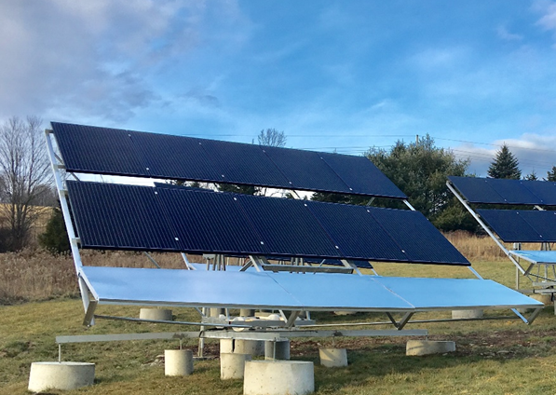
Sustainable Energy Management Systems
The SEMS products significantly increases the amount of solar energy collected (regardless of the Solar anel employed) by horizontal diffraction reflection, or disflection (U.S. Patent pending ASN: 16/179,918). Disflection is a technique employed to enhance illumination of photovoltaic solar panels. Real Time Tracking offers tracking in real time without any pre-programming. Real time tracking (210° of east/ west trackin) guides the trackers to the best point of irradiance for maximum energy production. When these two technologies are combined (Reflectrac) it results in significant increase of sun hours exposure on the solar panels per day, this translates to extending the solar day from 3-5 to 8-10. James Loven has received a U.S patent on the concept of reflection and combining tracking (patent #: US 9,548,698 B2,). These two technologies translate to 40% more capture of energy and 20-25% more than other tracking systems. SEMS has created a product called the RST3000.
Key Design Features of RST3000:
Horizontal diffraction reflection or disflection.
Heavy duty limit switch assemblies designed specifically for solar trackers.
Real Time Sensor.
Self-hobbing worm gear.
Shock resistant and self-adjusting A.C. worm drive.
Through bolt racking system to prevent module extraction by wind.
Electronic controls with embedded control (under development) for supervisory functions.
Operators autonomous.
Ballasted foundation system.
Disflection technology is dispersal of light rays to assist energy collection with dispersed reflected light created by irregular planar diffraction. Disflection is not concentration of sunlight on solar panels or otherwise known as a solar concentrator. A Solar Concentrator is a device which concentrates the solar energy incident over a large surface onto a smaller surface. The concentration is achieved using suitable reflecting or refracting elements such as mirrors or lenses, which results in an increased flux density on the absorber surface compared to that existing on the concentrator aperture.
The physical embodiment of this technology consists of a horizontal reflective type structure on the front of the tracker. The disflector is made of .025 mill grade aluminum supported by aluminum frames and extensions from the tracker carriage and module racking assemblies. The intent is capture morning and afternoon sunlight which is wasted on the fixed tilt arrays and single axis solar trackers. The wind profile is minimized by the employment of the disflector on the bottom of the tracker. The mill finish is not like a mirrors or lenses. The surface grain of the material diffracts the incident sunlight in a specific plane in a reflective manner and provides for a uniformly dispersed illumination of the modules preventing over illumination of the modules while addressing wind loading.

