Slide 1
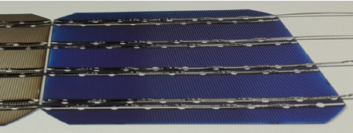
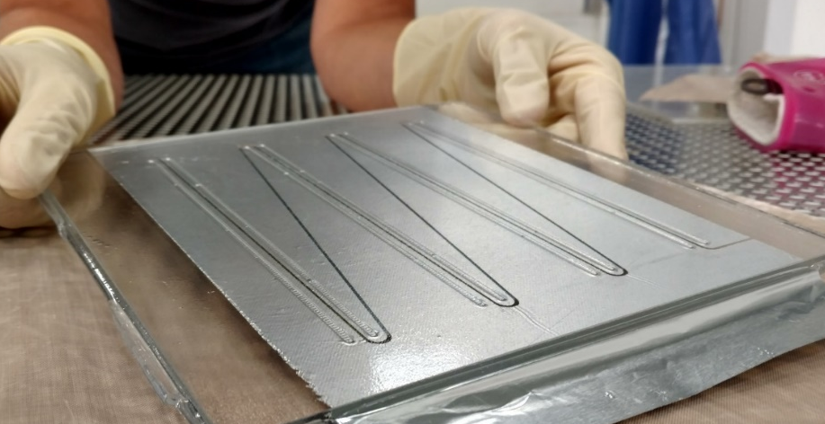
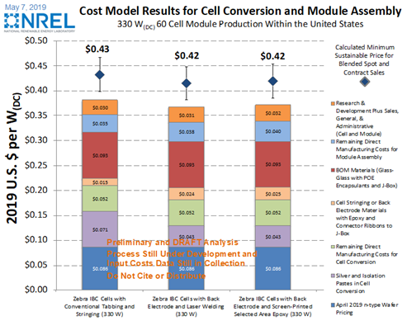
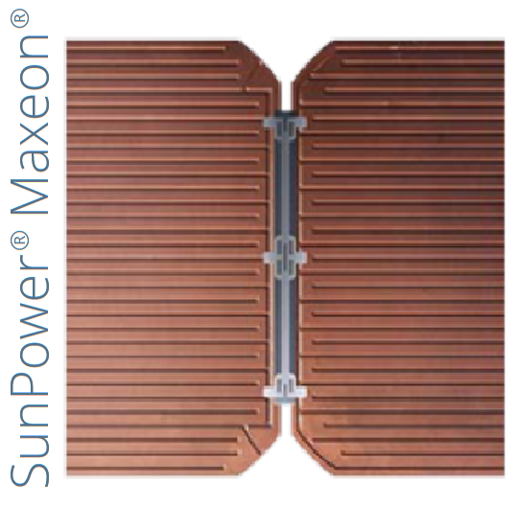
Sunfish Solar
Back-contacted silicon modules at the cost of PERC
Problem
Our approach and plan
Impact
Back-contacted (BC) modules → highest efficiency
But high metallization costs!
Remove plated metal, paste, and ECA from BC cells
Replace with embossed Al foil and Sunfish bonding to cell
Demonstrated high efficiency and reliable mini-modules; time to scale!
NREL cost analysis shows lower $/W than other BC modules; path to cheaper than PERC
With higher W/m² than PERC translates into lower LCOE
Ready | Set up manufacture and test team
Set | Manufacturing test run and efficiency test
Go | Small production run and qualification tests

