Slide 1

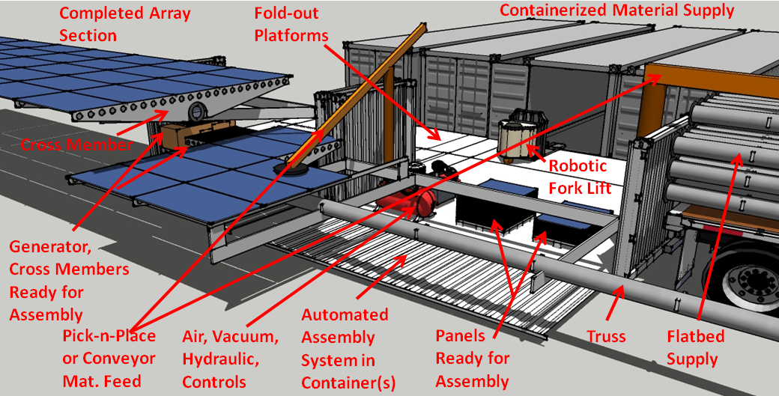
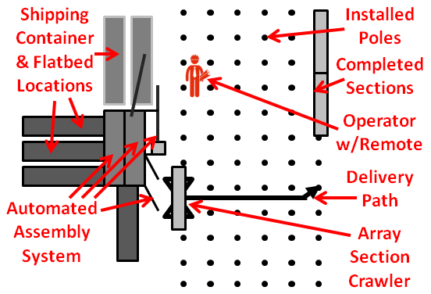
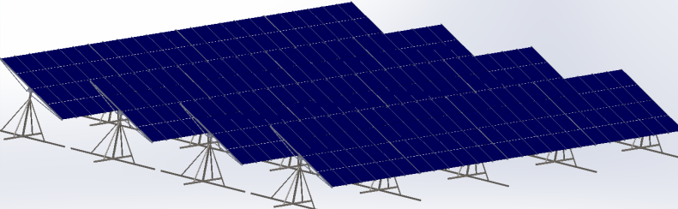
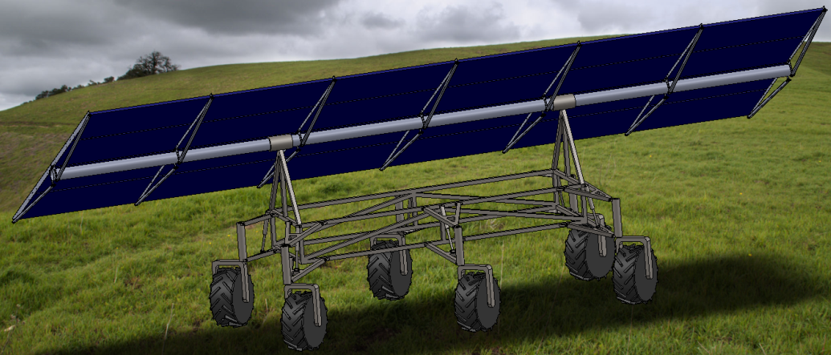
PV RoboticsTM - Automated Solar Installation
Accelerating the Transition to #RE100
‘PV at a Pace to #SolveClimateChange’SM
Over 50% PV Installation Cost Reduction
        Exceeds DOE #SunShot2030 Goals
      High-wage PV Jobs for the 21st Century
    Essential in Full Employment Economy
For Grass or Ground w/o Damage
Semi-Autonomous Array Section Crawlers
    Pallet Carrier “Swarm Bots” in Development
Full System Concept Demo Nearly Complete
Multi, Incremental Beta Test Sites Planned
      Retired Solar Exec Support
Free Standing or Landfill Use
Ready Soon as shown here →
Expert Industry/University Team Ready!
      Pallet Carrier “Swarm Bots” in Development
Array Section Crawler
Technology for Rapid #ClimateAction
Automated PV Assembly To Achieve #SunShot 2030 Cost Goals and Rapid #ClimateAction!
Patents Pending including Automation, New Floating 1-Axis Tracking, Integrated Structural/Electrical Connectors

