Slide 1
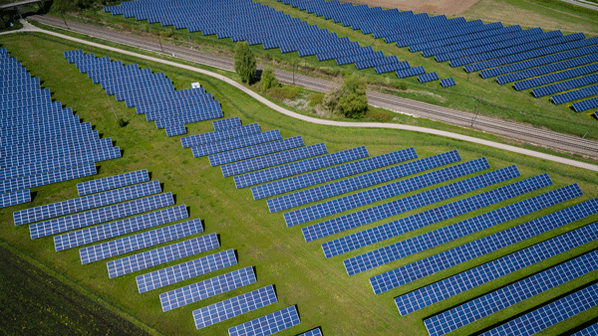

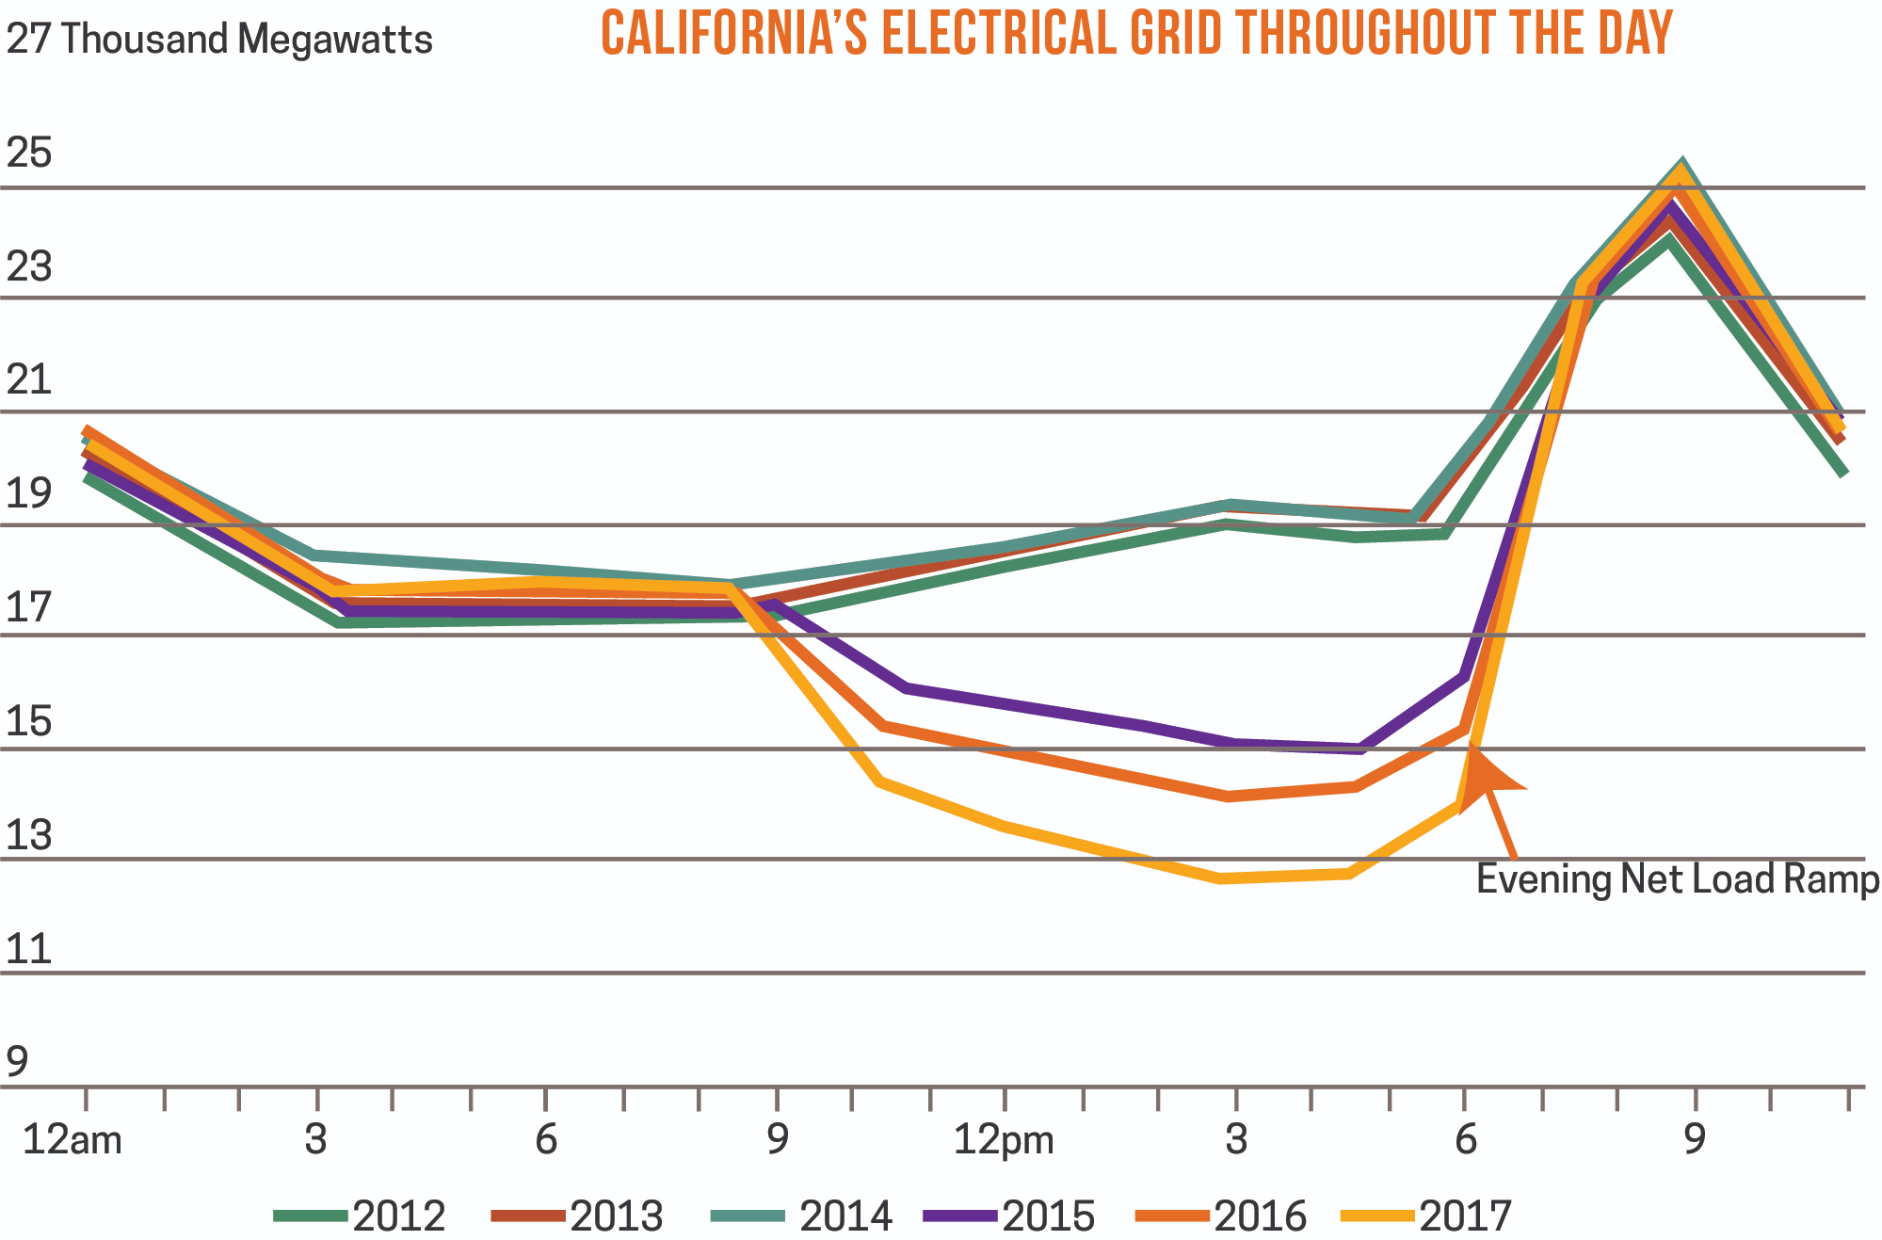

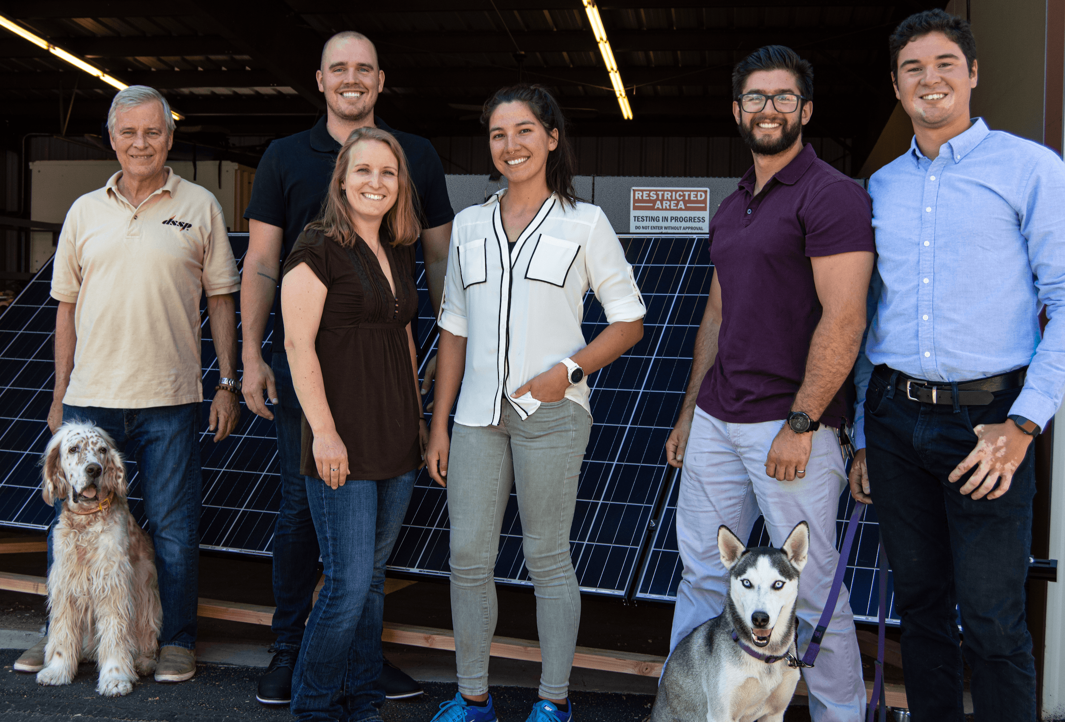
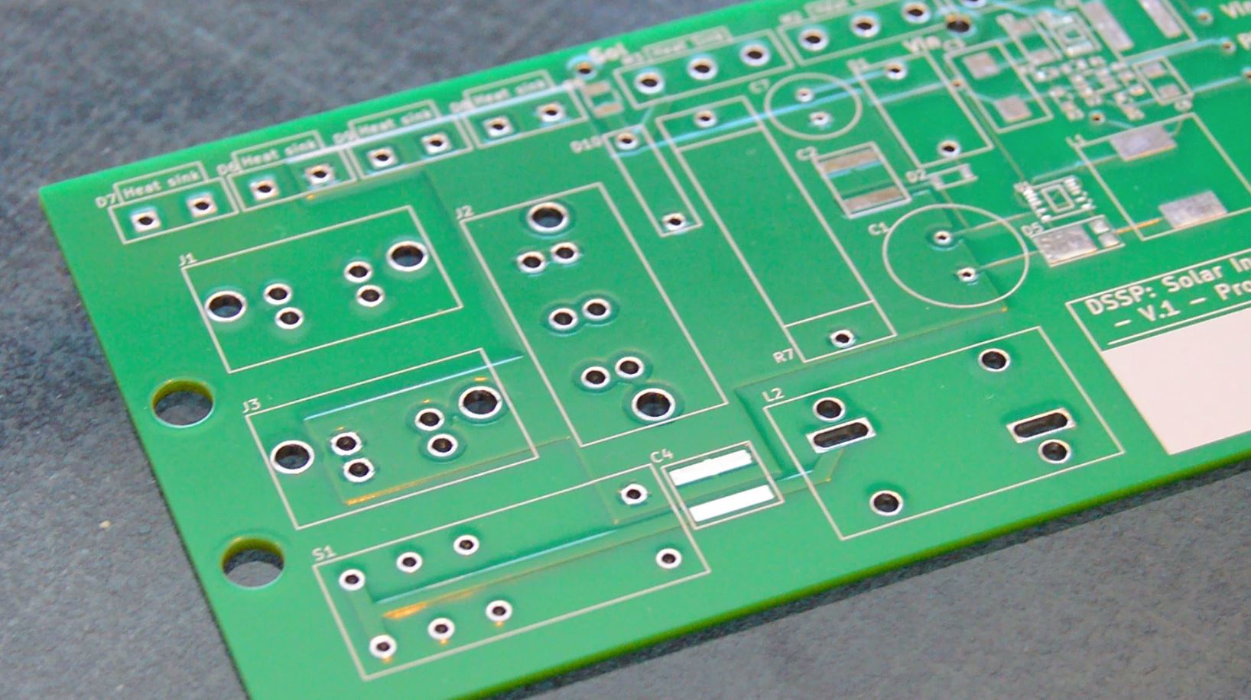

The Mallard Controller:
Addressing the Duck Curve through Solid State Solar Water Heating
The Problem
Our Solution
A significant problem exists in renewable energy--power peak usage and energy production times are mismatched. Photovoltaic systems make the most energy during the middle of the day when homeowners have all but completely ramped down their power usage. Water heaters account for 10-40% of homeowner's energy cost, representing one of the largest problems to solve for home energy use.
The problem with current PV systems boils down to interconnection issues. Regulations, costs, and time associated with tying into the grid dissuades many potential customers. Off-grid energy saving solutions such as onsite battery storage or thermal water heating systems require expensive and complex installations.
The power generated by renewable energy and power grid utility demands can be graphed into what is known as the duck curve (shown below).
The Mallard Controller accepts DC current directly from a small, dedicated PV panel array and outputs a Pulse-width modulated (PWM) AC signal. This signal is capable of powering a standard electric water heater resistive element, avoiding the conversion loss of a typical DC to standard-AC inverter, without needing to tie into the grid. The Mallard Controller can also work in conjunction with household AC power without the interconnection issues, if the user desires.
 | Mallard Controller System | Thermal Solar Water Heater | Grid-tied Electric Water Heater | Battery Storage System
Installation Cost | ✓ | ✗ | ✓ | ✗
Off-Grid Operation | ✓ | ✓ | ✗ | ✓
Convenience | ✓ | ✗ | ✓ | ✗
https://cpowerenergymanagement.com/has-california-finally-solved-the-duck-curve/
Plan
✓ Schematic design
✓ Prototype board build
Ready! Challenge Submission
Ready! Phase
Market Research
Networking
Prototype Testing
Redesign
Prepare for “SET!”
In collaboration with
Wayne Sawka, Danny Cox, Trisha Buescher, Jackee Ellis, Vince Camilleri, Trevor Summerfield, Greg Atchley

