Slide 1

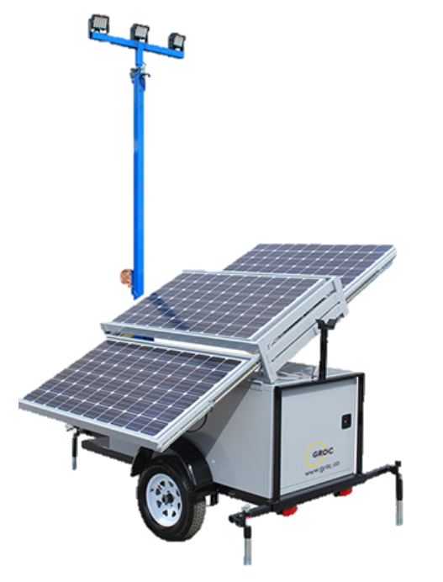




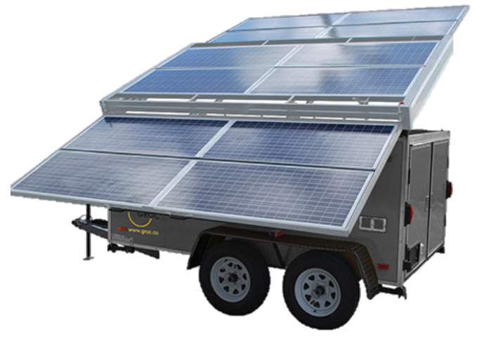





HIGH POWER, HIGH CAPACITY SOLAR GENERATOR
OUR GOALS:
Completely Fossil Fuel Free
Increase Power Density
Reduce Charging Cycle
Increase Availability and Reliability
Optimized for Specific Industries
Modular
Mobil
Plug and Play
User Connectivity
GROC - Transforming Mobile Power Solutions

