Slide 1
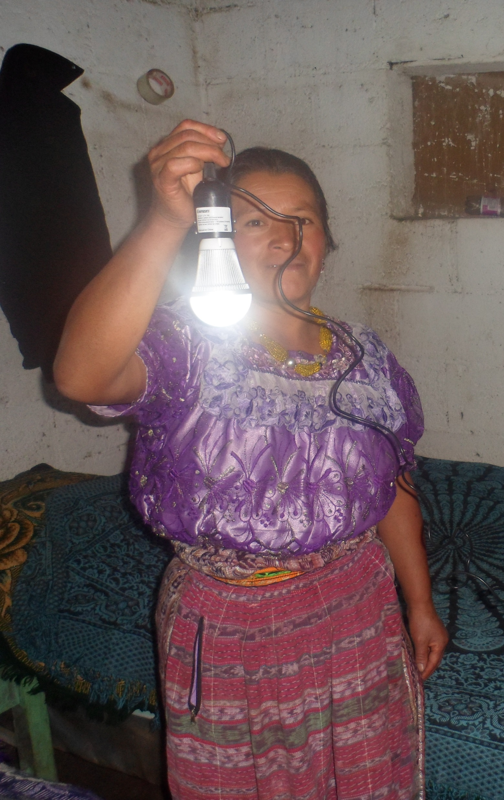
Solar-20
Twenty year solar home power systems for international rural development.
Over one billion people lack electricity
High failure rate of current technology
5 – 200 watt solar power systems
400% longer battery life
Help families thrive world-wide
Help kids study at night and stay in school

