Slide 1
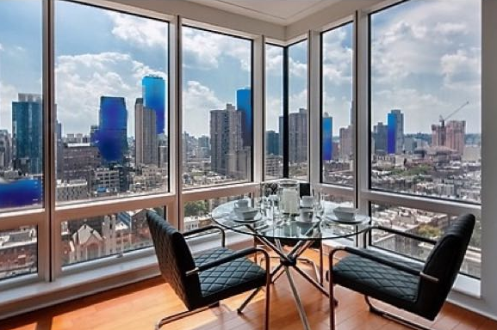
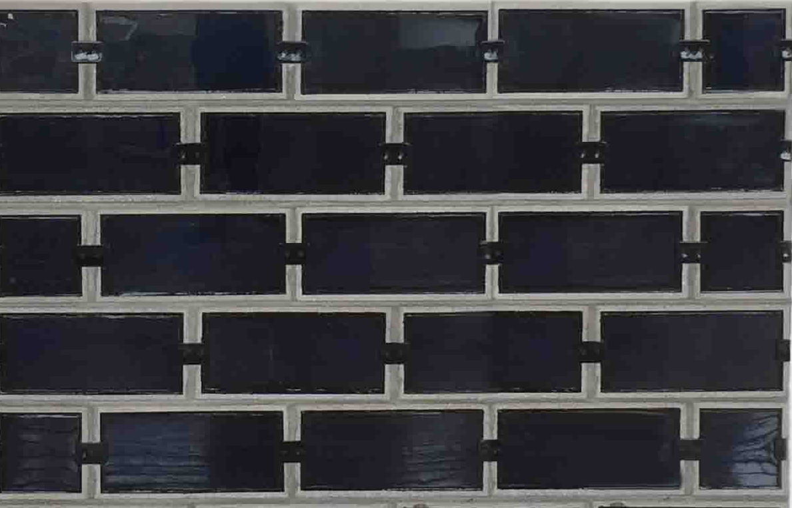
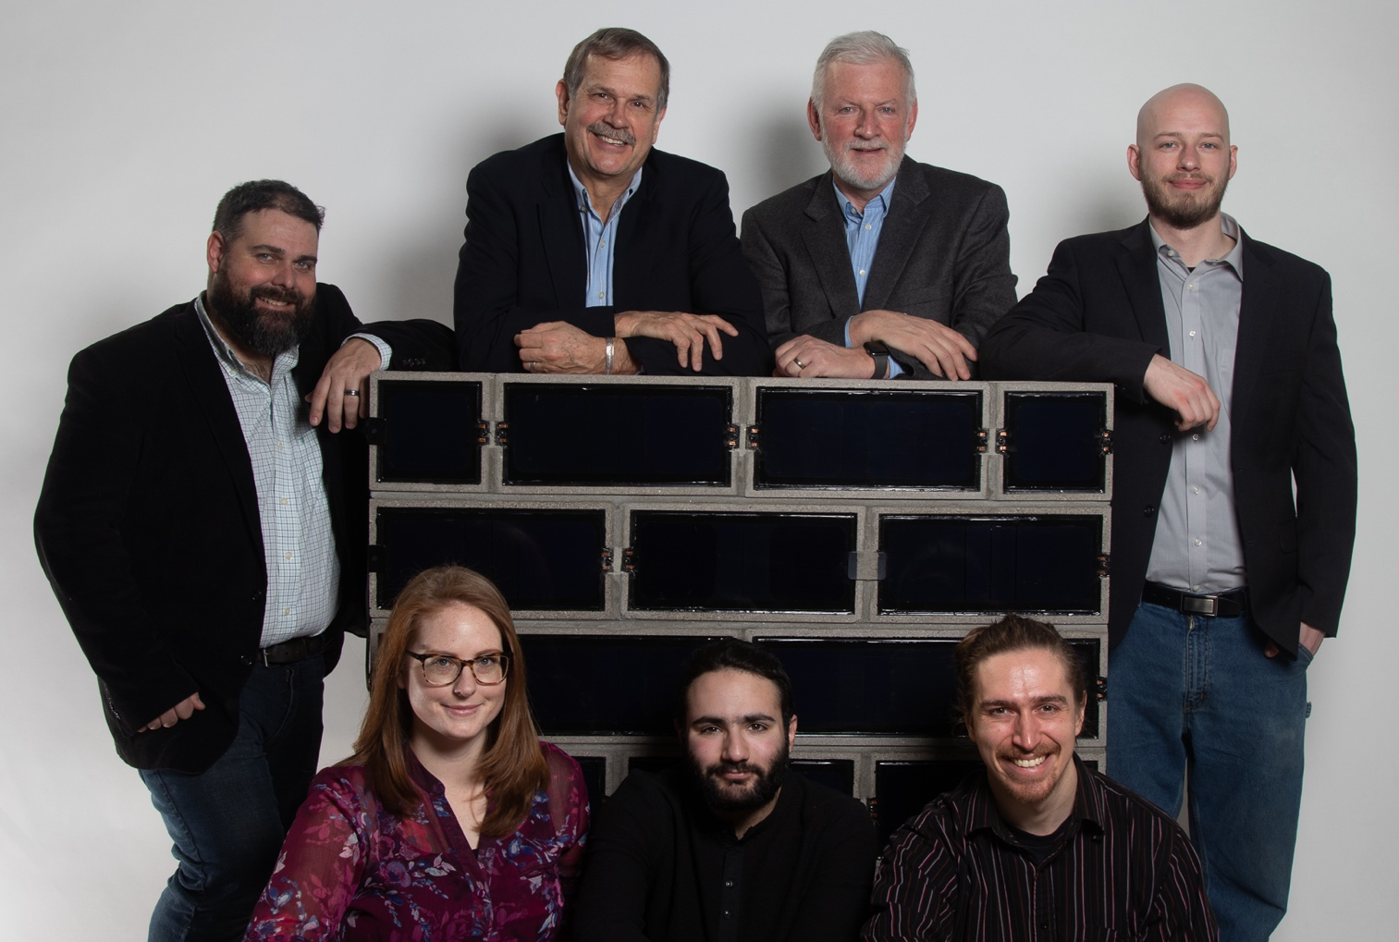






Vertical Solar for Cities
SolaBlock Wall Systems: Empowering Cities with Solar
Current Solar Modules are a Poor Fit for Cities.
  Poor architectural fit and poor economics.
SolaBlock Wall Systems are Designed for Cities.
  Best architectural and economic fit.
  Brings benefits of solar to urban communities.
  Empowers communities to address climate change.
Seeking Technical and Business Development Support
  Technical support for low-carbon substrates
  Business development support for serial production
Key Personnel
Kevin McAllister (CEO)—Former founder and CEO of major business.
Patrick Quinlan (CTO—Former NREL Senior Analyst, White House & Congressional Tech Fellow. Jason Laverty (COO)—R&D mason, construction technologies and industry partnerships.
116 Pleasant Street, EastWorks 254, Easthampton, MA www.solablock.com (339) 230-4600
Support
Bottom Lines
Fierst, Kane & Bloomberg LLP
Radiance IP Law, LLC
SUPPORT

