Slide 1
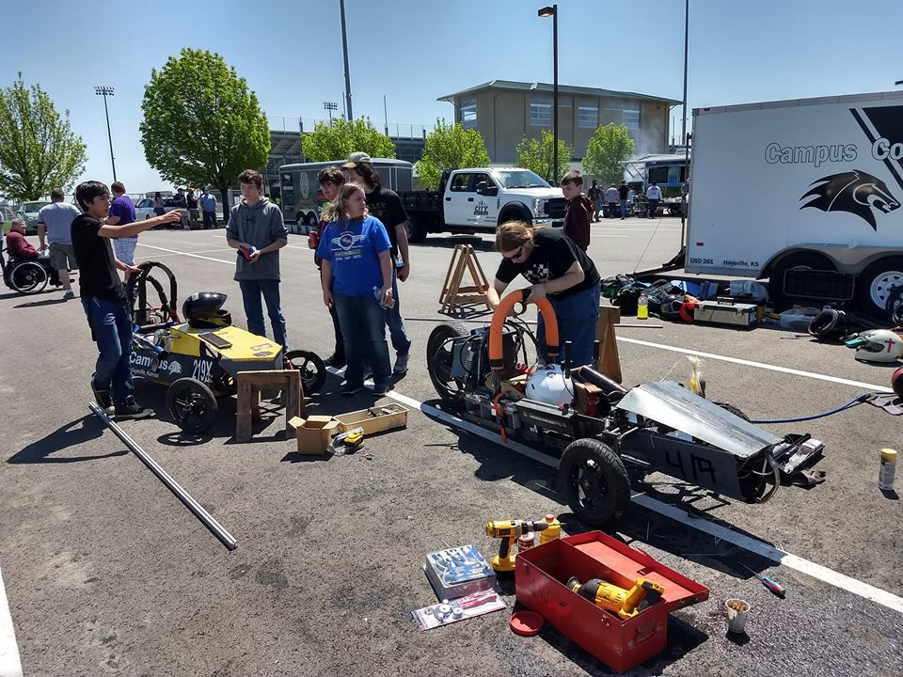
High School Solar Electric Cars
Our Goal is to make it more affordable and more exciting to add solar power to electric vehicles
Current solar panels typically provide less than 1% of the power needed to run the motors. By creating a modular solar cell system that can cover more area of the vehicle easily, we would like to see that percent increase to 10%

