Slide 1
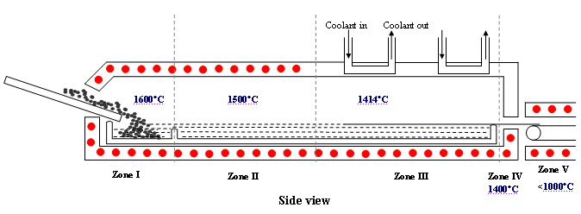
Continuous Wafer Production
Core Team: Erik Ydstie (captain), Professor of Chemical Engineering at Carnegie Mellon
Michael Helman, COO and Founder Industrial Learning Systems
Reed McManigle, Tech. Transfer Office at Carnegie Mellon University
Objective: Reduce the cost of making silicon wafers by a factor of two by continuous production
and a new method to control micro-structure in the horizontal ribbon growth (HRG)
process. The process produces a continuous ribbon of mono-crystalline silicon.
The technology will be tested in a $ 2M pilot plant system at CMU.
Process Concept
Pilot Plant
Development is at TRL 3 and will be at TRL 5 within a year.

