Slide 1
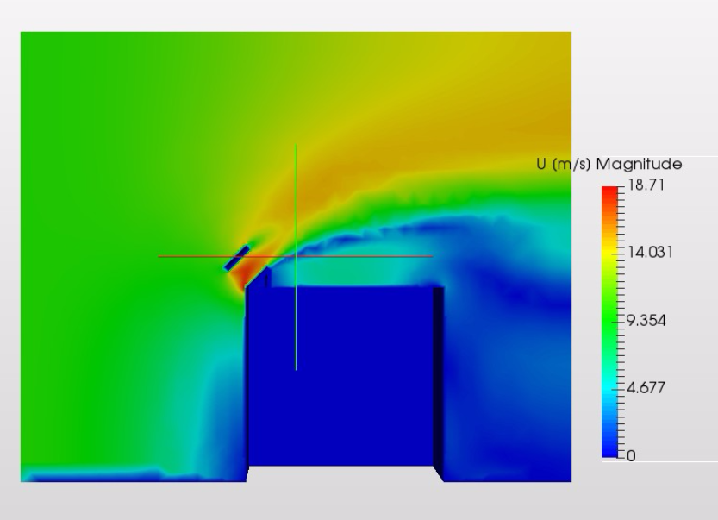
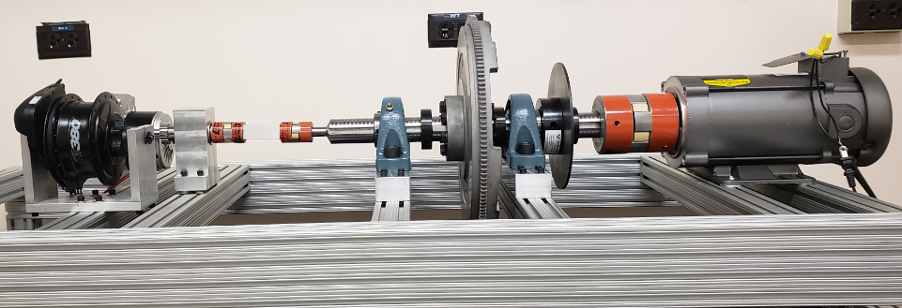
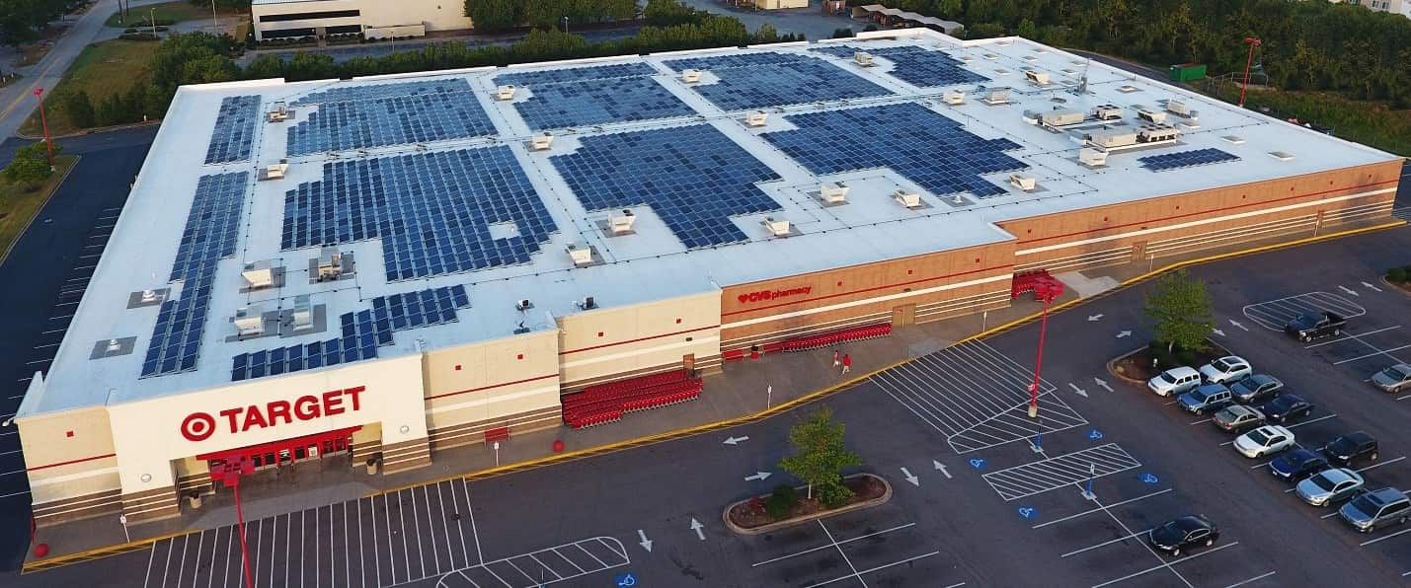
Commercial Building Solar, Wind and Storage Solution
Use Edge Effects for Solar and Wind
Storage-Integrated Powertrain
Sale to Solar Installers
Add on product to solar offering 20% additional energy generation
Diversifies offering of installers in volatile market
Using soft costs from solar installers allows overall cost reduction and market adoption
Validated with 100+ installers
Wind Turbine Rotor
Flywheel
Generator
Inverter
Grid
Reduce costs of solar and wind by placing a combined system on roof edge
Channel captures naturally faster wind speeds at roof edge
Solar sits on top, weight of turbine provides stability to loads
Modular install like solar today
Hardware Cost Reduction, Intermittency Reduced through Storage
Total Power Increases
Soft Cost Reduction
Partnerships with Argonne National Lab and Illinois Institute of Technology; Seeking Pilot Project Opportunities!

