Slide 1
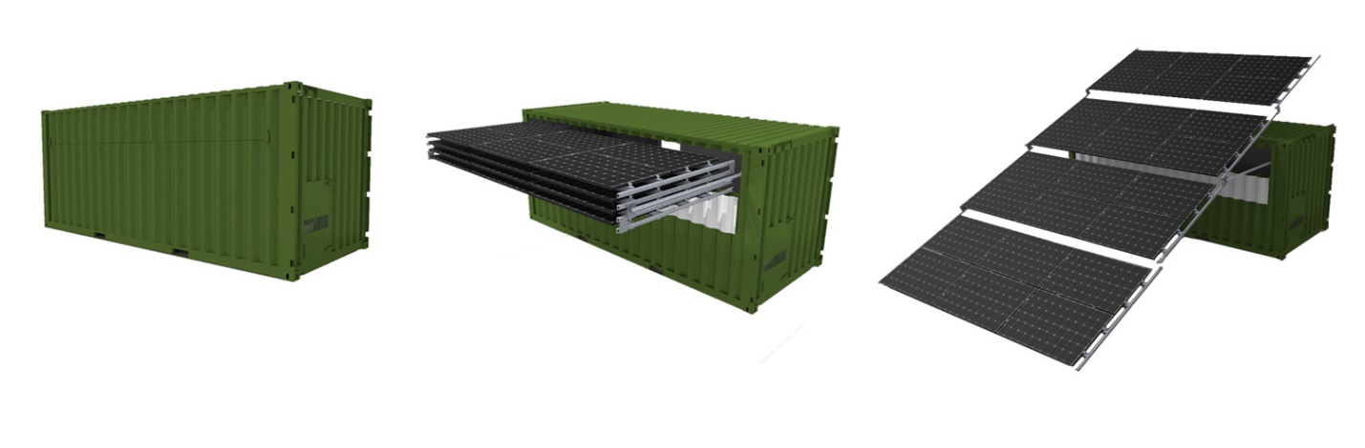
Weatherproof PV Power for Storm Resilience – SurePV
Factory Built and Rapidly Deployed Solar PV Microgrid Protects Critical Infrastructure From Catastrophic Grid Loss
Fred Milder, PhD. Team Leader, AMENERGY Distributed Energy Resources
Project Summary
Key Personnel / Organizations
The U.S. electrical grid consists of large centralized generation plants and long distance transmission and distribution lines that leave critical infrastructure at risk. Rather than system-wide attempts to protect the entire grid from hazards, we believe that adoption of small, local, solar microgrids is a priority in the race to protect our critical infrastructure. Our project goal is to create a product that will accelerate that adoption and protect our infrastructure.
The major objective of this project is to develop and test a solar- based, local energy generation product (SurePV) that will directly connect to critical infrastructure such as hospitals, emergency shelters, communications structures, and water supply systems. The SurePV is delivered as a complete system in a 20 ft shipping container, and will operate grid-tied or off-grid, responding to the presence of the grid by automatically switching between the two modes. The automated panel retraction to protect the unit during storms is triggered by a command or a National Weather Alert from the internet or a cell phone.
Fred Milder, Peter Page, Mark Howell / AMENERGY
Gared Gruber / G2 Project Fusion
Kenneth Armijo / Sandia National Laboratories
Key Milestones & Deliverables
Ready: | Critical Concept Proven
Set: | Product Subassemblies Development Product Development Complete Deliverable of 4 Manufactured Units
Go: | Field Validation Testing of Manufactured Units
Project Impact
The goal of Weatherproof PV Power is to protect the nation’s critical infrastructure from electrical energy disruptions. The SurePV is a solar-based distributed energy resource (DER) that will operate as a fully islanding microgrid, guaranteeing continuous electrical service to any attached infrastructure element. In normal operation SurePV adds a solar resource to the grid; when the grid collapses due to a cyber attack or a natural hazard, the SurePV provides the needed electric service to protect the critical infrastructure. The unit self-protects during extreme weather events by automatically retracting the panels back into the container while still providing power from batteries or an internal backup generator. Deployment of SurePV units at critical infrastructure across the grid will contribute to the building of a resilient power ecosystem.
SurePV Product Function
Automatic Deployment and Retraction — Providing Continuous Power to Critical Infrastructure

