Slide 1
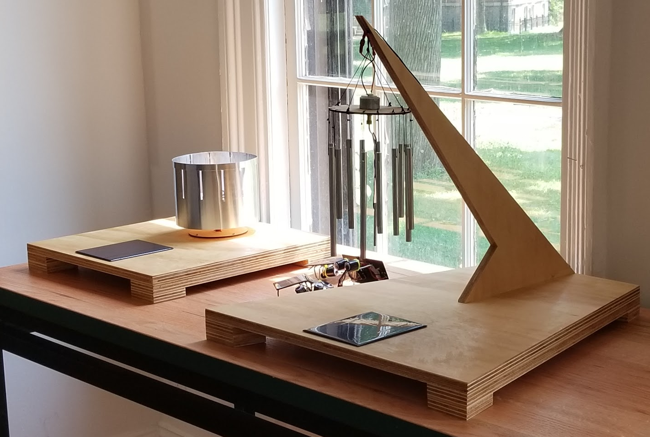
Solar Power for Artists
Educational resources to enable artists, designers, and educators to create successful photovoltaic projects.
Educational hardware kits
Web-based resources
Classes
Consulting
Image: 3 interactive solar powered art installations; left: solar powered zoetrope, center: B.E.A.M. bots, right: solar powered chimes

