Slide 1
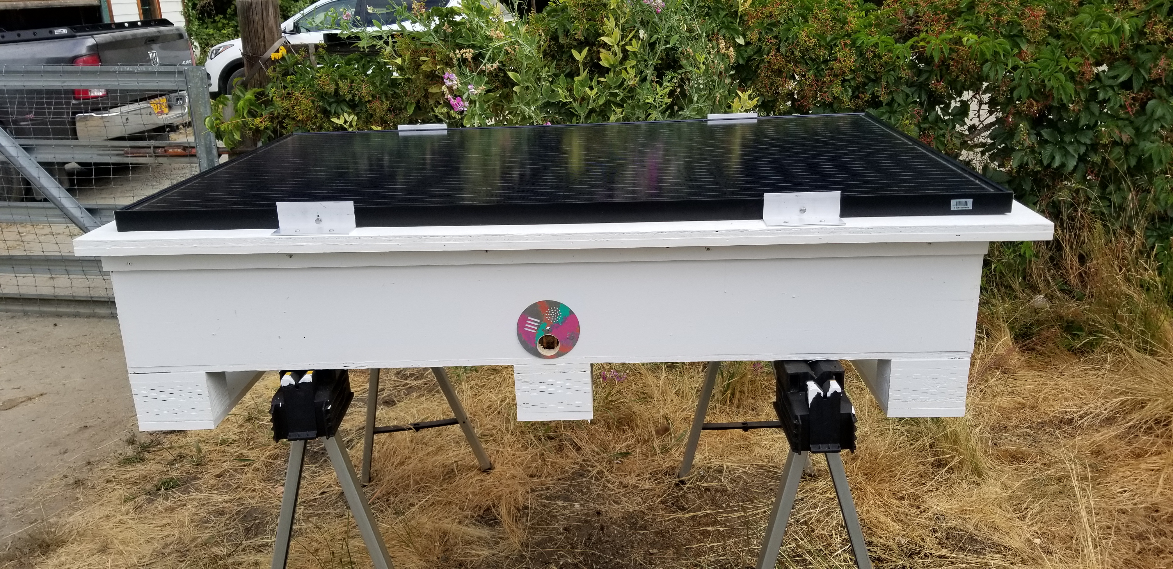
Introducing the Apivoltaic hive
A great way to work with utility scale solar to create pollinator habitat, bee colonies, and products
A legal work around Oregon’s restrictions for solar on high value farmland
Can be stand alone or grid tied
Provides power for hive monitoring
Incentivizes the creation of large tracts of long term pollinator habitat utilizing the concept of Agrivoltaics

