Slide 1
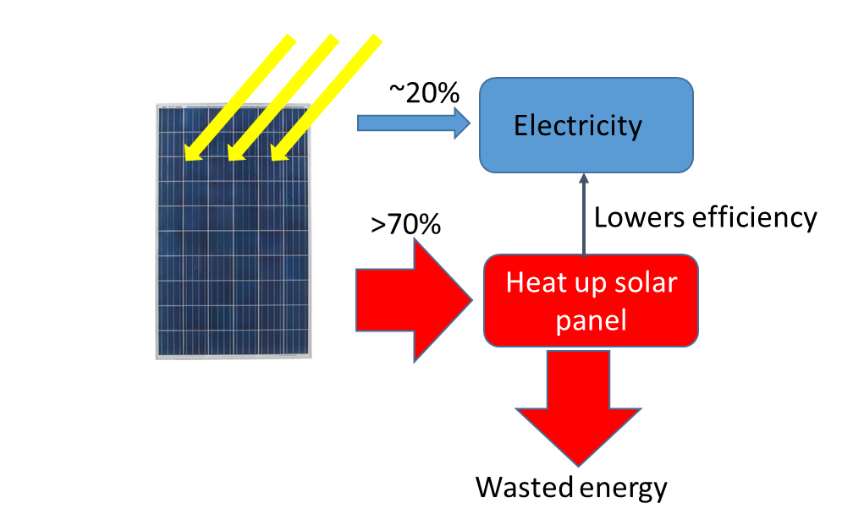
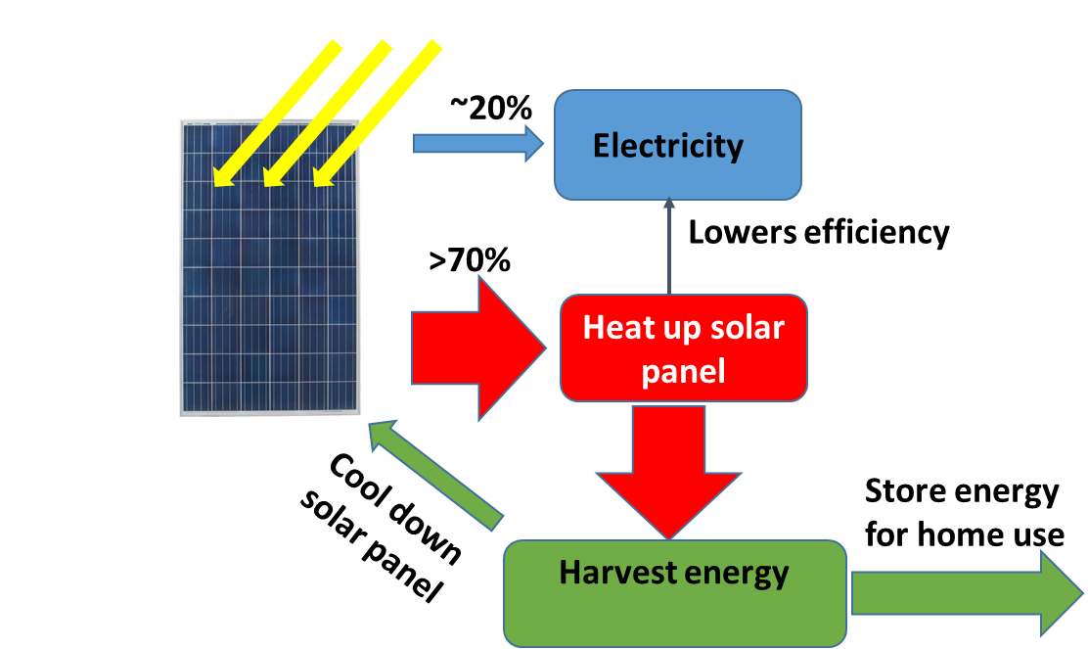
Project title: Power up my home
Team IBT, higher efficiency
Lead: Kaizhong Gao, Ph. D./IEEE Fellow
Goals:
Demonstrate prototype device and efficiency improvement.
Demonstrate integrated solution with partners from industry.
Produce viable path to productization to improve home solar system efficiency.
Technology summary: Improve solar panel efficiency by reducing its temperature. Build cost effective energy harvesting to further improve energy efficiency.
Impact: Additional 5% energy efficiency gain, i.e. 25% increase to baseline.
Now:
Our goal:
Challenge decades long of impossible
Increase energy efficiency for America homes
Demonstrate path to a cost-effective solar system

