Slide 1
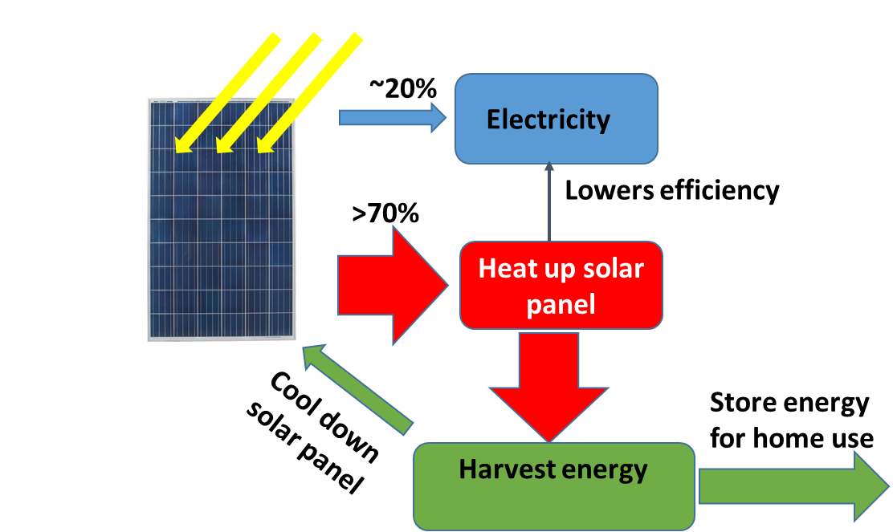
Project title: Power up my home, Voucher need
Team IBT, higher efficiency
Lead: Kaizhong Gao, Ph. D./IEEE Fellow
Lab. of choice, 1st NREL, 2nd Oak Ridge
1. Material properties measurement, this including electrical and mechanical properties, including thermal conductivity, density, elasticity and electric conductivity etc. The test will be done with bulk materials (i.e. not nanomaterials).
2. Solar system efficiency measurement: we will conduct in house measurement, to help community adopt to our technology, it is desired to have independent test and validation. This will require the lab. to be able to measure energy output from solar system accurately, as well as other energy form, heat, electricity etc.
3. Advanced fabrication, particular for nonconventional structured polymer.
Background: for our device build, we may use some special designed materials base on our own research. Therefore, we like to get additional support on materials property test, since it is for bulk materials, NREL has a team is able to help.
For efficiency measurement, many tests are needed, therefore, the voucher amount has higher $ value requested.

