Slide 1

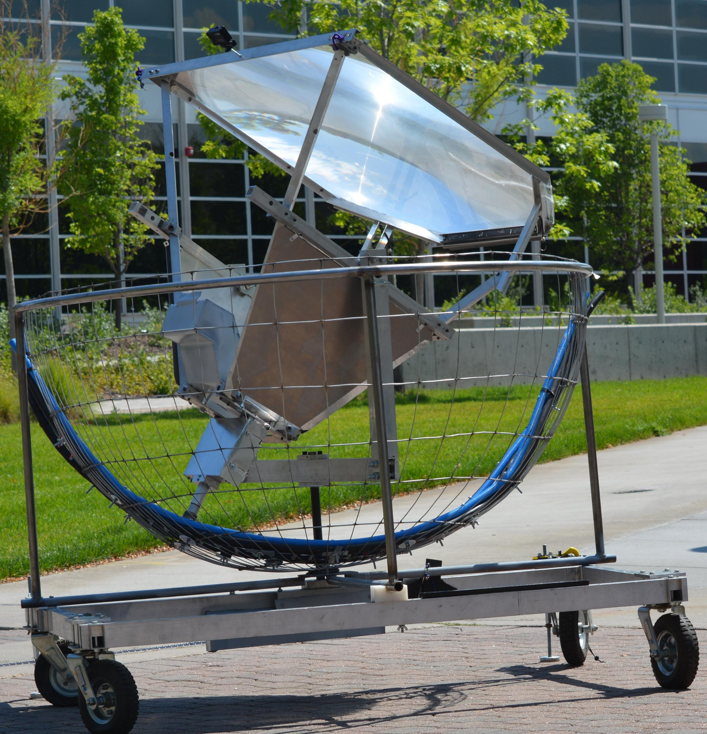
Drinkable Water
For Billions of People
SOLaSOL
Solar Tracker
Tracks the sun
mechanically
Manual/Automatic
operation
Autoclave
Disinfection of
instruments
High Efficiency
1 KW Sun Energy
Solar Cooker
Survival device-outdoor sports- third world needs
Low Cost
Melting of
Plastics and Metals
Promotes Innovation in Solar Energy applications
High Reliability
Rugged
Ideal for isolated regions
Solar
Art
Stirling
Engines
Common, inexpensive
components
Solar Education
Modules
Multipurpose devise for Solar Application
Developed at UC Denver
Minimum
Maintenance

