Slide 1
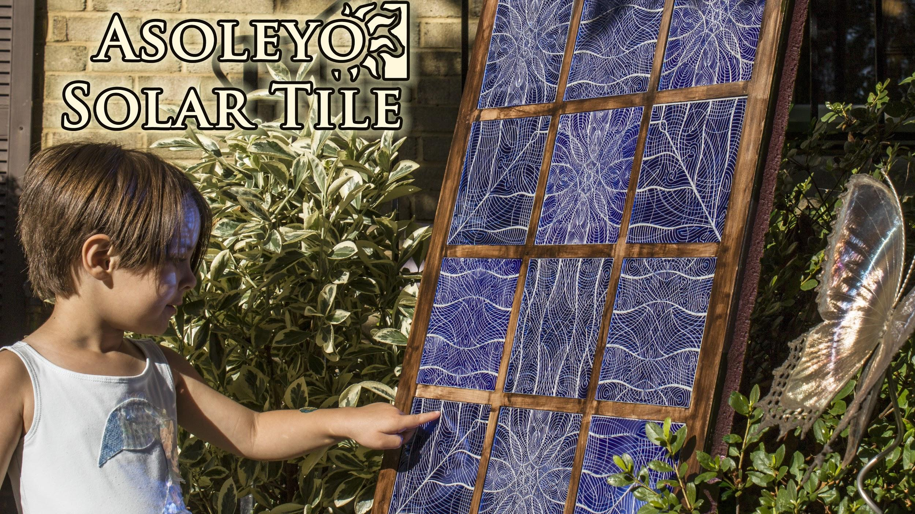
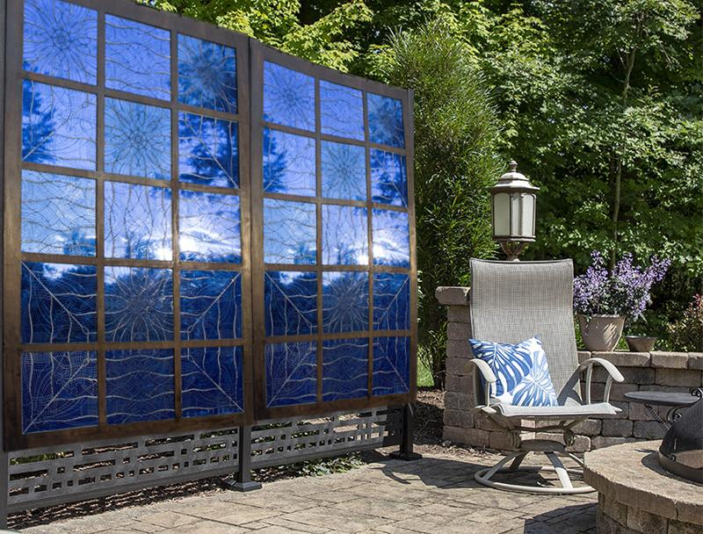

Small-Scale Design Prototype
Artist’s Rendering
We’ll re-design silicon PV cells’ front contact grid, to create visually attractive, designer solar panels that enhance upscale outdoor areas, and are a desirable addition to yards, parks, and architecture.

