Slide 1
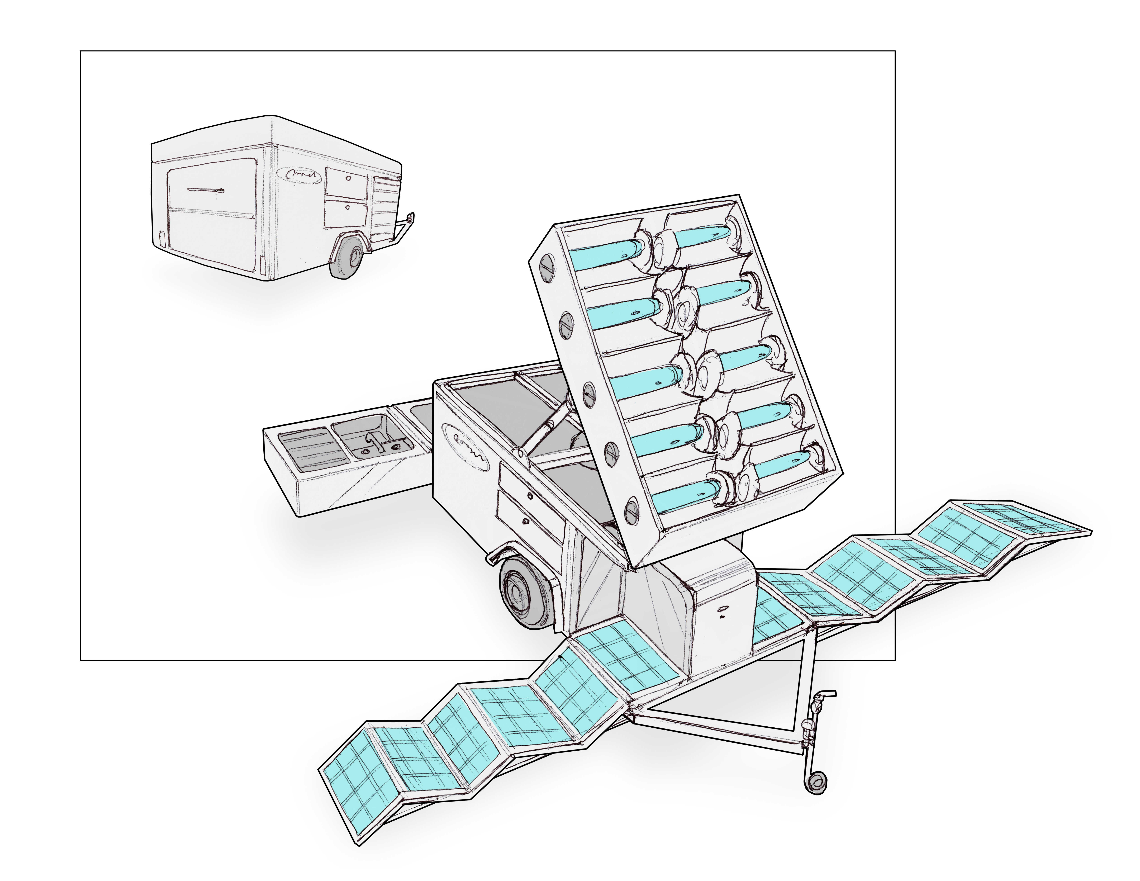

Disaster Relief Trailer:
Off-grid trailer with enough energy to feed 100 people every hour, 24/7
Mobile Solar Kitchen:
Compact
Rugged
Off-grid
Trailer Carries: Power, Lighting Water, Cooking, Cooling, Prep Area and Storage
transforms
for highway
speeds
overhead
lighting
hybrid solar
oven array
sanitation
station
cold and
dry storage
accordian-style
solar PV array
deploys in
30 minutes
power center and
battery storage
Copyright GoSun Inc. 2019

