Slide 1

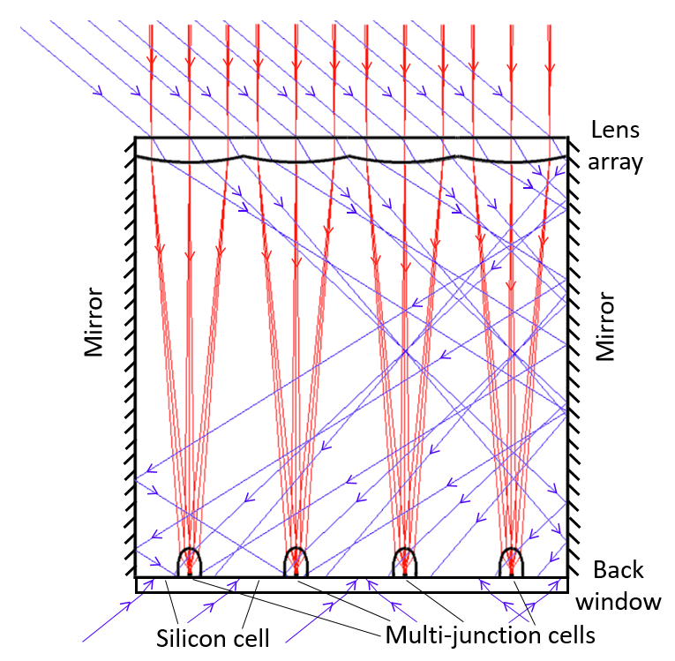



A practical way to double the output of PV panels
Hybrid PV panel has modified glass entrance sheet that efficiently separates the direct sunlight and diffuse sky components of solar energy
  Direct sunlight component focused onto mm-size multijunction PV cells, 43% - 50% efficient, mounted on silicon cells
  Diffuse sky and backlight components transmitted to the 20% efficient Si cell
Set! demo prototype shown is a working 3” section of a full-scale module. Energy output to be compared in the field to the same Si cell alone
Overcomes the fundamental losses of previous “CPV” solar. Close ≥ 100% energy output gain over a wide range of solar resource
Good potential for lower LCOE than silicon PV
Demo will have an entrance window of glass formed as a 4x4 array of 18 mm square lenses
Side mirrors in the demo will ensure full response to diffuse rays at all angles, as in full 1 m x 2 m panel with same size lenses
Projected energy gain vs Si on single axis Phoenix Kansas City New York City
115% 105% 95%
Roger Angel
Zach Holman
Nick Didato

