Slide 1
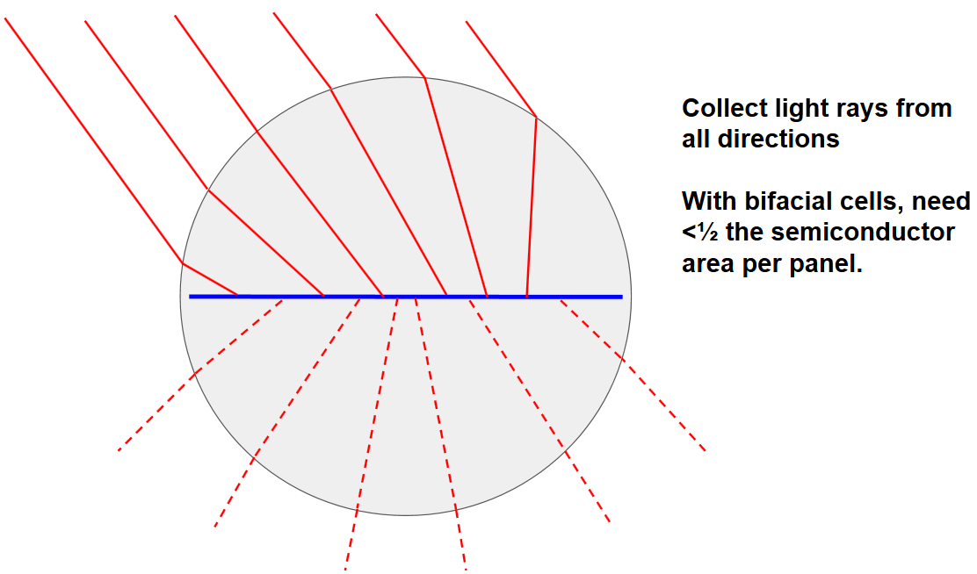
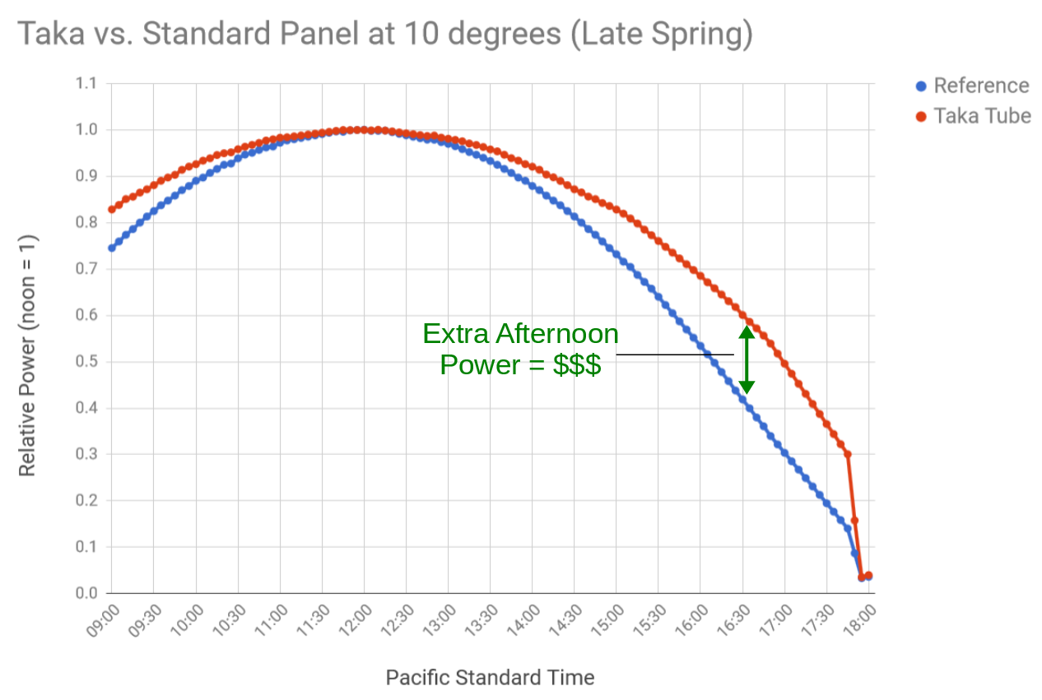
Lowest BOS Cost
  Self-Ballasting, No Penetrations
  Install 4x Faster
Performance
  Highest Bifaciality
  Low Cell Temperature
  Sun Tracking, No Moving Parts
  More Roof Coverage, Power Per Roof
Ready
Prove Customer
Prove Design
Set
Prove
Manufacture
Go!
Prove
Company
Notes:
<number>
Chris Barnes (650) 954-7124 and Brandon Moores (510) 520-6394

