Slide 1
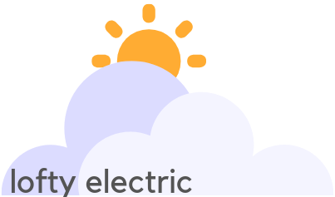

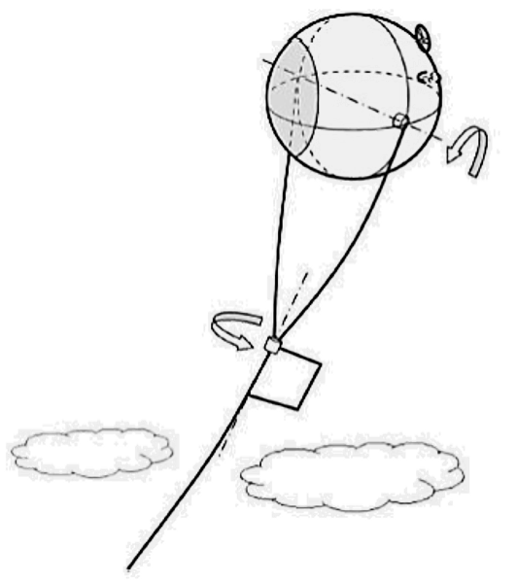
The Problem
Slowing PV efficiency gains
Climate reduces output
Land constraints
Challenges of higher green-energy market penetration
The Solution
Change the operating environment - to the sky!
Lofty Electric combines aerostats (blimps) and solar panels to produce energy
The Aerostatic Platforms for Electricity (APEs) are moored to the ground
with an electrically conductive tether
APEs will operate from above treetops (50m) to above the clouds (6 km)
Why High-Altitude?
Available Sunlight + Higher Efficiency = 4 - 10x more energy*
Aglietti, 2009
(Higher solar radiation + cloud albedo
+no shading +longer daylight hours )
(Lower temperature + cooling winds
+higher quality panels)
*per panel per day versus a standard ground-based panel

