Slide 1

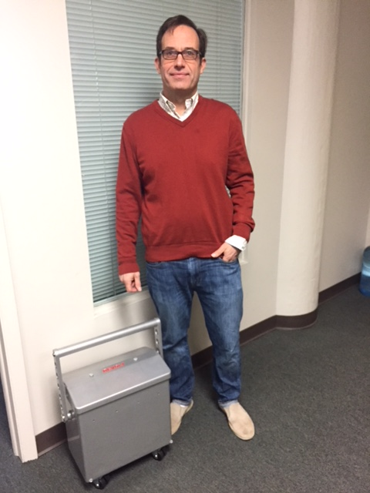
Home Solar and Storage System
4 Integrated Functions:
  5kW Battery / Solar / Grid-tie / UPS
Store Energy: Use at night / 14hr Back-up Power
No Power Export: No Utility Agreement Needed
Small size: 10X Size Reduction
Portable: Take Power With You

