Slide 1

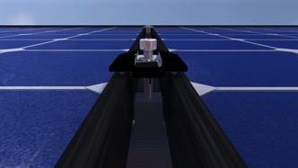

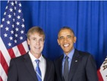

No Exposed Conductive Parts Solution for NEC 690.12 Rapid Shutdown Requirement
No Exposed Conductor Design
Problem: MLPE (module level power electronics) have been used to address NEC 690.12 Rapid Shutdown requirement. However, most MLPE solutions are either more expensive and not proven to last 30 years. Cost of repairing those failures are very high, because installers would need to replace failed electronic components module by module.
Solution: We designed the “No Exposed Conductive Parts” solution which can eliminate the risk of electric shock by eliminating direct contact with metal in case of fire, meeting NEC 690.12(B)(2)(3) requirement. We are in the process of filing patent(s) for our design.
Core Team:
  Sean White – IREC Certified Solar PV Master Trainer. Author of PV and the NEC, Solar Photovoltaic Basics, and Solar Engineering and Installation.
  Kevin Gao – Mechanical engineer and entrepreneur in solar. Inventor of multiple US patents.
  Madame Mi Yue- Owner of SNEC, world’s largest solar trade show and connections to 100s manufacturers in the solar PV industry.
Plan: Work with national labs and industry leaders to test prototypes and then small volume production.
No-exposed metal

