Slide 1

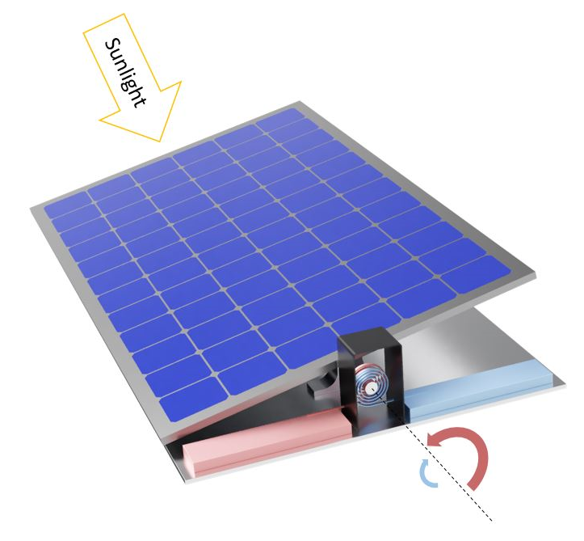
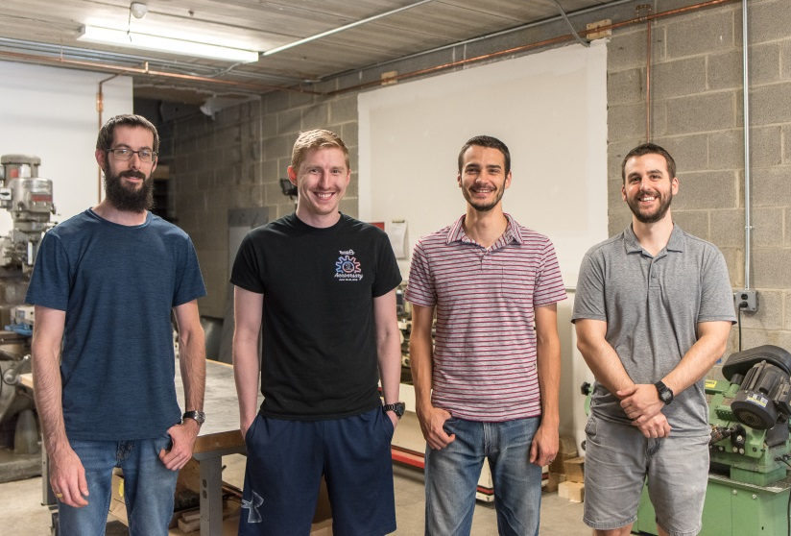

Passive Solar Tracker
Solar tracking by panels can increase efficiency by up to 40%.
Current systems are uneconomical due to significant maintenance and part costs.
Our system uses bimetallic coil springs and two sensing plates to passively track the sun throughout the day.
As one plate receives more sun than the other, it creates a torque difference causing the panel to tilt towards the sun.
Coils
Sensing Plate

