Slide 1

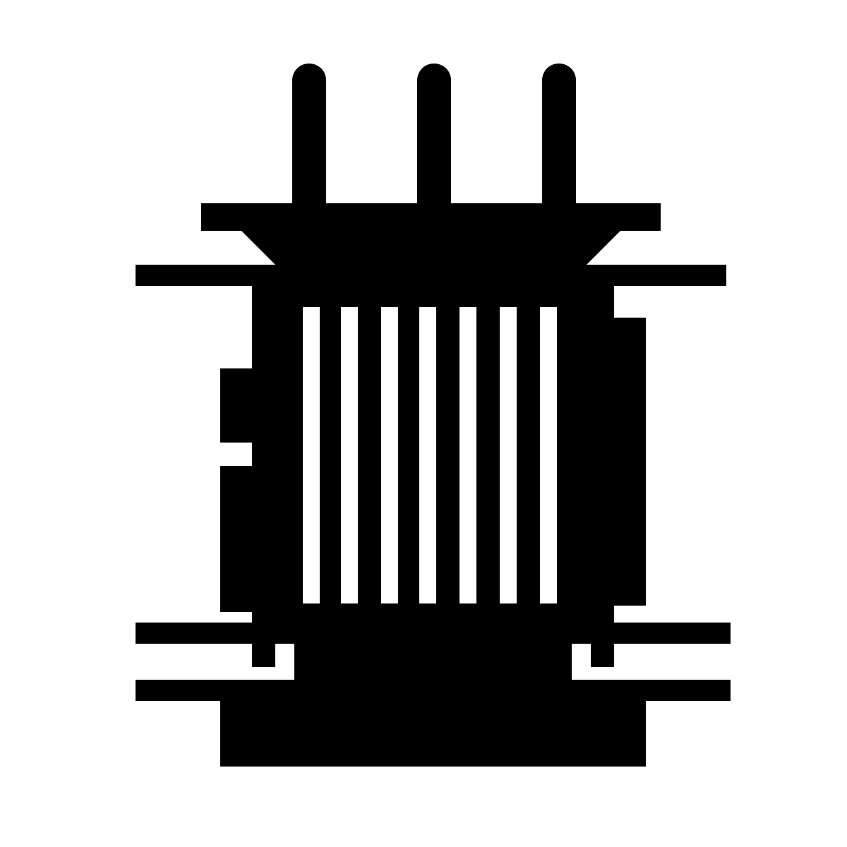
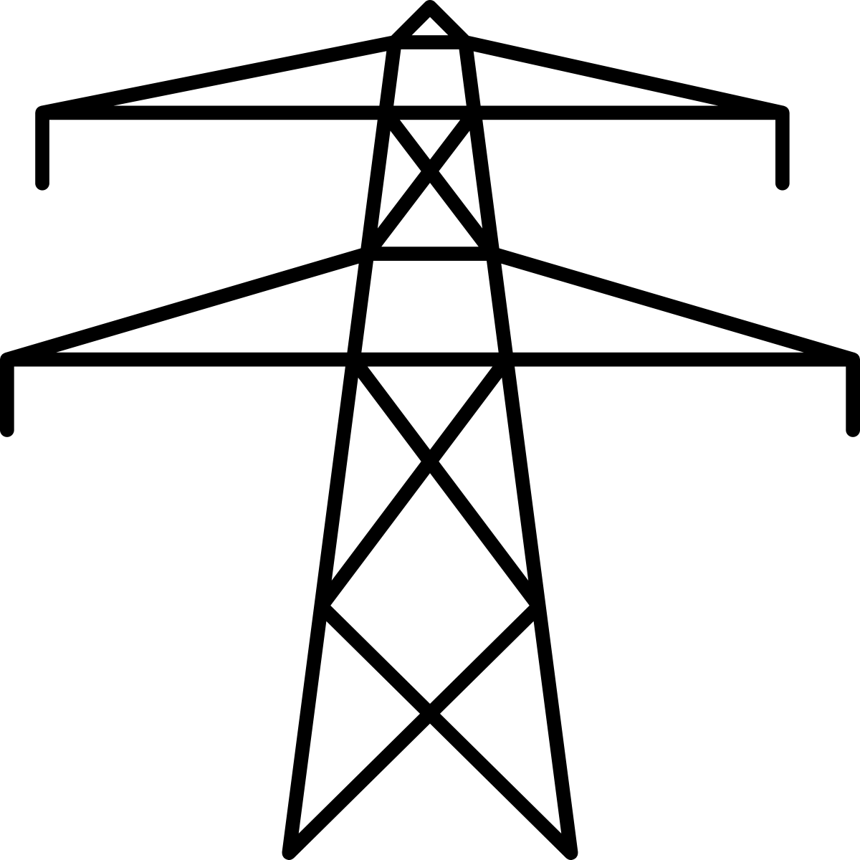
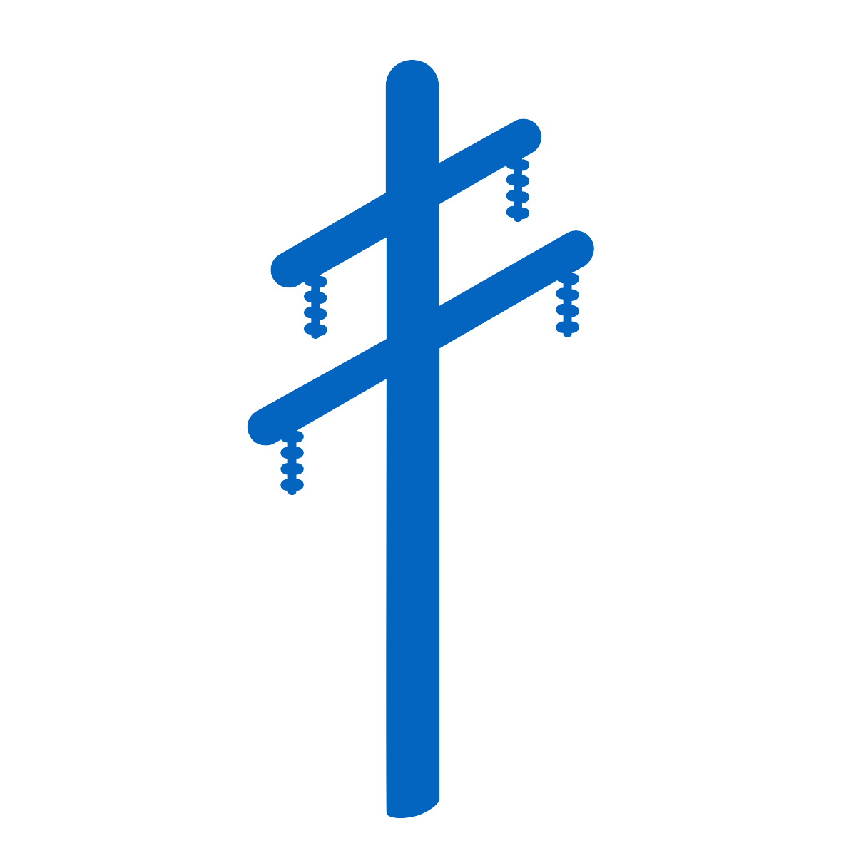
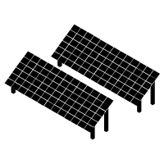
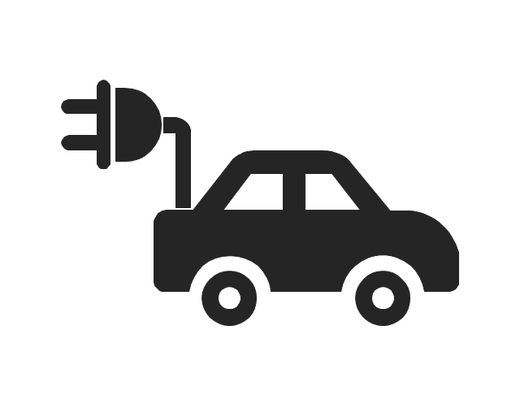



Many of the future challenges for solar integration and reliable operation of the electric system will occur at the distribution level
Distribution scale solar is critical because it allows for economies of scale without incurring large interconnection costs.
Switched Source has a tool that enables utilities to tie distribution circuits together and create a network out of existing infrastructure.
This networked configuration, coupled with the Power Router’s ability to route power to where it can be optimally utilized, enables 2-3x more solar to be connected to the distribution system without triggering costly substation or line upgrades.
In addition to solar benefits, the Power Router can increase the reliability and efficiency of distribution systems, along with their capacity for more electric vehicles to be connected.
GENERATION
TRANSMISSION
Sub 1
Sub 2
DISTRIBUTION
Midpoint Recloser
Midpoint Recloser
Info@SwitchedSource.com
Power Router

