Slide 1
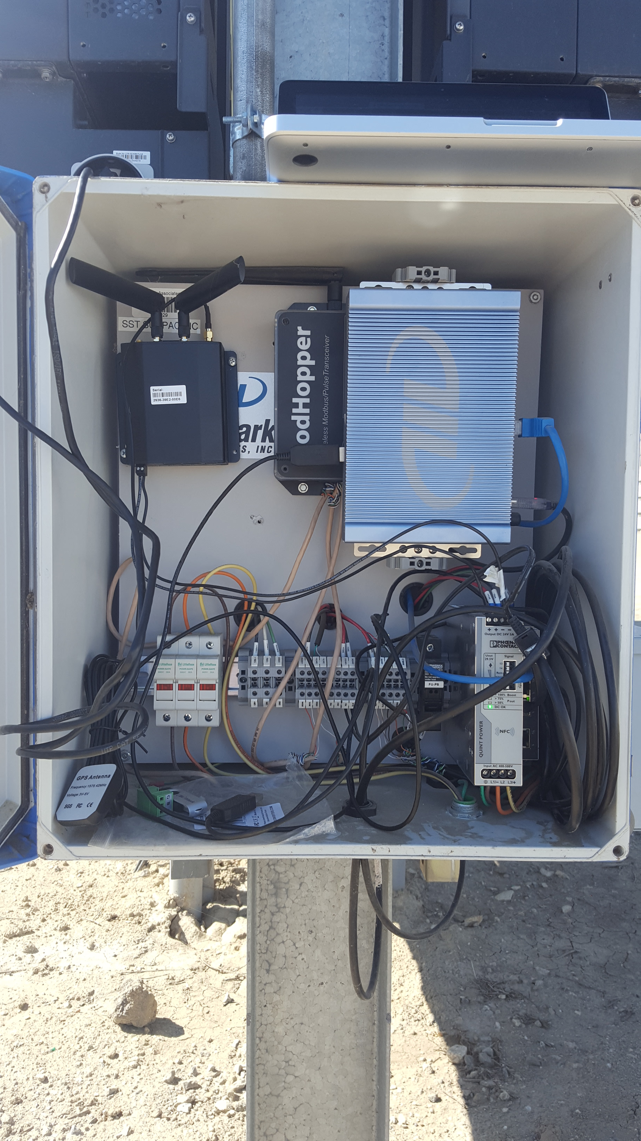
Powerfly: A Plug-And-Play Solar Array Monitoring Device
Solar, Embedded Systems, IoT, Cellular, Energy Harvest
James D’Albora, james@verifyenergy.com
Daniel Gerber, daniel.l.gerber@gmail.com
Goal: support the solar industry by providing compliant and affordable monitoring
CA will soon require secure Sunspec compliant monitoring through Rule 21
Monitoring systems today are expensive and difficult to deploy
We propose the Powerfly, the first secure communications gateway for the solar industry
Features cutting-edge energy harvesting technology, an embedded cellular modem, backup battery, revenue-grade metering, and truly plug-and-play functionality
Current partners: LBNL, Spectrum Energy
Future partners: Sunspec, Wivity, Kitu Systems, K2 Energy, Polycase
Inverter
A
B
C
Powerfly
Solar Monitoring Today
-Requires dedicated power from breaker panel
-Requires setting up mesh network, lacks security
-Not Sunspec compliant
-Cost: $1000 per inverter
Powerfly
+CT energy harvesting
+Backup battery for outages
+Secure cellular uplink
+Revenue grade metering
+Sunspec and IEEE 2030.5 compliant for Rule 21
+Cost: $500 per inverter
+10x faster installation

