Slide 1
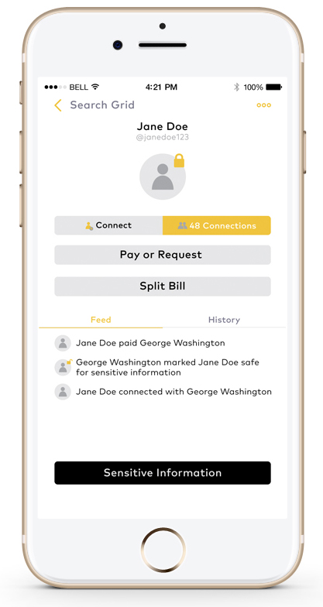
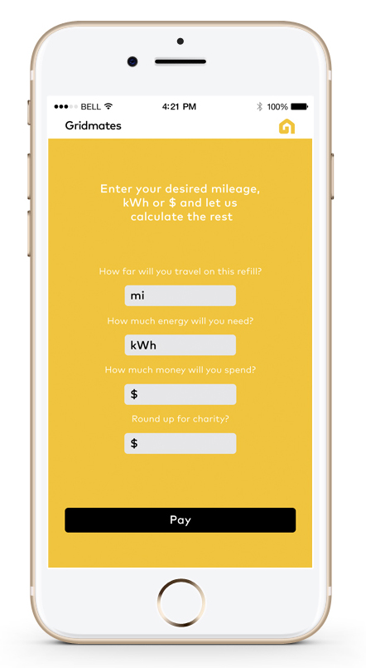
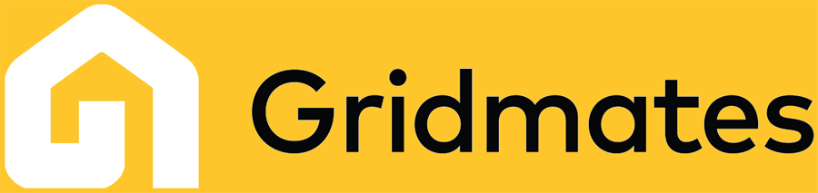
Energy BridgeTM | by Gridmates
Introduction
Project Goal
Following the evolution of decentralized production and consumption, Energy BridgeTM by Gridmates is a plug n play blockchain based distributed billing system, for microgrids and Virtual Power Plants.
Energy Bridge supports:
Secure blockchain based transactions
Decentralized peer to peer transactions
Integrations with existing billing systems/ Meter Data Management (MDM)
The purpose of the project is to enhance Gridmates platform and create a one of kind distributed billing system to cover the needs of peer to peer energy exchange (debits and credits) in microgrids and Virtual Power plans (VPPs). Energy Bridge will be developed on blockchain and will support the integration with existing systems to cover a wide spectrum of applications (island mode or grid connected mode). During the project, Gridmates team will perform product development but also a real testing with a Microgrid and a utility partner.
About Gridmates
Project Team
Gridmates is the world’s first cloud platform designed to end energy poverty. Gridmates helps utilities and energy retailers improve Community Engagement and Customer Assistance Programs by connecting givers of energy with people in need. Gridmates product is a web and mobile app for Smart Energy gift cards.
Dr. George Koutitas (CEO) holds a PhD in Electrical Engineering and a PostDoc on Smartgrids
Dr. Costas Tzaras (CTO) has more than 15 years of business experience in SaaS
Angelos Angelou is the former vice president of Economic Development in the City of Austin
Andres Carvallo is a former CIO of Austin Energy and is a utility expert
www.gridmates.com

