Slide 1

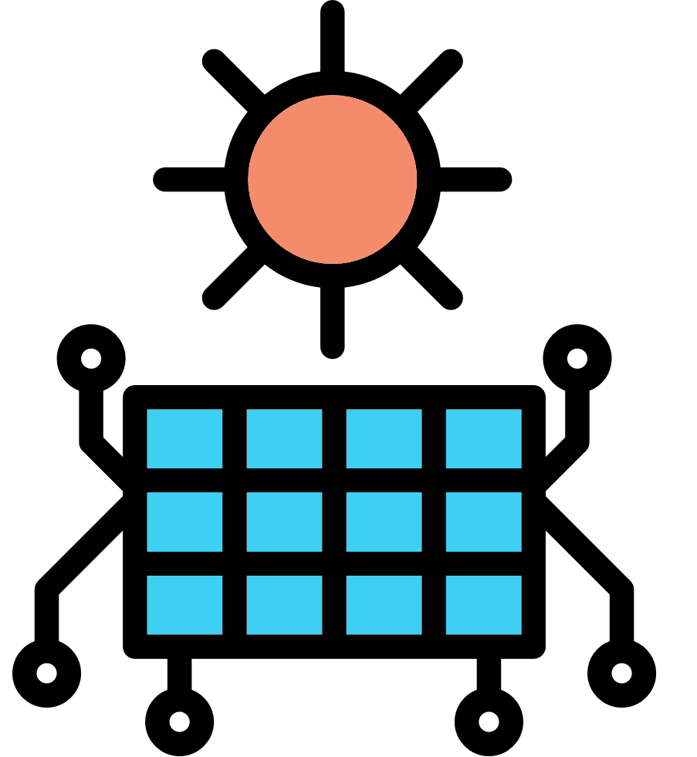

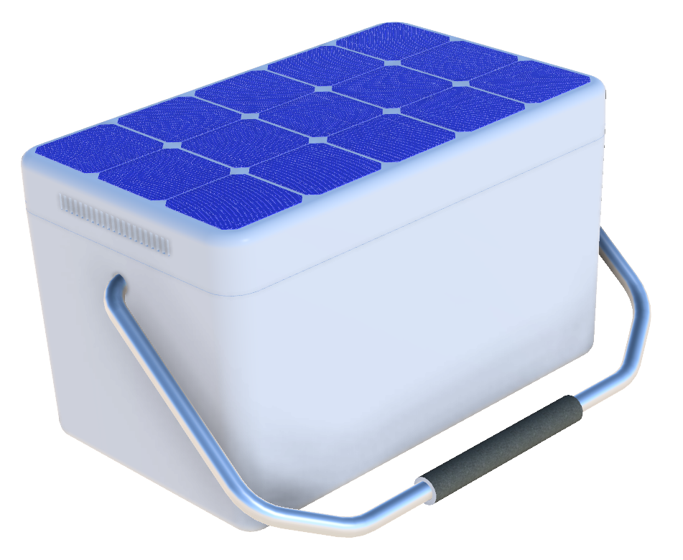

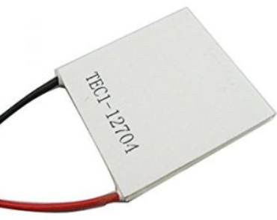

Ultra high efficiency insulation is used to keep internal temperatures in the appropriate range and power use at a minimum
Solar Cooler
Solar Powered Off-Grid Portable Refrigeration
High efficiency solar cells capture solar energy
Cold air is captured inside unit and is circulated to achieve even refrigeration temperatures
Power is applied to thermoelectric device (TEC) creating Peltier Effect
Energy is held in high capacity battery
www.arc34.com

