Slide 1

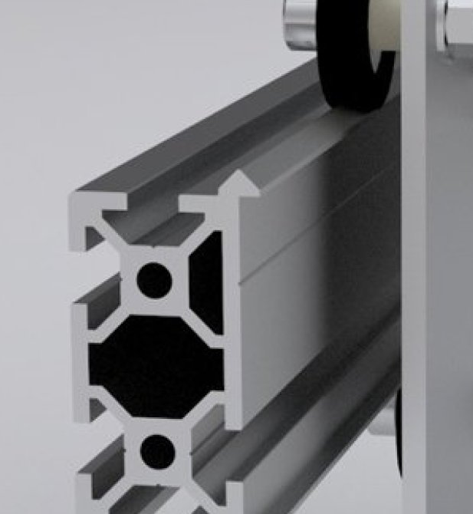
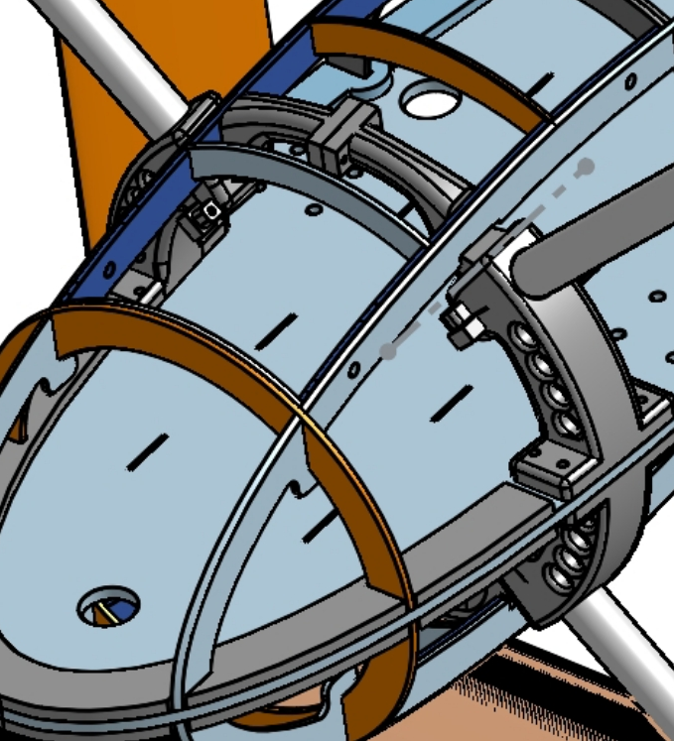

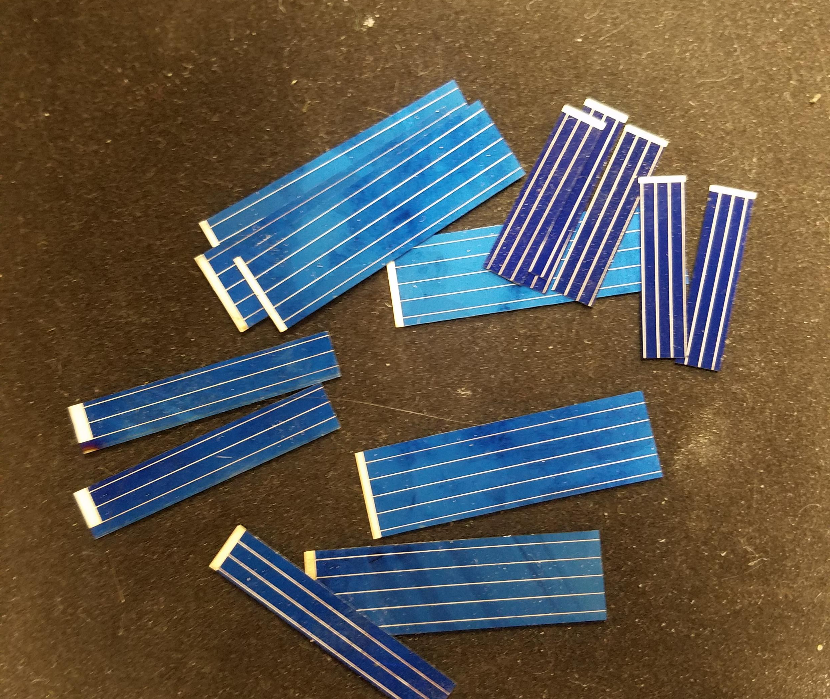
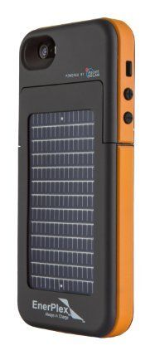
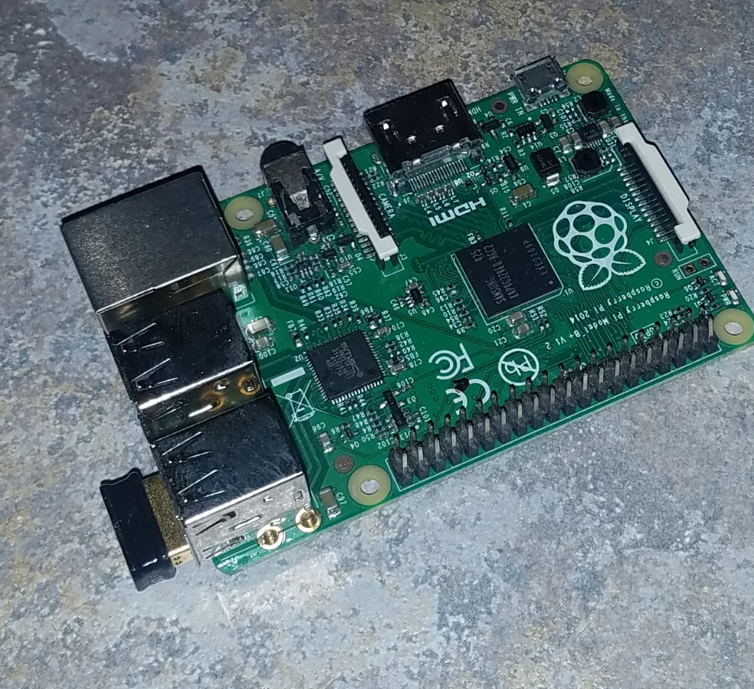
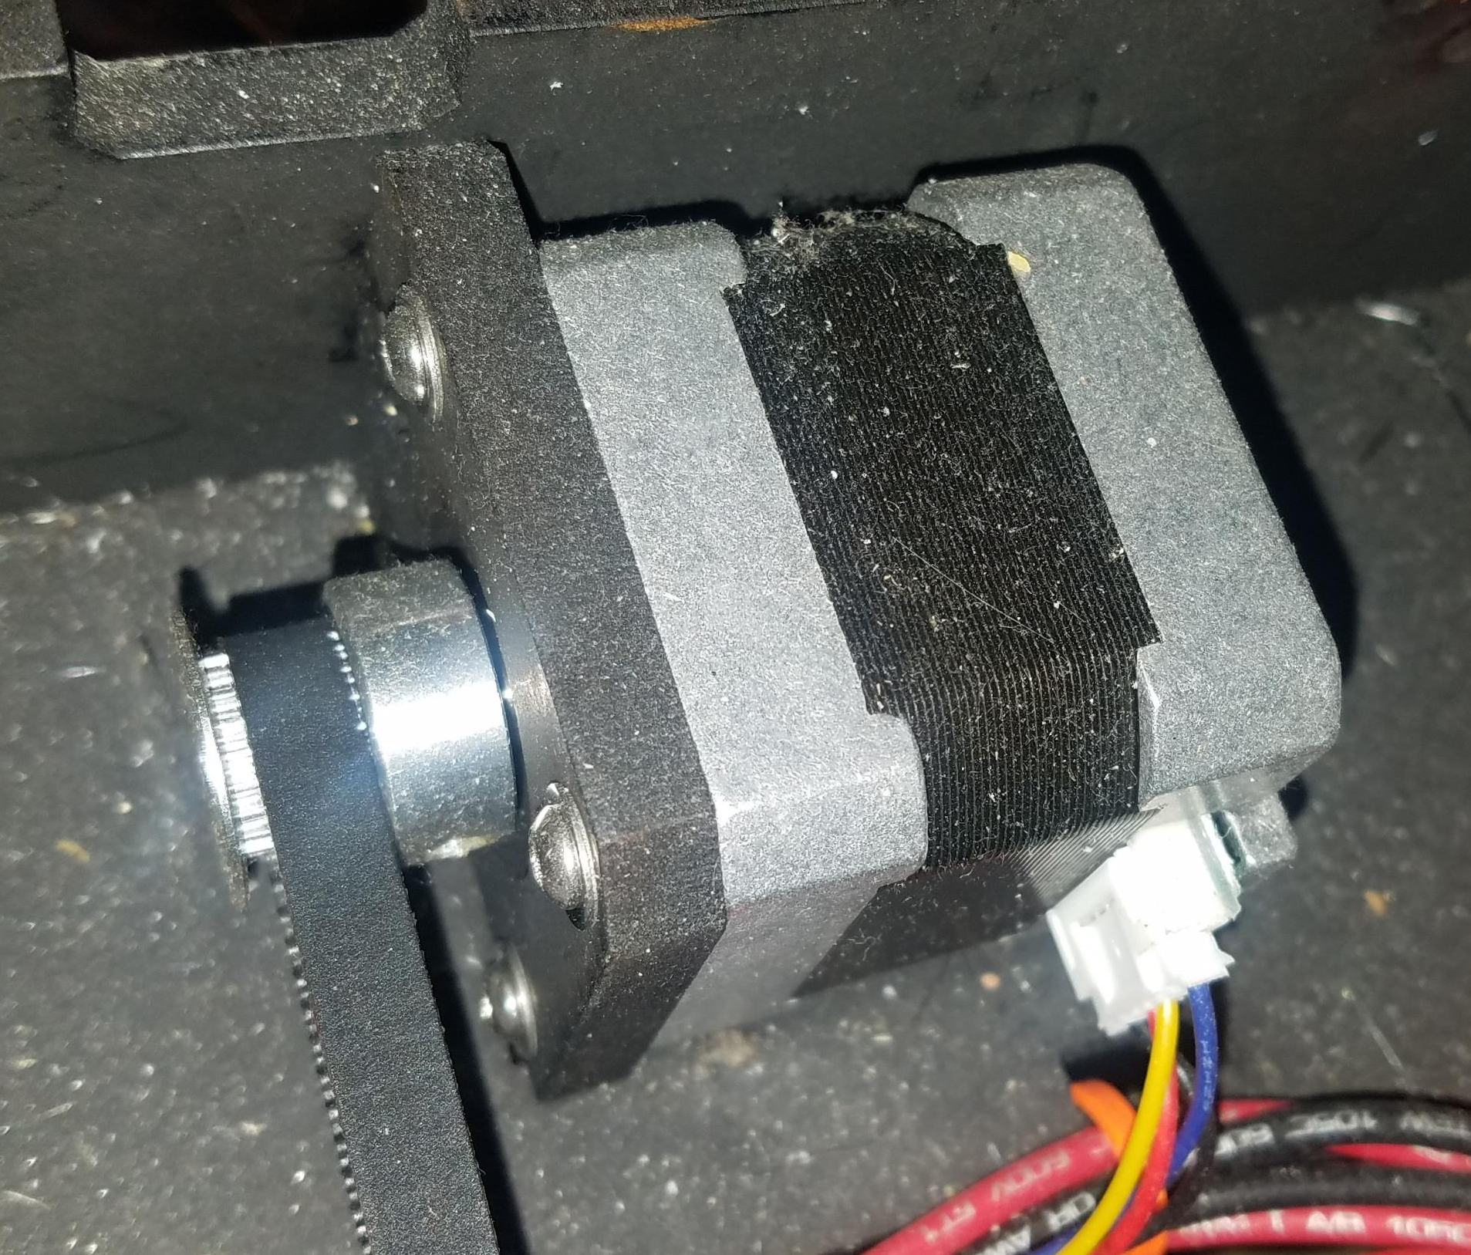

PowerPoint Infographics Sampler
BIG opportunities in micro solar!
The Teq Strategy solution will automate the manufacturing and assembly of micro solar wafers into custom, micro solar panels for integration into consumer products.
The Internet of Things (IoT) and consumer electronics market is growing at breakneck speeds.
These products requires a lot of energy and battery life is key. To make these devices energy independent, many device makers are integrating micro solar panel.
The IoT devices market is expected to grow from $107 Billion to $551 Billion by 2022 with many of these devices requiring solar.
Micro Solar Manufacturing System
Solar wafers
Teq Strategy innovation in micro solar manufacturing

