Slide 1
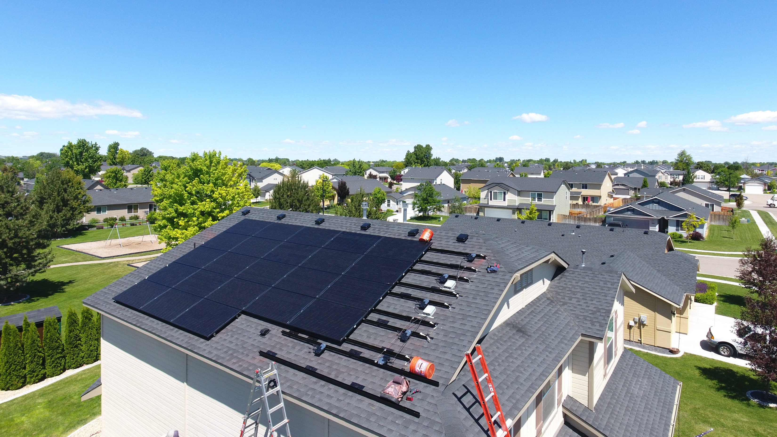
Awaken Solar by Joshua “Sunshine” Hill
The goal is to create an educated and informed public regarding quality American-made solar products, companies and policies. Information will be distributed for free through constant feedback from customers who go solar by partnering with Awaken. Live speaking events, daily online postings, interviews with industry experts and video lectures will help contribute to a higher level of public knowledge regarding solar photovoltaics. Leads for solar will create revenue through contracts with trusted local solar providers in each market. The review site will be independent of the solar providers, and built by organic feedback of objective customer data such as: bid to installation timeline, system performance, warranty and service metrics, etc.

