Slide 1
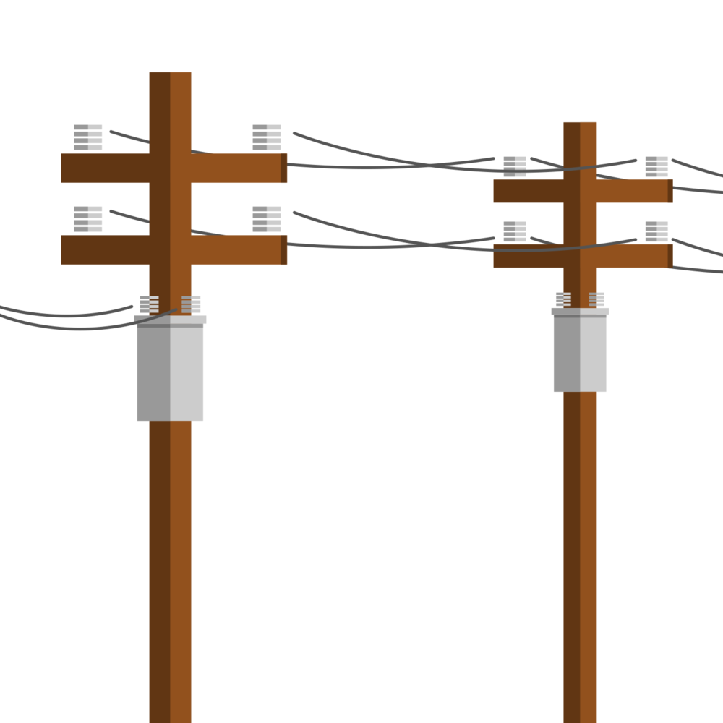
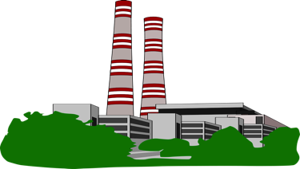

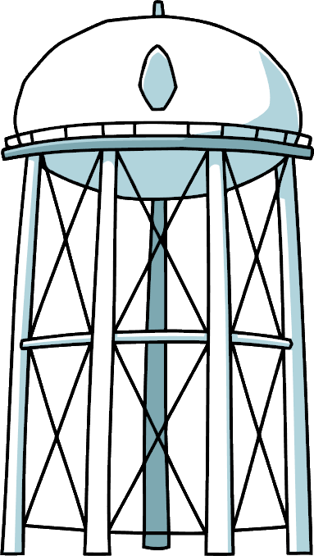


Electric Grid
Out
In
Filling Station
Power Plant
Solar Farm
Water Tank
PEM Electrolyzer
Hydrostatic Pressurization
Significantly reduces operational costs, by eliminating the need for mechanical compression.
Eliminates thermodynamic problems caused by gas compressing (heating) and expanding (cooling) in constant volume vessel.
Fill rates and discharge rates are unrestrained, both in volume and duration.
An unlimited number of cycles can be performed each day, 365 days per year.
100% of the gas can be removed from the chamber each cycle.
Solar Wind Storage provides a reliable means to store any amount of curtailed solar power as hydrogen in man-made underground chambers.
Chamber Mechanics
Accumulating gas (red) forces water (blue) from the chamber bottom up pipe (yellow arrows).
When gas is withdrawn, water flows through the pipe back into chamber.
This balancing of the gas pressure in the chamber and the hydraulic pressure in the water pipe maintains constant pressure on the hydrogen gas throughout the entire fill/empty cycle.
Notes:
In our system the chambers are flooded prior to filling with hydrogen gas. There is only way in and out of the chamber for the water and it is through the water pipe opening at the bottom of the chamber, which is connected to a surface reservoir. The accumulating gas in the top of the chamber has to force water out of the bottom of the chamber to make room for additional gas. In order to do this the gas pressure in the chamber has to overcome the weight of the water in the water pipe. Or as it is known in fluid mechanics, it has to overcome the hydrostatic pressure in the water pipe. The hydrostatic pressure is used to maintain pressure in the chamber as it is being filled for storage and emptied for transportation. The hydrostatic pressure feature eliminates the need for mechanical compressors and the costs associated with them.

