Slide 1
Enhanced PV Solar Power System Design With a MPPT Controller as a Function of Temperature
Y.Dinakar
M.TECH (Power Systems)

Slide 2

Contents:
Introduction
Literature Review
Problem Statement/Extension work
Block diagram
Design of Simulation and Results/Hardware Design and results
Discussion on results
Conclusion /Scope of future work Publication
References

Slide 3
Introduction
Solar PV power generation is the best option compared to the fossil fuel based power plants now–a-days .Definitely the thermal and nuclear power plant will retire in future due to the development of the above mentioned
The sun irradiance is 1345 w/m2 but some of it deflected and the irradiance reaching earth is 1000 w/m2
The demand for PV systems is growing in power system distribution area
The solar installations are costly affair ,many techniques were proposed such that maximum power is extracted from solar array at all times since higher returns revenue is expected from it

Slide 4
Literature Review
In general when a PV module is directly connected to a load ,the operating point is seldom the mpp
A power converter is needed to adjust the energy flow from the PV array to the load
Multiple well known direct control algorithms are used to perform the maximum power point tracking(MPPT)
MPPT algorithms are used to control the duty cycle or the operating voltage of a photovoltaic system to ensure maximum power at all times

Slide 5
Literature Review
Perturb & Observe(P&O):This is the most widely used algorithm in the industry.It involves perturbation of the operating voltage or the duty cycle based on a comparison of the generated power .This ensures maximum power point.
Incremental Conductance: This algorithm is slightly more complex & robust.The central idea is that the incremental conductance is compared to the instantaneous conductance & the duty cycle is adjusted accordingly.
Fractional open circuit voltage: This algorithm is different from the first two and is based on the principle that the maximum power point voltage is always a constant fraction of the open voltage

Slide 6
Literature Review
PID Controller : the PID gains is necessary for a more efficient real-time controller with minimum overshoot and minimum rise time in output voltage.

Slide 7
Problem Statement/Extension work
Development of MPPT With variable temperature unlike the Existed MPPT controller methods where varying insolation and shading conditions are tackled
To maximize total output power of the solar system while minimizing the steady state oscillations and the tracking time, by using this algorithm.
To enhance PV solar power system design in KLEF
To do economic analysis of AC energy generated annually & savings in Energy Bills
To calculate installation cost of proposed system and depreciation cost.

Slide 8
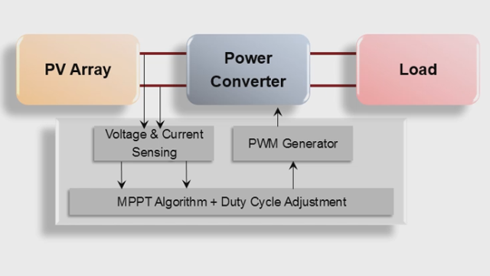
Block Diagram

Slide 9
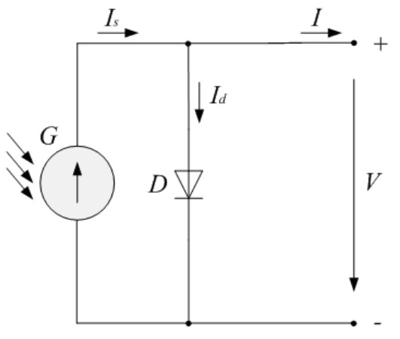
Design of Simulation and Results/Hardware Design and results
Mathematical Model of a PV cell
Ideal single diode equivalent ckt
The diode I-V characteristics for a single module are defined by
the equations
Id=I0* [exp (V _{d} /V_{T})-1] ( 1)
VT=KT/q ×nI×Ncell (2)

Slide 10
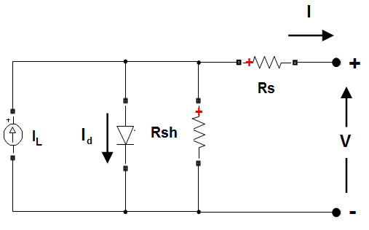
Practical single diode equivalent ckt

Slide 11


PV module modelling is based on the following non linear equation(Rp=Rsh)
At maximum power point situation
The open-circuit voltage at temperature T is obtained as
Vo c _{T} = V o c (1 + beta_ V o c (T–25)) (5)
The short-circuit current at temperature T is obtained as
I s c _{T} = I s c (1 + alpha_ I s c(T–25)) (6)

Slide 12
Electrical parameters of (TS250 PV module) of KLEF (old EEE block)
TS250 PV module
STC
TS250 PV module
NOCT
Parameters | Value (Make:Tata solar)
Model | TS250
Nominal output power (w) | 250
Power tolerance(%) | +/- 2.5
Module Efficiency | 15
O.C voltage(v) Voltage at Pmax | 38.1 30.7
SC current(A) Current at Pmax | 8.58 8.16
Parameters | Value (Make:Tata solar)
Power outputPMAX (W) | 180
Voltage at Pmax vmpp(v) | 27.2
Current at Pmax Impp(A) | 6.64
O.C voltage(v) Short-circuitcurrent ISC(A) | 33.5 7.15
NOCT (ºC) | 47+-2
Temperaturecoefficient ofPMAX (%/ºC) | -0.4383

Slide 13
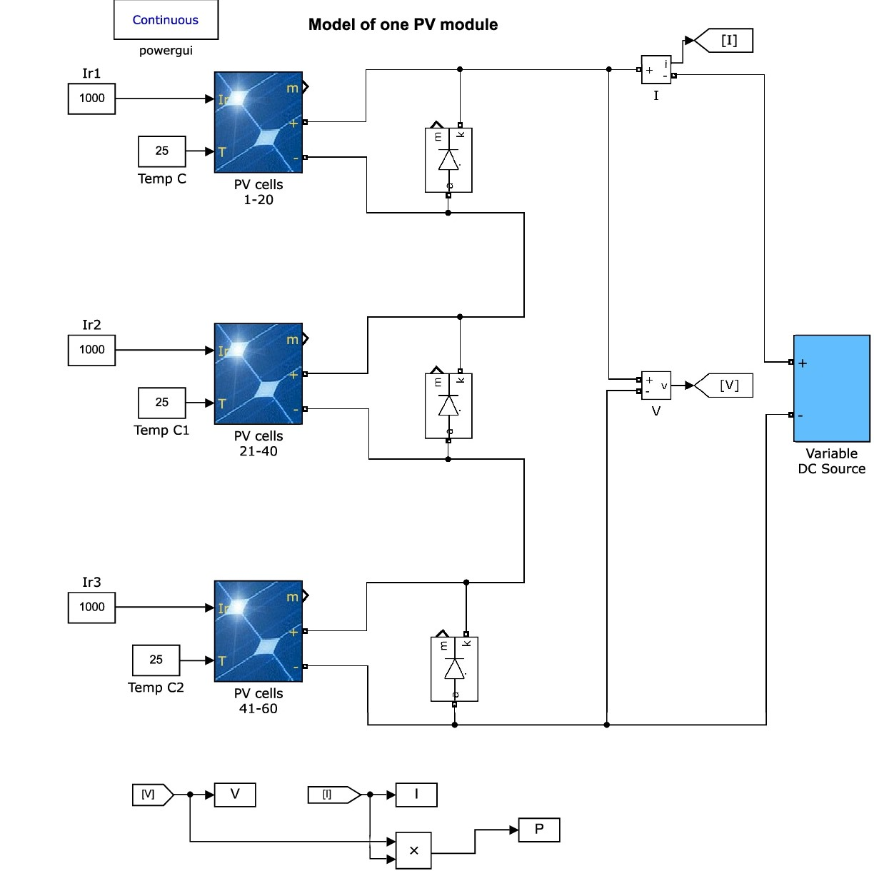
Matlab model for unshaded /shaded for one PV module

Slide 14
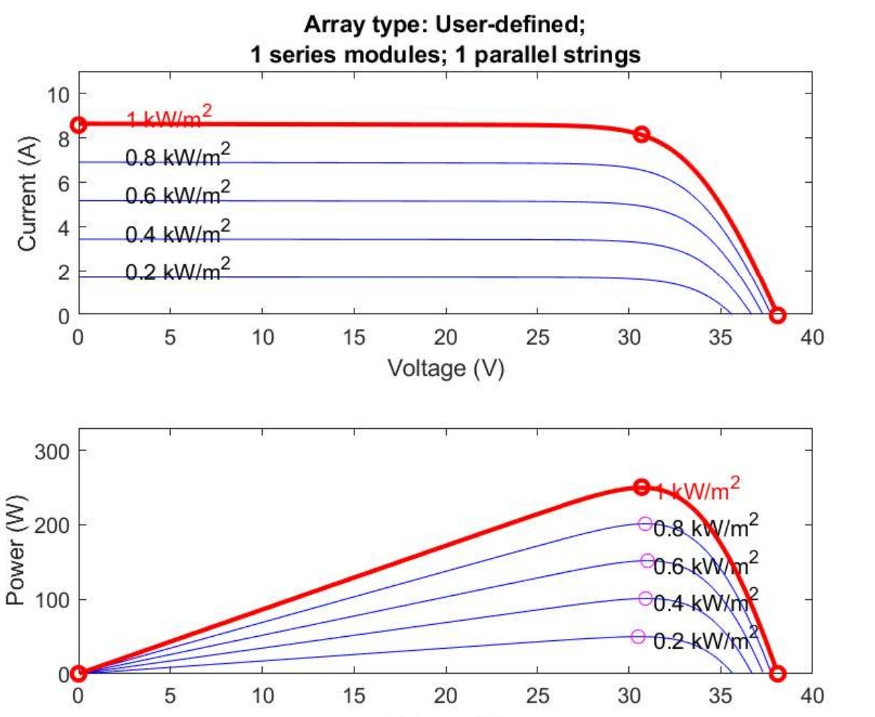
Observation I : I-V and P-V characteristics of PV cell under variable irradiance and constant temperature conditions

Slide 15
Table2 Simulated Results
Irradiance (kw/m2) at 25C temp | Voltage(Vm) | Power(Pm)
1 | 30.7v | 250.5w
0.8 | 30.9 | 201.4w
0.6 | 31.02 | 151.8w
0.4 | 30.91 | 101.1w
0.2 | 30.51 | 49.8w

Slide 16
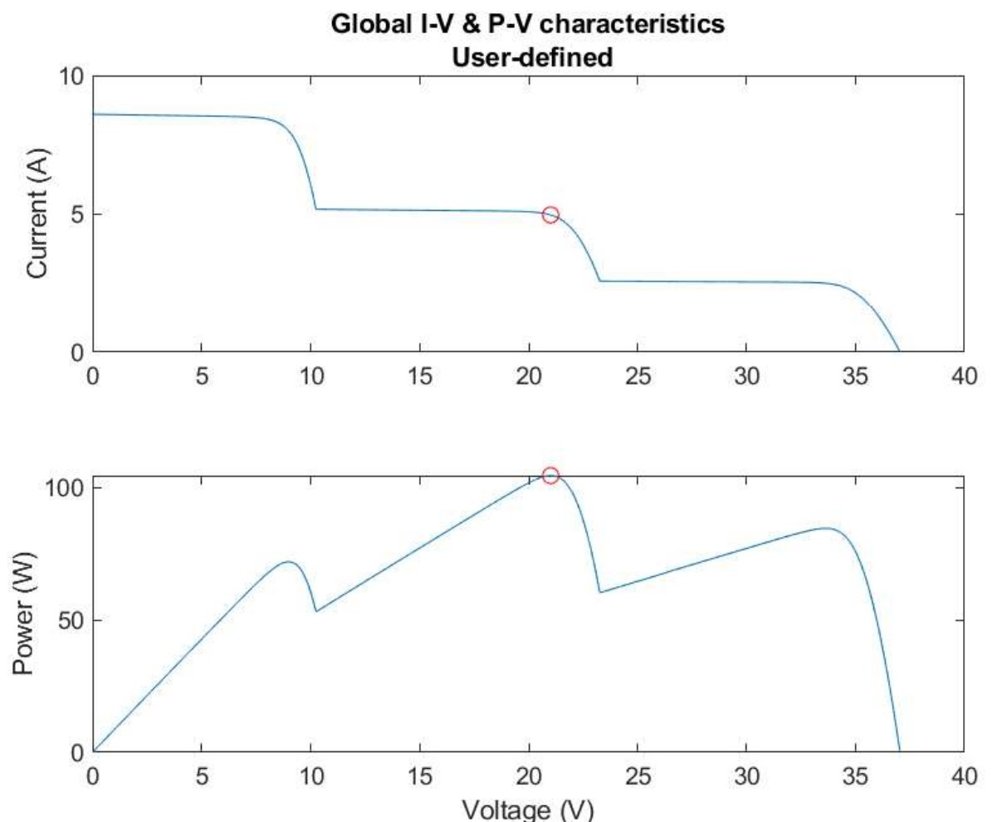
  Observation II :Global I-V and P-V characteristics of PVcell under partially shaded condition.

Slide 17
The module is having three strings each having 20cells each and given standard irradiance of 1000w/m2 to first one and partial shading applied for 300w/m2 & 600w/m2.
The Global maximum (Pm=104w) which is 34%less than the expected(250/3*(1+0.3+0.6)=158w).Bypass diode protect the modules when cells are shaded or damaged.
So many multiple peaks are there but one with red circle is GMPP which is important and the MPPT should locate this point accurately

Slide 18
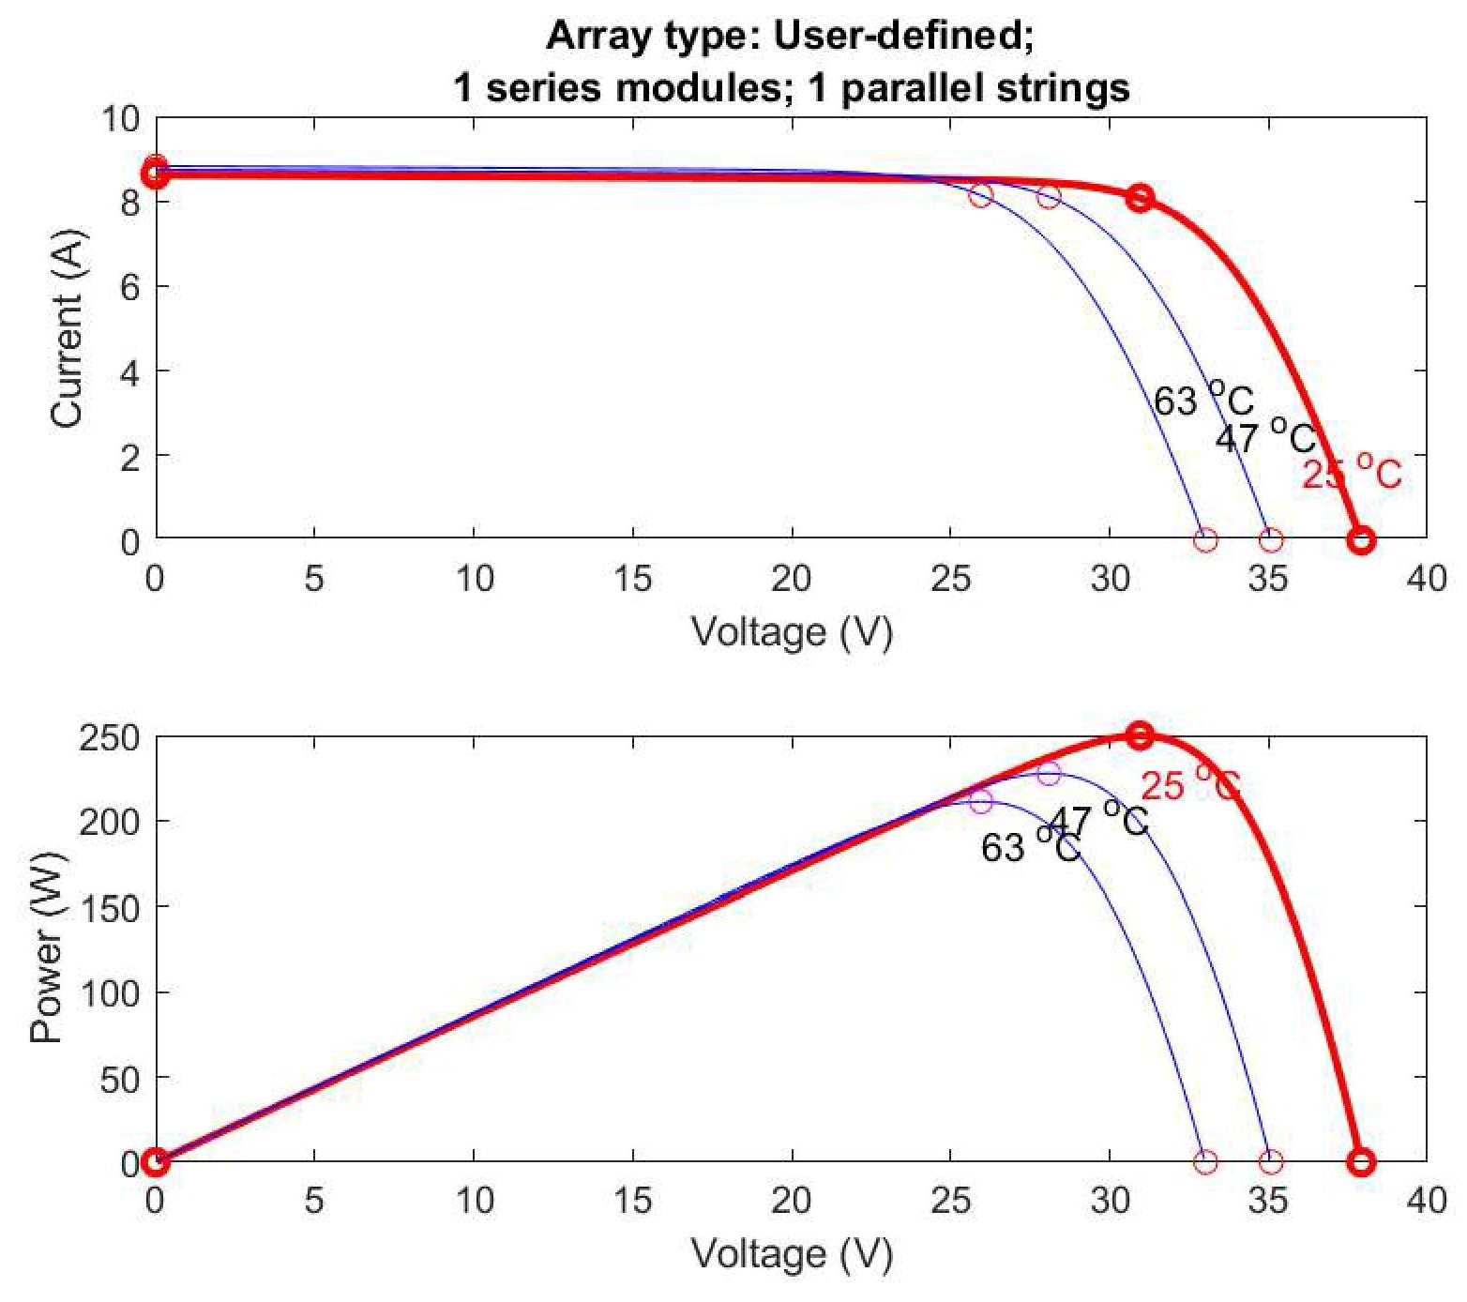
Observation III :PV characteristics under different temperatures

Slide 19
Table-3 simulated results
An approximate expression for calculating the cell temperature is given by
Tcell=Tair+(NOCT-20)S/80 , s-irradiance
Temperature(º c) | At 1000 irradiance | 800 irradiance
25º c | 250w | -
47º c | 227w | 180w
63º c | 211.1w | 170w

Slide 20
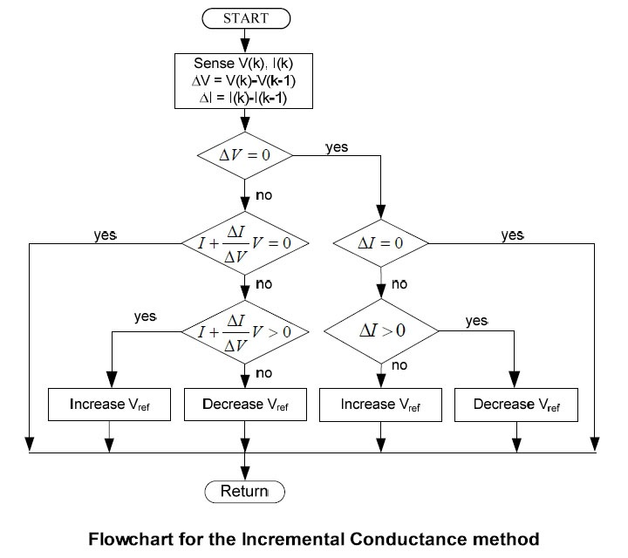
Algorithym for Incremental & conductance
Ref:IEEE-Intelligent techniques for MPPT control in PV systems

Slide 21
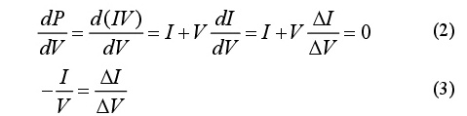
The equations are
The principle of this method is to
judge whether the system work at MPP or work at the left
or the right.

Slide 22
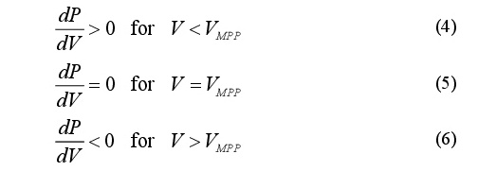
Therefore, by analyzing the derivative, one can testwhether the PV generator is operating at its MPP or farfrom it using equations (4) - (6).
conductance (Δ I/ΔV). Vref is the reference voltage at
which the PV array is forced to operate. Once the MPP is
reached, the operation of the PV array is maintained at this
point unless a change in ΔI is noted, indicating a change
in atmospheric conditions and the MPP

Slide 23
Table-4 Ratings of KLEF Solar Power system (69kw)
Specifications | System 1 | System2 | System3
PVmodules (nos) | 108 | 60 | 108
Power from PV aray(KW) | 27kw | 15kw | 27kw
Technique used by mppt | Perturb& observe | Perturb& observe | Perturb& observe
Dc link voltage | 760v | 760v | 760v
Inverter (KVA) | 30KVA | 15KVA | 30KVA
Inverter type | 3 level IGBT bridger | 3 level IGBT bridge | 3 level IGBT bridge
Inverter control | SRF | SRF | SRF

Slide 24
System-1-27kw 18Mx6S=108
System2-17kw 17Mx4S=68
System3-25kw 20X5=100
Total:69kw Total:276 nos
Data sheet:
Vmpp=30.7
Impp=8.16
Pm=VmppxImpp=250W

Slide 25
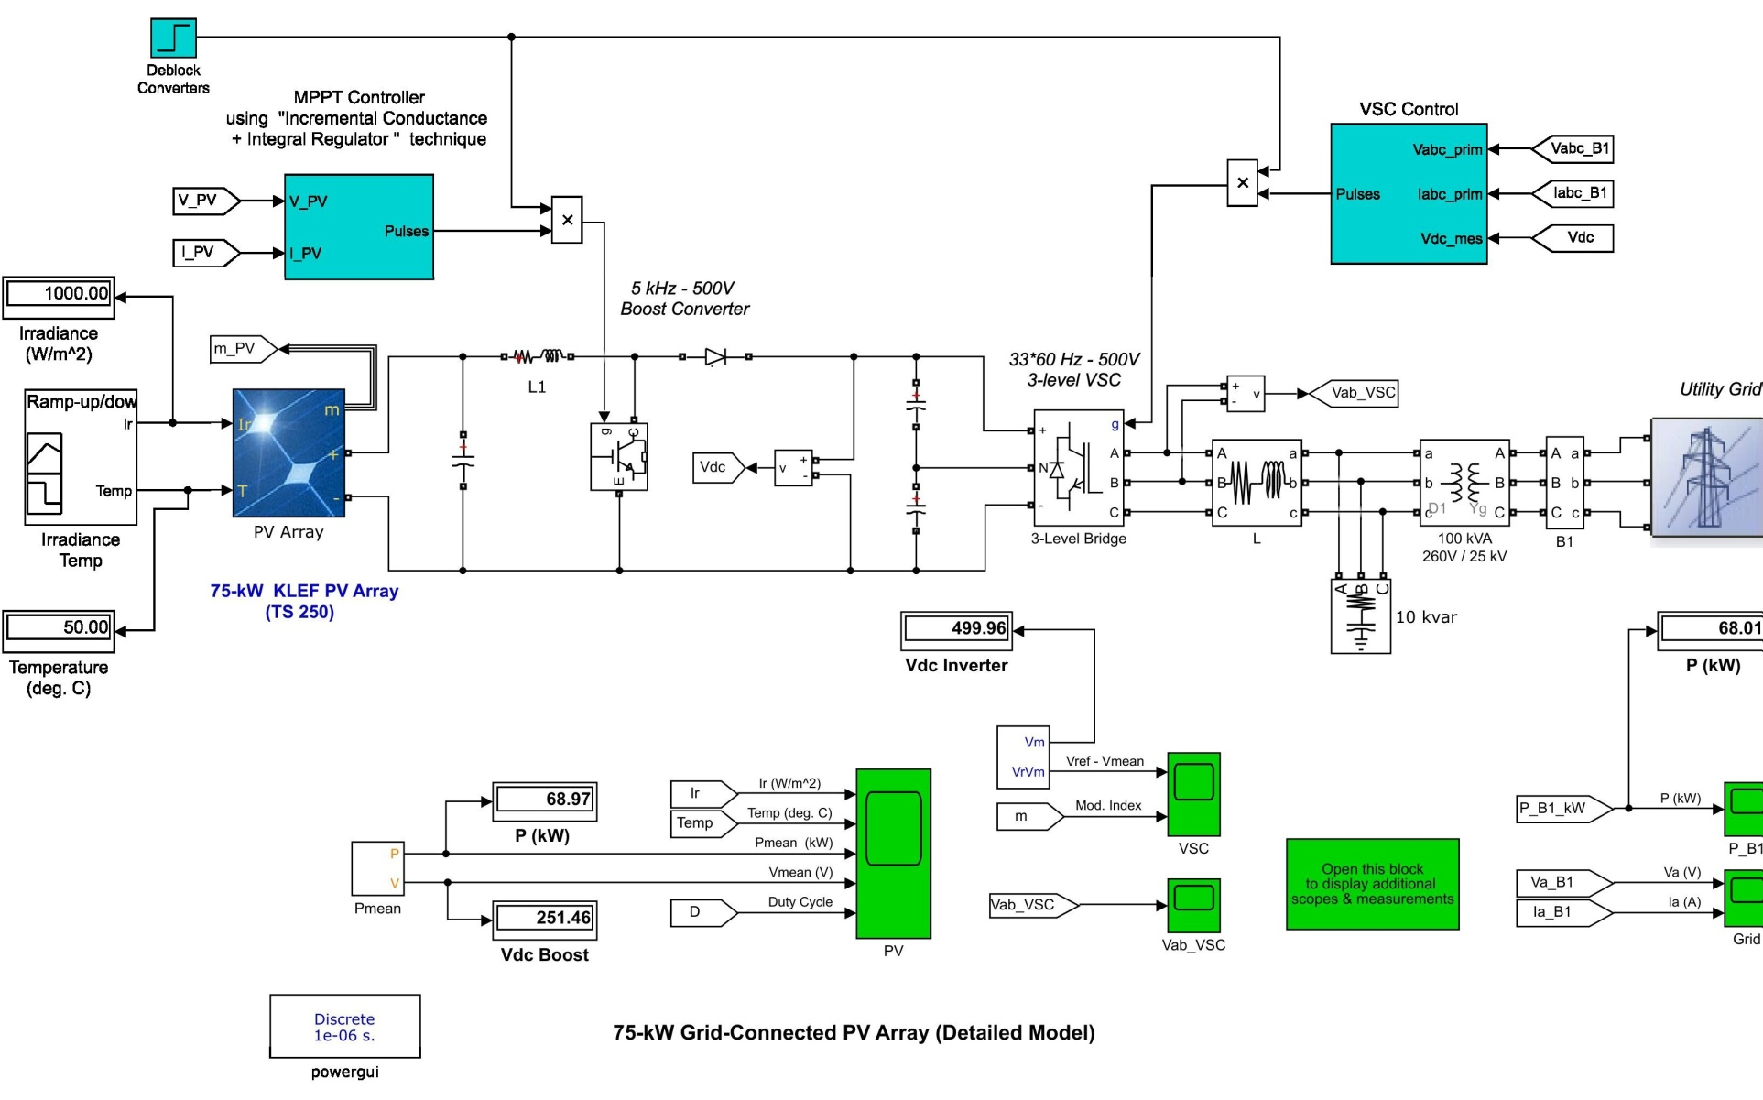
  Observation IV: Power -Time characteristics of MPPT Model as a function of variable irradiance and variable temperature.( Inc-con algorithym + integral regulator).

Slide 26
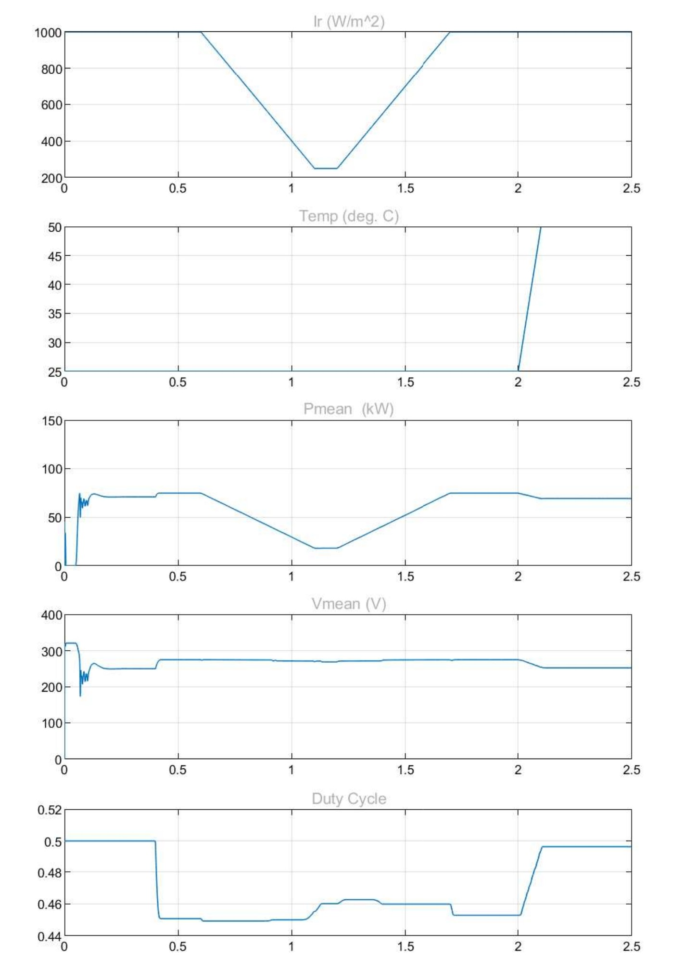

Slide 27
Table-5 Simulated Results
This MPPT model gives information of the temperature impact Actually array(TS250) has to generate 69kw as intended ,but at 50c ,it is generating only 62kw because of temperature rise.
Module Temperature(C) | At 1000 irradiance(KW) | At 800 irradiance(KW)
25c | 69kw
47c | 62.84kw | 50.72kw
50c | 61.99kw
63c | 58.32kw | 46.65kw

Slide 28
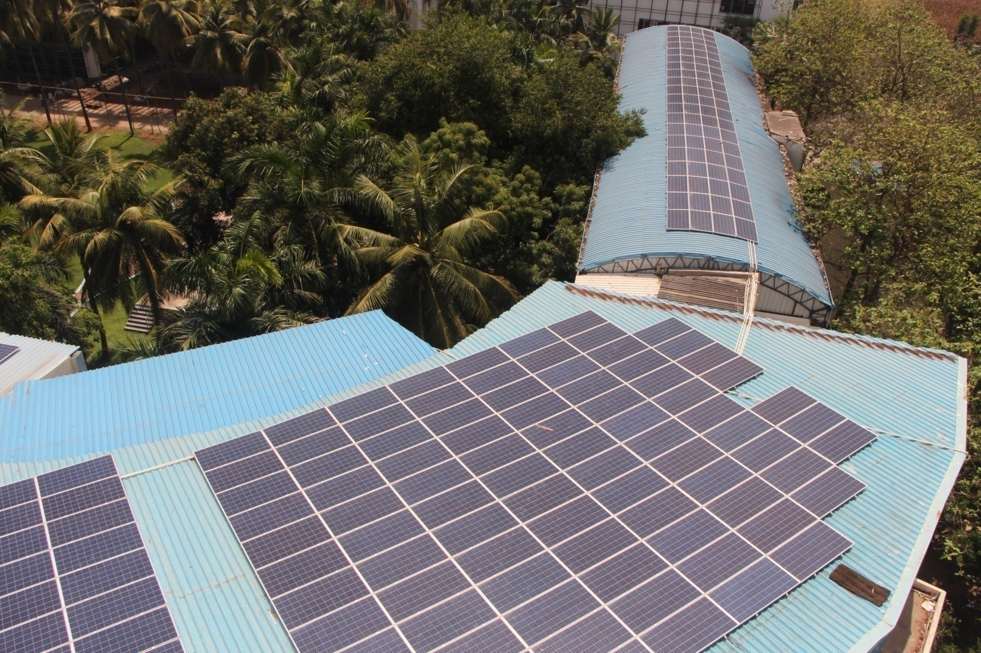
KLEF PV solar power system

Slide 29
Discussion on results
Three systems are there in KLEF so designed to have a installed capacity of 69 kw but as the modules are derated from there nominal capacity from 250 w to 211w
so the overall capacity to 58.32 kw so the proposed system is that it should have one more system of 12 kw to be installed along with the old to meet the requirement and enhance
the use of solar and reduce the grid usage .such that the paying electric bills charge will come down and further returns on solar investment will be good
The system output is having a reduction of 15% because of temperature effect But due to cableloss,connectors,invertorloss,light induced degradation,soiling of the array etc.
The derating factor is taken as 10%
So the overall derating factor is 0.75 (10%+15%) system loss to be applied to installed capacity to get available capacity

Slide 30
Techno-Economic Analysis
Cost of 1 unit of energy is =Rs 6.41/ KWH
The installed capacity is 69 kw at STC conditions so it should generate annually (nominal value)
=69kw*5*365=1,25,925kwh-----(1)
Peak sun irradiance taken-5kw/m2
In real world conditions it will generate
=Stc value *overall derating factor=94,443 kwh
Practical measured energy from (solar-log 2000GPRS) annually- 90,000 kwh ----- (2)
Difference from (1) and (2) is 35,925 kwh .
Overall lost capacity=35925/(5*365*0.75)=26kw

Slide 31
So while designing taken only the nominal peak capacity ,so 26kw solar power still needed to add to peak value
The units taken from grid for internal power usage instead of that if 26 kw solar power as system-4 is added to overall system then .
Saving in Electricity billing charges :=35,925*6.41 =2,30,280Rs
Taken a particular block for reference if other blocks are also taken into picture and huge savings will be obtained .This method may increase the installation cost but long term returns are more beneficial to us and overall quality is improved .

Slide 32
Ratings of KLEF Solar Power system(proposed)
Specifications | System 1 | System2 | System3 | System4 (proposed)
PVmodules | 108 | 60 | 108 | 49
Power from PV aray(KW) | 27kw | 15kw | 27kw | 26kw
Technique used by mppt | Perturb& observe | Perturb& observe | Perturb& observe | Perturb& Observe/I&C
Dc link voltage | 760 | 760 | 760 | 760
Inverter (KVA) | 30 | 15 | 30 | 30
Inverter type | 3 level IGBT bridger | 3 level IGBT bridge | 3 level IGBT bridge | 3 level IGBT bridge
Inverter control | SRF | SRF | SRF | SRF

Slide 33
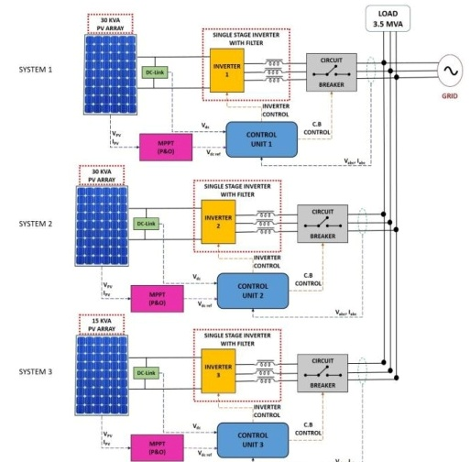
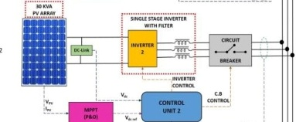
Block diagram of the overall system proposed existing three systems + 1 new system)

Slide 34
Installation Cost of Proposed
26kWp Solar power system
S no | Item description | Qty | Price
1 | SOLAR PV MODULE, 250Wp | 104 | 1040000
2 | GRID TIE INVERTER FOR 30kWp ARRAY, MPPT RANGE 480VDC TO 800VDC, THREE PHASE OUTPUT | 1 | 140000
3 | 10 MODULE MOUNTING STRUCTURE FOR 250Wp MODULES WITH 15Deg FIXED TILT | 10 | 50000
4 | ARRAY JUNCTION BOX 6 I/P & 6 O/P WITH 2 NO.S OF SPD TYPE II PF WITH FRP BOX | 1 | 10000
5 | AC DISTRIBUTION BOARD WITH 4P, 1X63A MCB AND MULTI DATA METER-(OUTDOOR TYPE) WITH ARM Al CABLE OUT PUT | 1 | 10000
6 | OTHER MISCELLENOUS ITEMS | AS PER required | 50000

Slide 35
Total project cost =13 lakhs Rs
30% subsidy by indian government =13*0.7=9.91 lakhs
ROI /Payback period:9.91/2.3=4.3 years
2.3 lakhs is the revenue generated by the system.So the solar system will take 4-5 years as a basic return on investment (ROI)
Calculate depreciation cost:
What is Depreciation?
Depreciation is a method of allocating some cost of a tangible long term asset over its useful life and thus, refers to the decrease in value of the asset during its lifetime. All fixed assets except the value of land decreases with the passage of time.
For Solar Power projects we generally calculate depreciation using straight line method. Formula for the same is,
“Depreciation = (Cost - Residual value) / Useful life”

Slide 36
Overall project cost : INR 13 Lakhs for solar plant
Book depreciation : 5.28 % (As per Companies Act)
Residual Value : 10 %
Calculation of book depreciation as per Straight Line Method=5.28*13=68 .64
Every year 68.64 =68,640 rs is depreciated .Shown the table for five years only because the ROI is usually for 4-5 years
At the life period the cost of the system cost is nil.
Life period of solar array:25 years (as per mfg).
Years | 1 | 2 | 3 | 4 | 5
Book depreciation | 68.64 | 68.64 | 68.64 | 68.64 | 68.64

Slide 37
Conclusion
India or other countries in the world wants solar installations in all the states so in coming years there is a clear target it wants all the power from solar panels which is achievable more over it also adds to the environmental benefit ie reduction of green house gases .
variation in ambient temperature will derate and reduce the life of the solar array .while selecting the solar panels for applications normally some margin of wattage is selected
This will benefit designers and maintenance personnel.

Slide 38
Publication status
Paper publication : Yes
Name of the journal : IJITEE (International Journal of Innovative Technology and Exploring Engineering)
Issue : March-10 -2019
Scopus database added : yes
Scopus Author ID : 57207821576
ORCID ID : 0000-0002-5258-0276

Slide 39
References
[1] N.Kumar,I.Hussain,B.Singh B singh.B. k Panigrahi.,”MPPT in Dyanmic Condition of partially shaded PV systems by using WODE Technique,”In IEEE Transacions on sustainable Energy,vol.8,no,3,pp.1204-1214,july 2017
[2] M.E.E.Telbany ,A.Youssef and A.A.Zekry.”Intelligent Techniques for MPPT control in photovoltaic systems:A comprehensive review.”in Proc. Of 4th International conference on Artificial Intelliegence with Applications in Engineering and technology.kota kinabalu,2014,pp,17-22
[3] B.Pakkiraiah ,G.durga sukumar”A New Modified Controller for solar photovoltaic system” 2015 IEEE International conference On research in computational intelligence and communications Networks 20nov,2015

Slide 40
[4] B.Bhargavi ,P.Linga Reddy ,”Improvement of solar Energy system under partial shading conditions in Koneru Lakshmaiah Education Foundation”,International Journal of Engineering & Technology 7(1.8)(2018)197-200
[5] Fakherdine keyrouz “Enhanced Bayesian based MPPT controller for PV systems”IEEE power and energy technology systems journal year 2018.
[6] J.ajaykumar,T sai sourav,K.P Prasada Rao,”observation ofP-V and I-V characteristics before and after partial shadow Effect on photovoltaic array using Boost converter.”international journal of engineering and technology,2018
[7] B.Subudhi and R.pradhan,”A comparative study on maximum power point tracking techniques for photovoltaic powersystems “,in IEEE transactions on sustainable energy vol.4 no1 ,pp.89-98 jan2013

Slide 41
[08] Bashar Mohammed Salih,Rasha A .Mohameed,Mohammed Ahmed Ibrahim,”The Environment coeffcients effect on I-Vand P-VCharacteristicscurves of photovoltaic cell using Matlab/Simulink"International journal of engineering and technology, 7 (4) (2018) 2651-265

Slide 42
Thank Q

