Slide 1
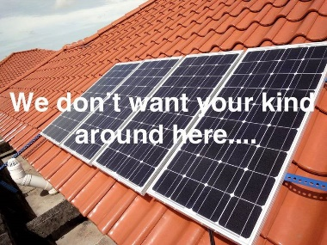
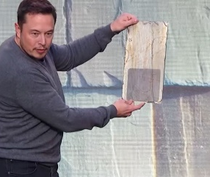
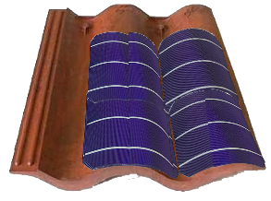
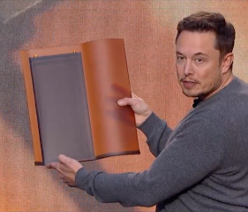
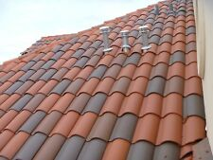
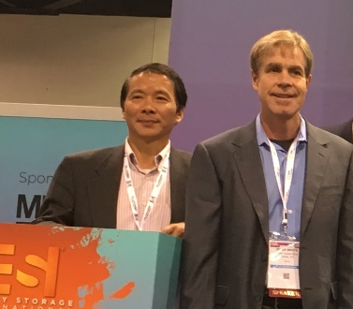
Solar Roof Tile with flexible mono cells
Problem
  Traditional solar panels are visually intrusive on residential roof top.
  Tesla solar roof tiles are:
    low cell/tile coverage ratio, high cost.
    installers still asking: where to get them? (difficult to make and rarely available)
Solution
  Ultra-thin & flexible mono cells on solar roof tile; use half-cells
    increase cell/tile coverage ratio by 68%, increase watt per tile output by 73%
    reduce solar roof tile cost by 42%
    achieve $15/sq-ft target
  Mix solar tiles & regular tiles, better aesthetic.
Team
  Kevin Gao – Entrepreneur in solar, mechanical engineer, inventor of multiple US patents.
  Sean White – IREC Certified Solar PV Master Trainer. Book Author of Solar Photovoltaic Basics, and Solar Engineering and Installation.
Plan
  Prototype with manufacturers, testing with national labs. Demo in 2020
Intrusive on roof top
Unveiled in 2016. Where to get them??
Our solar tile vs Tesla solar tile
16.8 watt per tile 10 watt per tile
VS
10 watt per tile
Better aesthetic roof
Kevin & Sean @ SPI2018
Notes:
Built functional prototype
Two deals with home builders
Two deals with service providers

