Slide 1
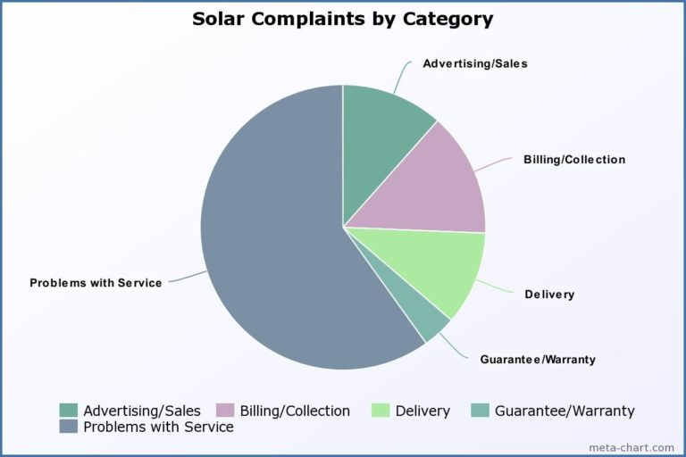
Your solar experts: Sales training and certification for the solar industry
The biggest obstacle to solar in the U.S. is unethical and deceptive sales.
YSE will: - Create a solar ethics and
knowledge test for solar sales staff
with results publicly available.
Provide online & live sales training
to solar reps & company sales teams.
Develop a standard of solar ethics which is common knowledge and known to the average solar customer.
Results will include an exponential increase in satisfied customers and referrals through the YSE follow-up program, where Each customer will Provide feedback for future customers.
yearsYoursolarexperts.com

