Slide 1
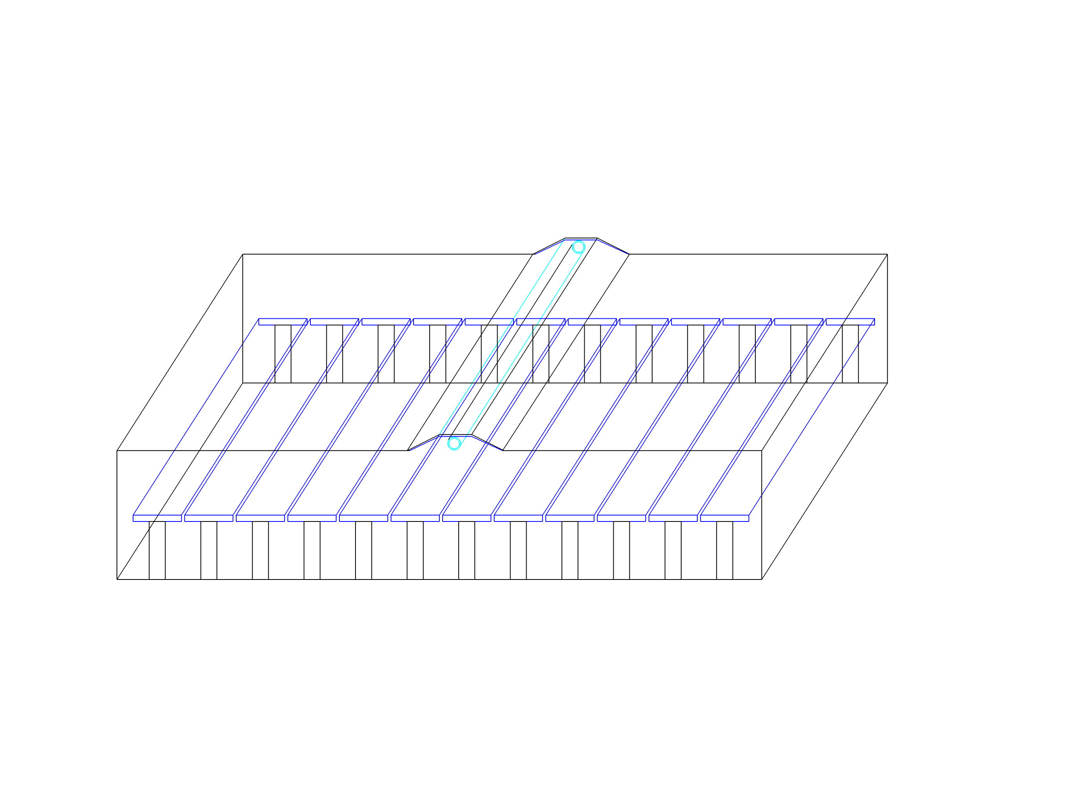
Linear Fresnel CSP Collector
Build in a factory and shipped to the installation site
Easy to install
Low maintenance cost
Easy Replacement
Higher Efficiency
Low Cost
Multiple applications
Long lifespan
American-made

