Slide 1

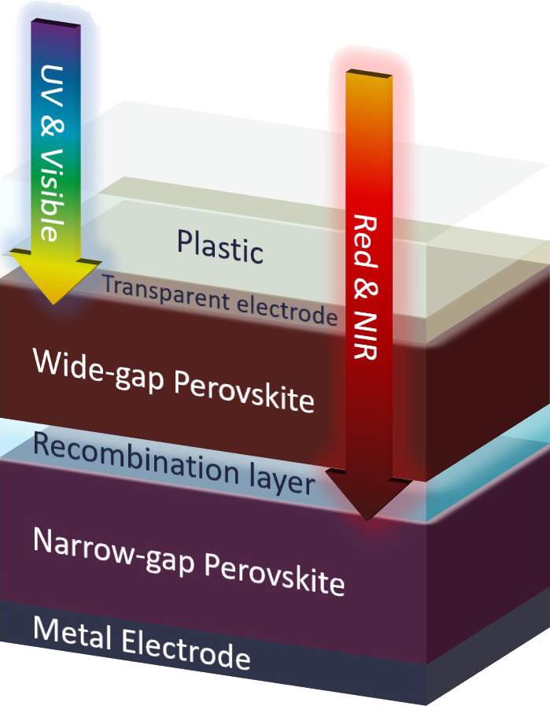
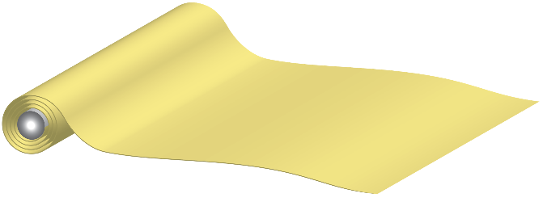
Lightweight, efficient solar panels
Swift Solar team members invented perovskite tandem technology together with Stanford, MIT, and NREL
Beyond the Competition
Cross-section of an
all-perovskite tandem cell
PERFORMANCE
advantage
High efficiency: > 30% line-of-sight cell (≅ GaAs)
High weight-specific power: > 500 W/kg (>10× c-Si)
COST
advantage
Low projected module costs: < 0.20 $/W
System savings for low projected LCOE: 30% below c-Si

